Slide 1
CHAPTER 4
Supply and Demand
Eleventh Edition

Slide 2
Chapter Goals
the law of demand / shifts in demand / movements along a demand curve.
the law of supply / shifts in supply / movements along a supply curve.
how the law of demand and the law of supply interact to bring about equilibrium.
the limitations of demand and supply analysis.
Notes:
This slide set includes most of the material in Chapter 4.

Slide 3
Demand
Demand refers to willingness and ability of someone to purchase a good and service.
Before you move on the next slide:
Elaborate: What might determine your demand for (willingness and ability to purchase) e-books?

Slide 4
Determinants of Demand
What might determine your willingness and ability your demand for—say—e-books?
Price (of e-books)
Income
Wealth
Tastes / preferences (how much you like e-books)
Price of substitutes (print books)
Price of complements (e-book reader)
Expected prices - Expected income
Notes:
Now think about how (in which direction) these factors above affect you demand.
i.e. Would you buy more or less e-books if you have more income?
Would you buy more or less e-books if the price of print books go up?
Important:
The difference between income (flow variable) and wealth (stock variable)
The definition of a substitute good and a complementary good

Slide 5
Demand
The law of demand states that the quantity of a good demanded is inversely related to the good’s price.
In other words, other things equal:
    Quantity demanded rises as price falls.
    Quantity demanded falls as price rises.
    Why?
    (What explains the law of demand)
Notes:
Why?
1) Substitution effect: when price of a good rises, people substitute away from that good to other goods.
2) Income effect: when price of a good rises, our real income (purchasing power) goes down. So we would purchase less.
3) The law of diminishing marginal utility: When a person consumes a good, the satisfaction or utility that they derive from the product decreases as they consume more and more of that product. For example, an individual might buy a certain type of chocolate for a while. Soon, they may buy less and choose another type of chocolate or buy cookies instead because the satisfaction they were initially getting from the chocolate is diminishing. The first piece of chocolate would taste better and the person would be willing to pay a higher price for it. (Note: Demand is about consumers! What do consumers want? Why do they purchase things? In economics, we assume that they want to be satisfied—maximize their utility!)
Must-watch video 1: https://www.youtube.com/watch?v=LwLh6ax0zTE
Note: The first 3 minutes is about the slope of the demand curve, the rest is about the shifts of the demand. It might be a better idea to watch this video after you finish reading the first 12 slides or watch in pieces. It is a short but very clear video. But he talks fast, so turn on the caption and/or reduce the playback speed if needed.

Slide 6
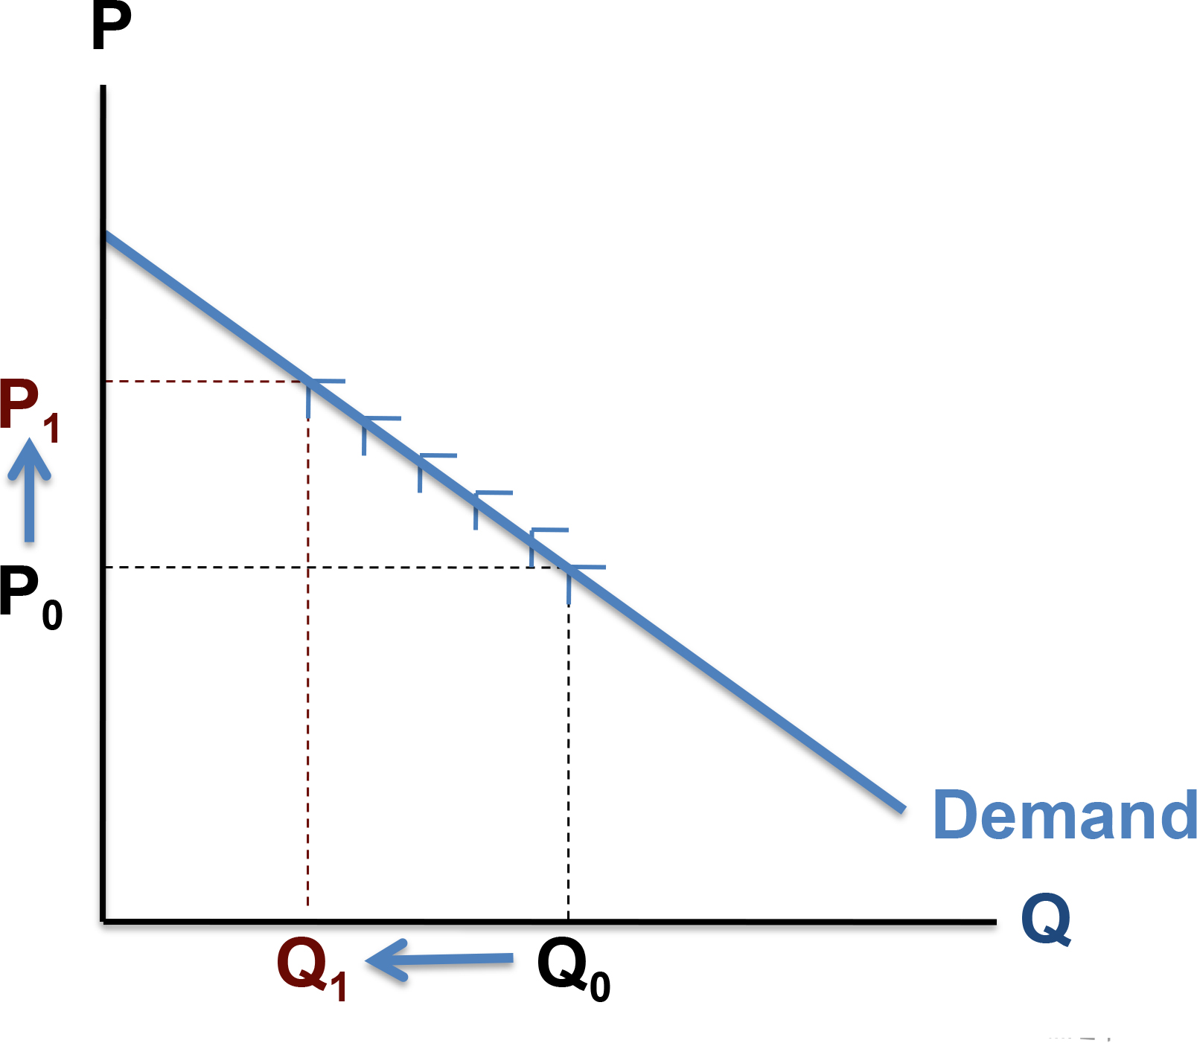
The Demand Curve
A demand curve is the graphic representation of the relationship between price and quantity demanded.
Price and quantity demanded are inversely related
The demand curve is downward sloping
As price increases, quantity demanded decreases
Access the text alternative for slide images.

Slide 7
Movements Along a Demand Curve
Quantity demanded refers to a specific amount that will be demanded per unit of time at a specific price, other things constant (ceteris paribus).
It refers to a specific point on the demand curve!
A change in price causes a change in quantity demanded. This is called a movement along the demand curve.

Slide 8
Shifts in Demand versus Movements Along a
Demand Curve
Demand refers to a schedule of quantities of a good that will be bought per unit of time at various prices, other things constant. Demand refers to the entire demand curve.
A change in anything other than price that affects the demand curve is called a shift in demand.
Notes:
Go back to the 1st must-watch video and watch the rest!

Slide 9
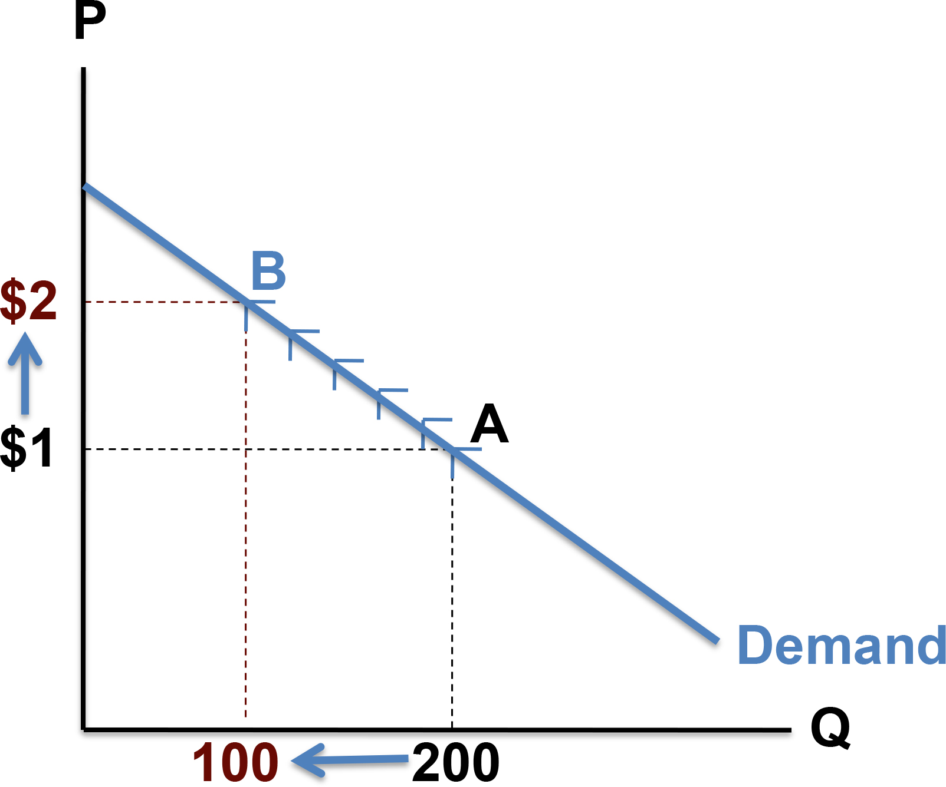
Movement Along a Demand Curve
A change in price causes a movement along the demand curve.
Access the text alternative for slide images.

Slide 10
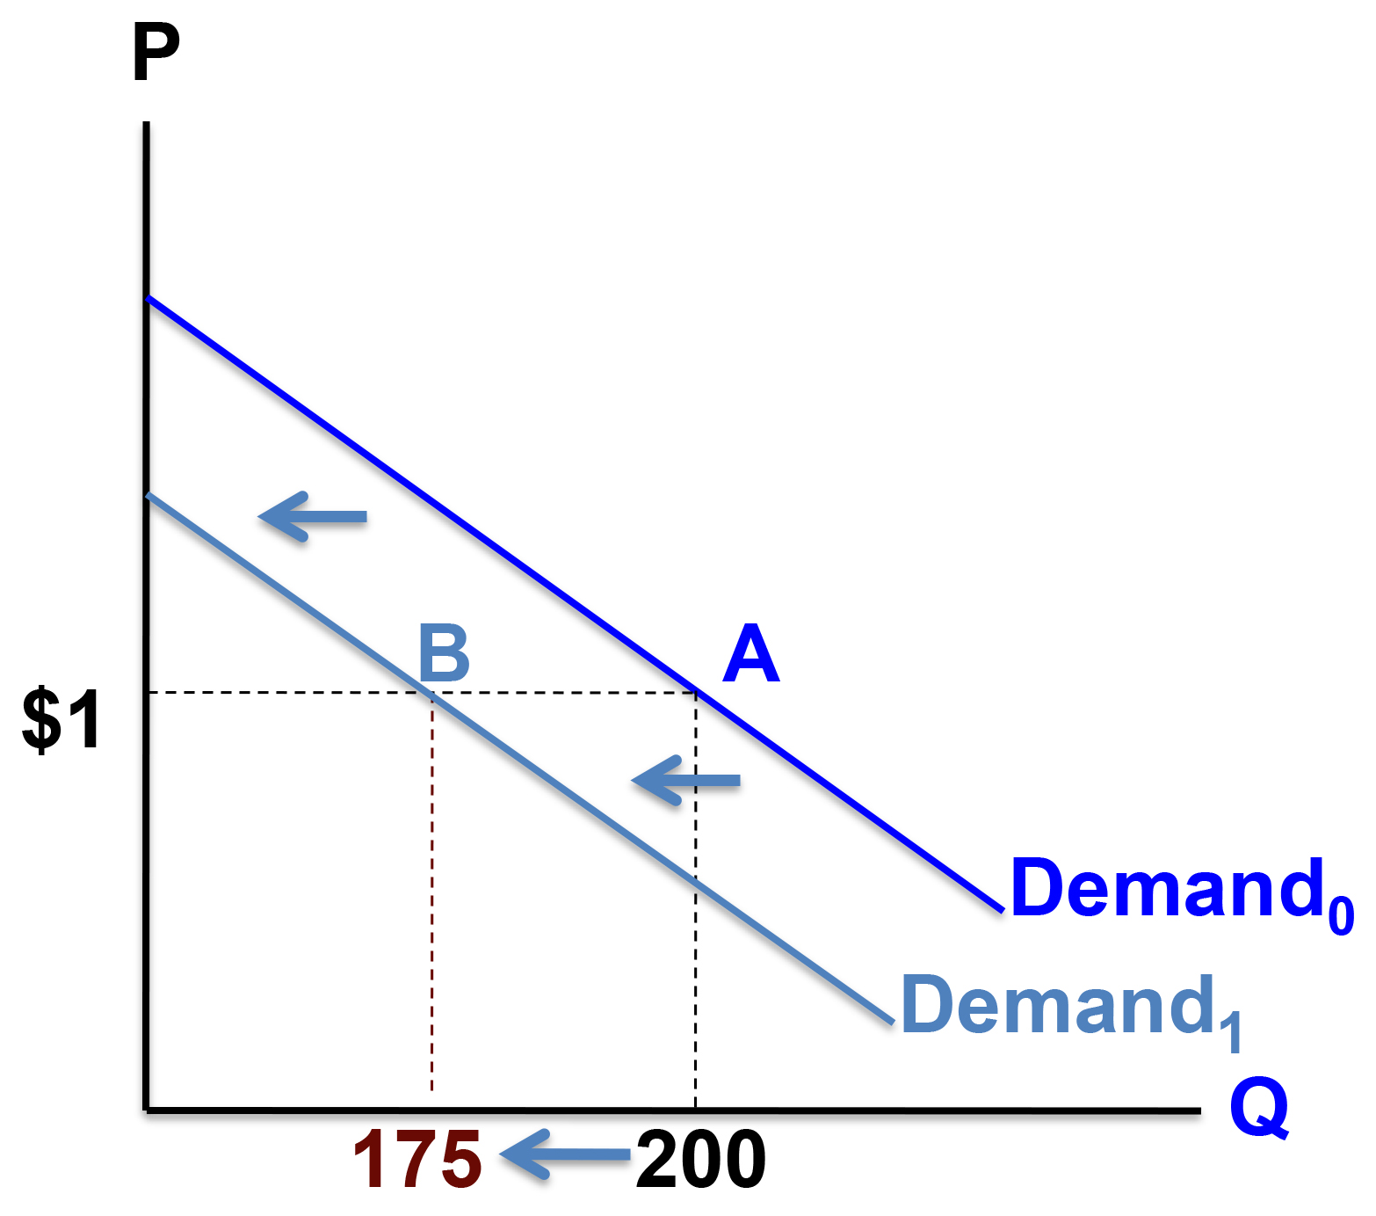
Shift in Demand
A change in a shift factor causes a shift in demand.
Access the text alternative for slide images.

Slide 11
Factors in Demand Shift
Important shift factors of demand include:
Income.
Wealth
The prices of related goods. (substitutes / complements)
Tastes / Preferences.
Expectations. (Price expectations / Income expectations)

Slide 12
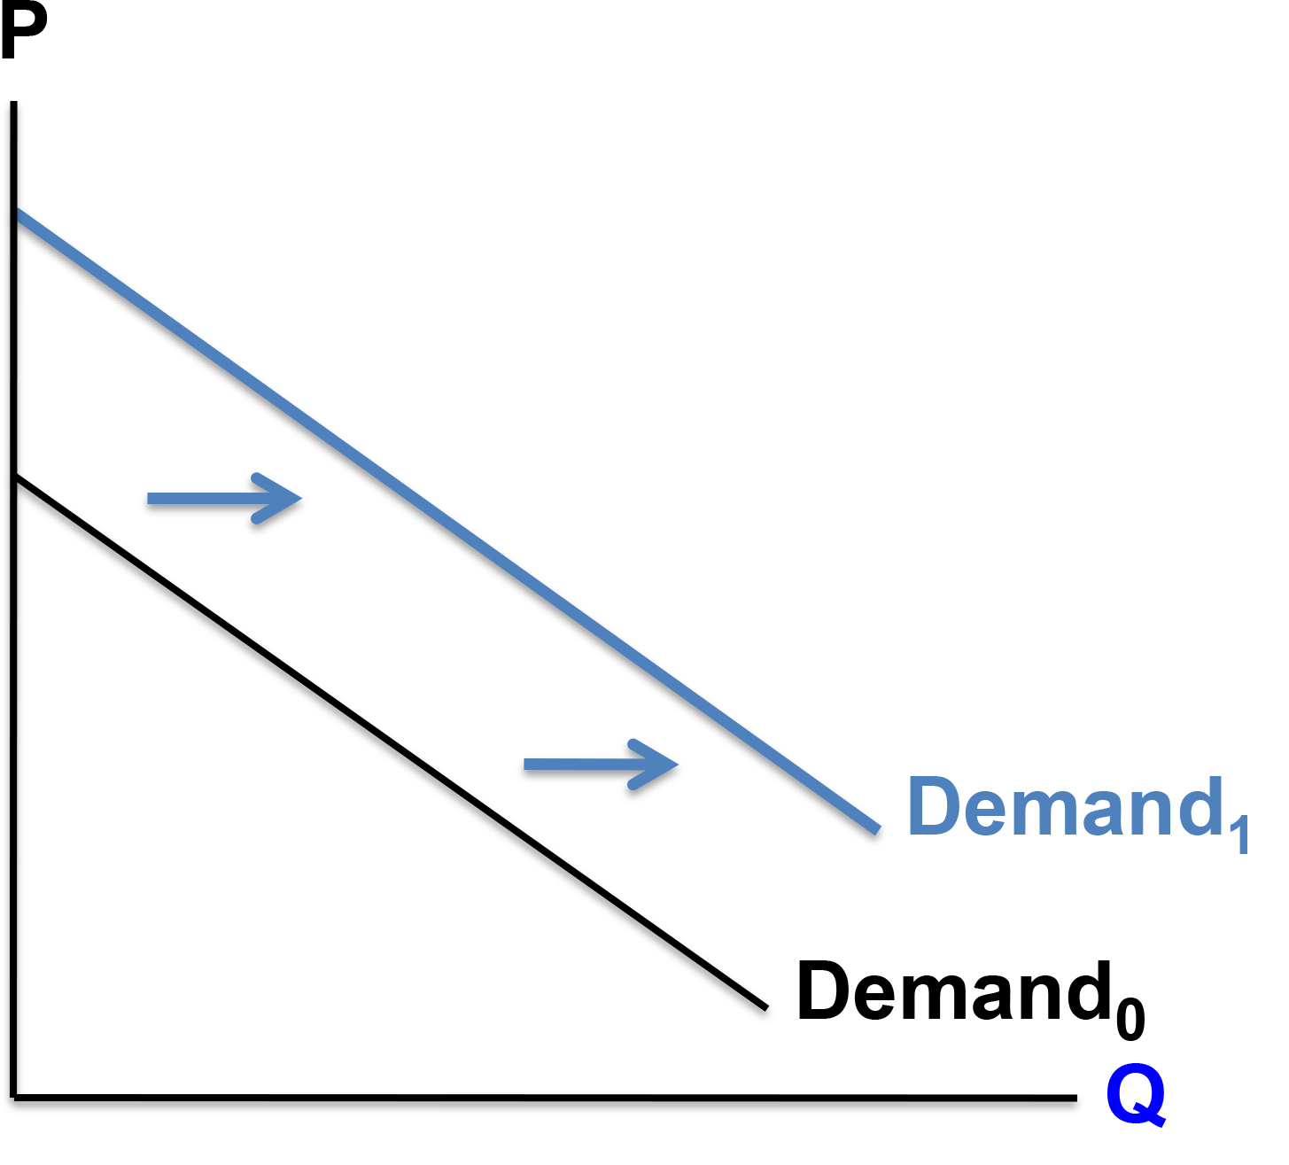
Application: Demand Shift
What happens to demand for gourmet chocolate if you won $1 million in the lottery?
Demand would shift out to the right because your wealth increased.
Access the text alternative for slide images.
Notes:
What happens to your demand for public transportation if you won $1 million in the lottery?
What happens to your demand for red meat if price of chicken increases?
What happens to your demand for wine if price of beer goes down?
What happens to your demand for French fries if price of beer goes down?
What happens to the demand for coffee if there are more news about coffee’s beneficial effects on health?

Slide 13
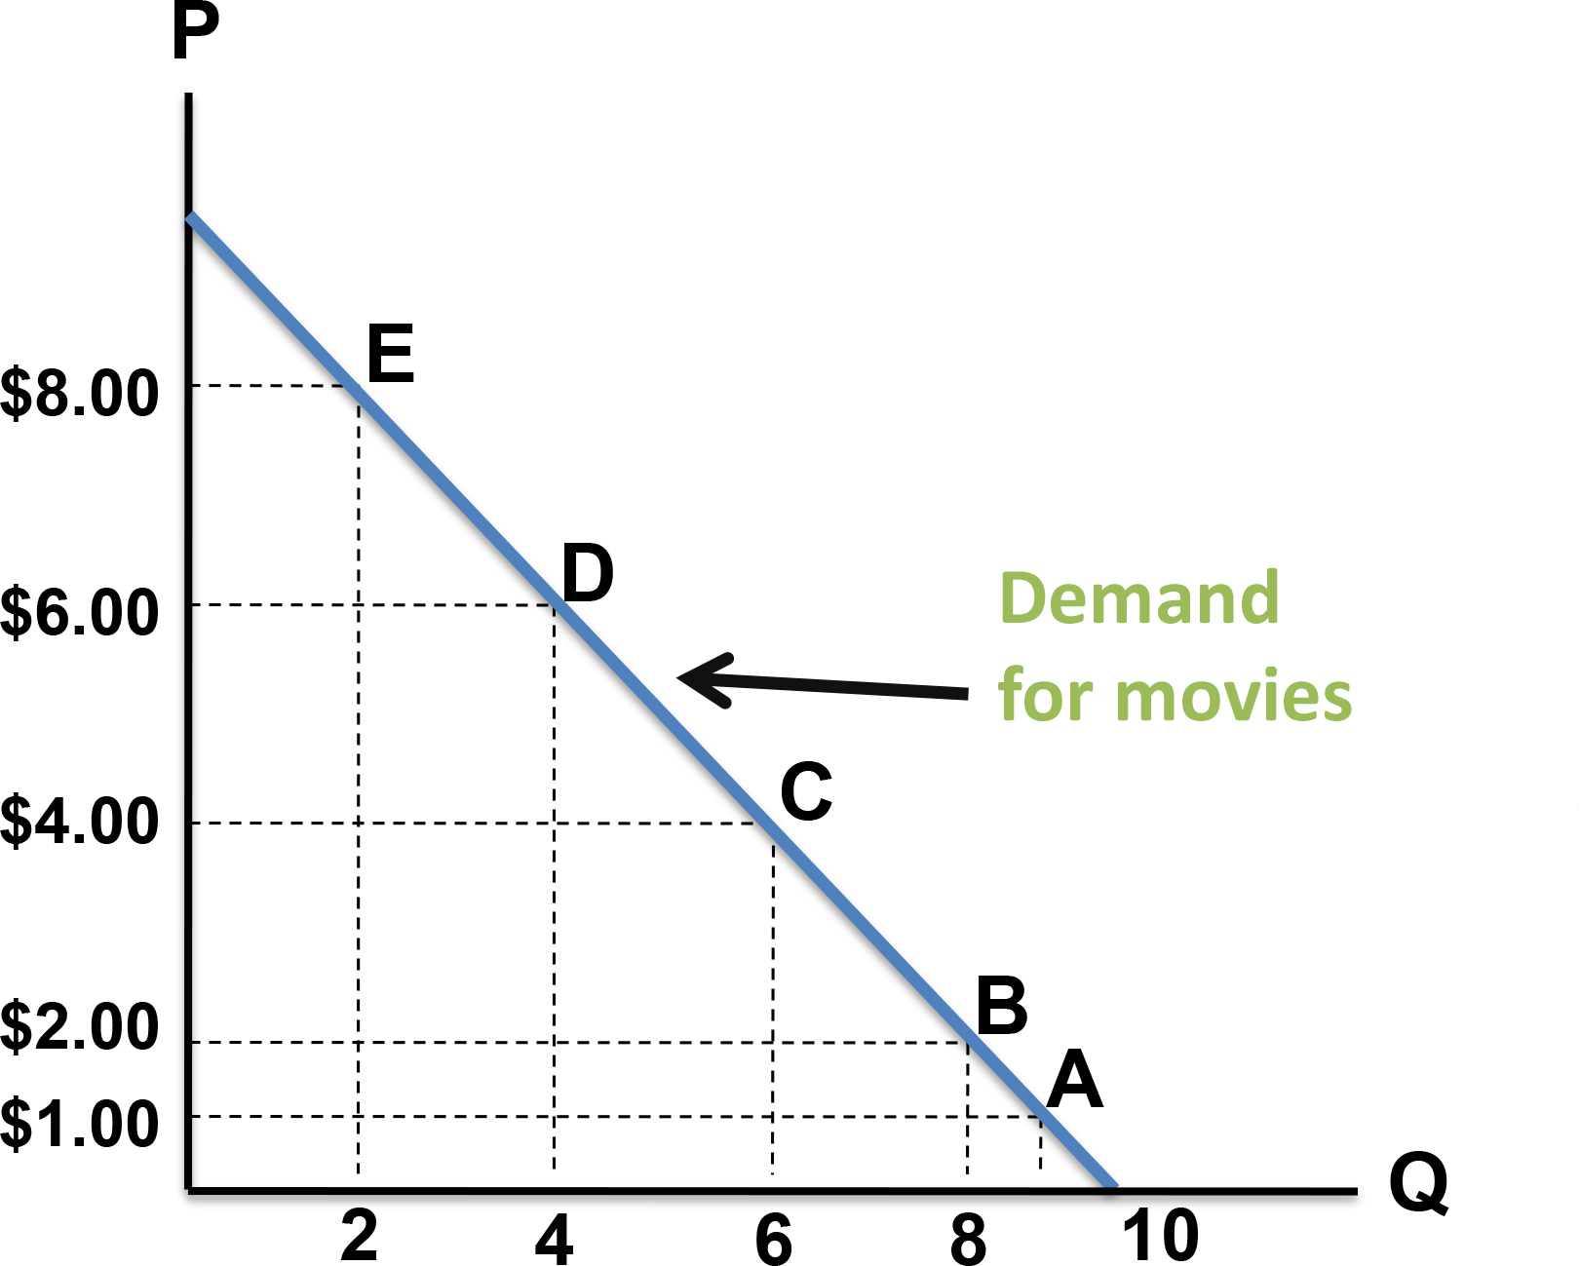
From a Demand Table to a Demand Curve
 | Price per movie | Movie rentals demanded per week
A | $1.00 | 9
B | $2.00 | 8
C | $4.00 | 6
D | $6.00 | 4
E | $8.00 | 2
Access the text alternative for slide images.
Notes:
This demand curve shows how many movies per week Alice rents at each movie rental price. It is an “individual demand” curve.

Slide 14
Market Demand: Price per Movie
Price (per movie) | Alice’s demand | + Bruce’s demand | + Carmen’s demand | = Market demand
$2.00 | 8 | 5 | 1 | 14
$4.00 | 6 | 3 | 0 | 9
$6.00 | 4 | 1 | 0 | 5
$8.00 | 2 | 0 | 0 | 2
Notes:
Let’s say there are only 3 people in our town who watch rental movies. So here we see each of their individual demand for movie rentals. How would we find the market demand for rentals? Remember market demand here means the whole town’s demand.

Slide 15
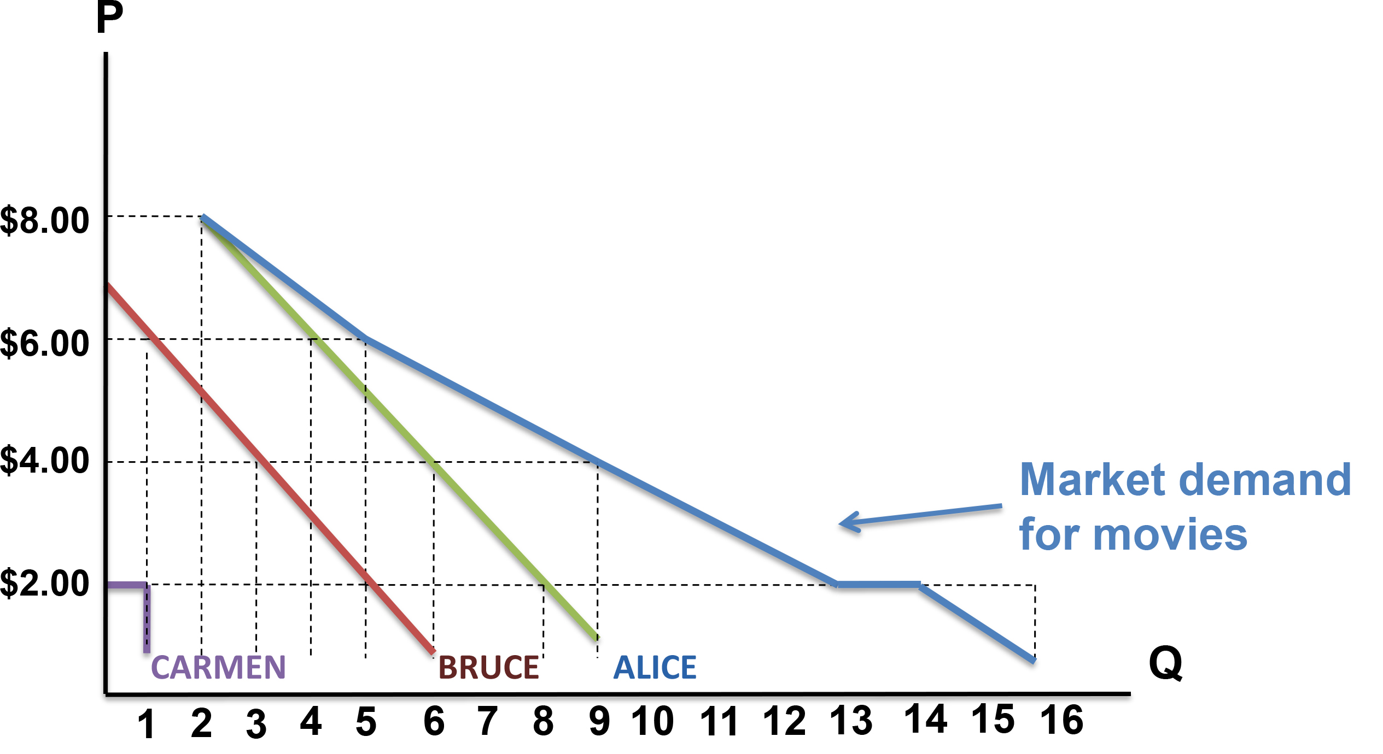
Market Demand Curve: Movies per Week
The market demand curve is the horizontal summation of all individual demand curves.
Access the text alternative for slide images.

Slide 16
Individual and Market Demand Curves
For the market, the law of demand is based on two phenomena:
  At lower prices, existing demanders buy more.
  At lower prices, new demanders (consumers) enter the market.

Slide 17
Supply
Supply is the willing and ability of someone to produce/sell a good or service.
The law of supply states that the quantity of a good supplied is directly related to the good’s price.
In other words, other things equal:
    Quantity supplied rises as price rises.
    Quantity supplied falls as price falls.
    Why?
    (What explains the law of supply)
Notes:
Note: Supply is about producer behavior. Producers use resources to produce goods and services. Why? To make profit. What is profit? Profit is the total revenue minus total (economic) cost. (Total revenue: Quantity of good sold x Price)
The law of supply occurs because:
Assuming a firm’s costs are constant, a higher price means higher profit. Also, when prices rise, firms substitute production of one good for another: Firms can produce different goods with the same resources (these goods are known as substitutes in production). If price of one good increases (ceteris paribus), the firm would be making a higher profit by producing that good.
Must-watch video 2: https://www.youtube.com/watch?v=ewPNugIqCUM
(Note: Only 1st minute is about the law of supply-the rest is about the shifters of supply—watch it all).
(Note 2: The video has some disgusting jokes, sorry! but the material is presented well.)

Slide 18
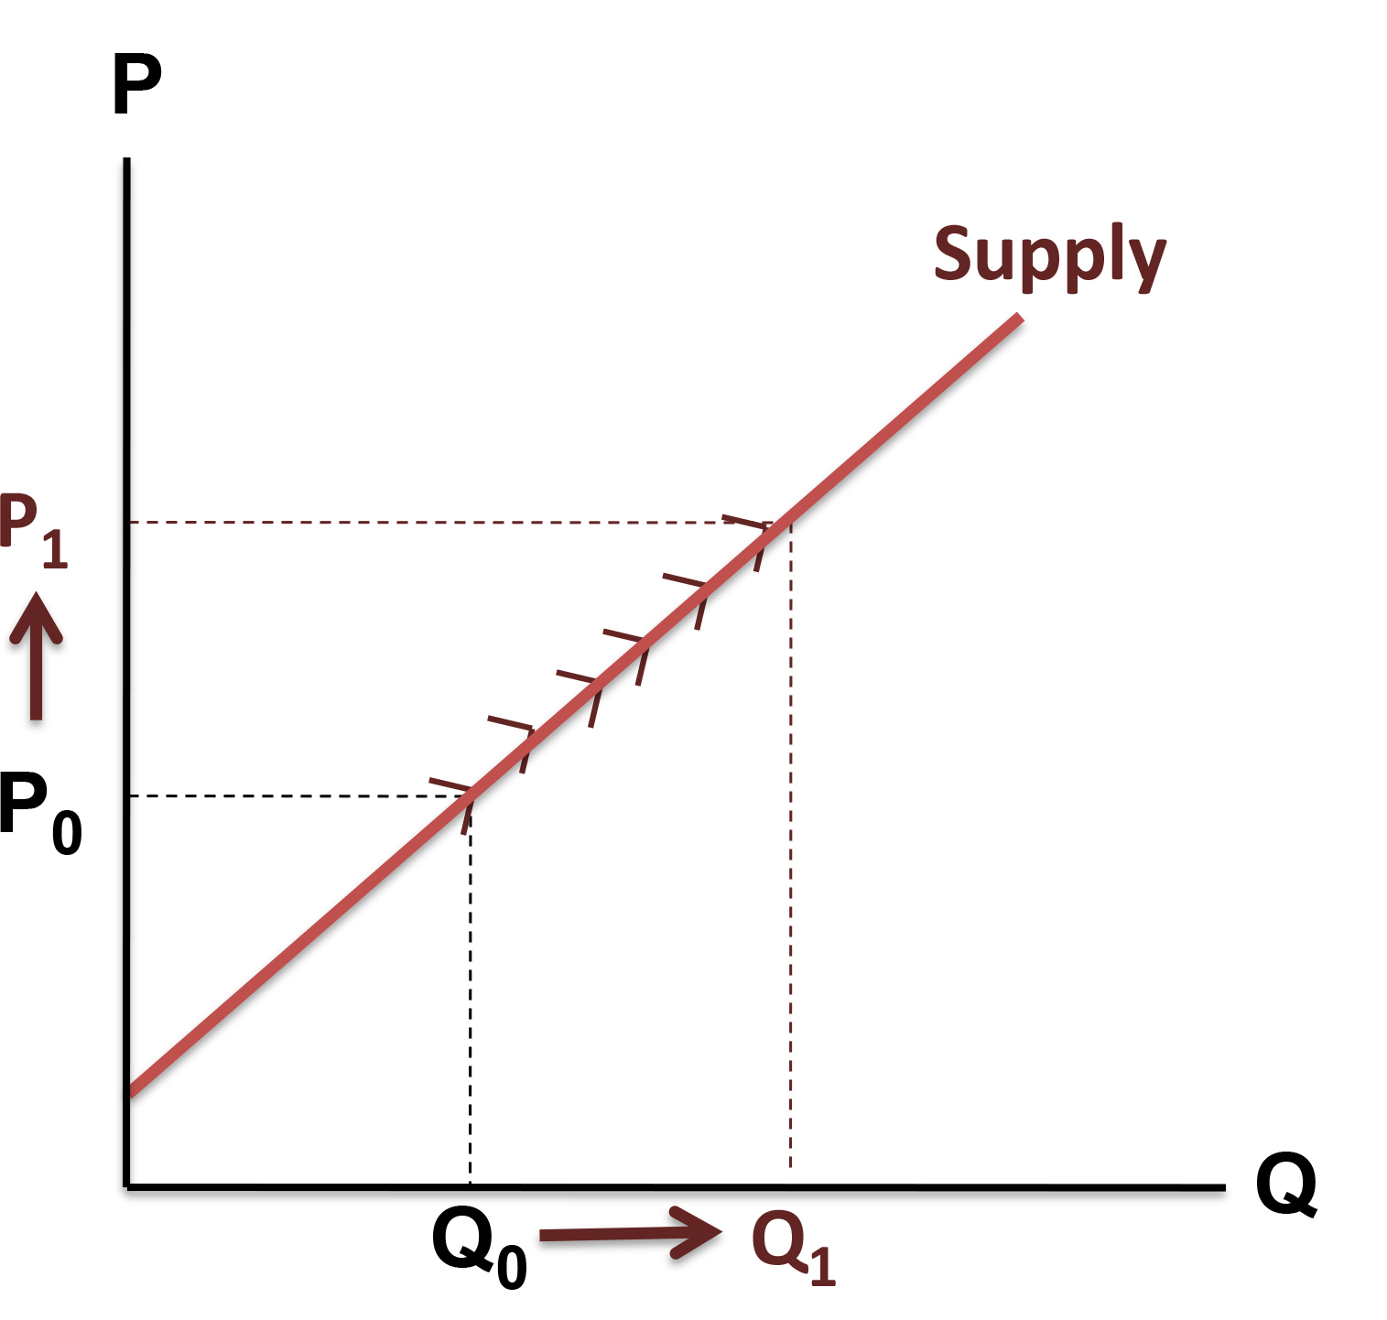
The Supply Curve
A supply curve is the graphic representation of the relationship between price and quantity supplied.
Price and quantity supplied vary directly.
The supply curve is upward sloping.
As price increases, quantity supplied increases.
Access the text alternative for slide images.

Slide 19
Quantity Supplied
Quantity supplied refers to a specific amount that will be supplied per unit of time at a specific price, other things constant. It refers to a specific point on the supply curve.
A change in price causes a change in quantity supplied. This is called a movement along the supply curve.

Slide 20
Shifts in Supply versus Movements Along a
Supply Curve
Supply refers to a schedule of quantities of a good a seller is willing to sell per unit of time at various prices, other things constant. It refers to the entire supply curve.
A change in anything other than price that affects the supply curve changes the entire supply curve. This is called a shift in supply.

Slide 21
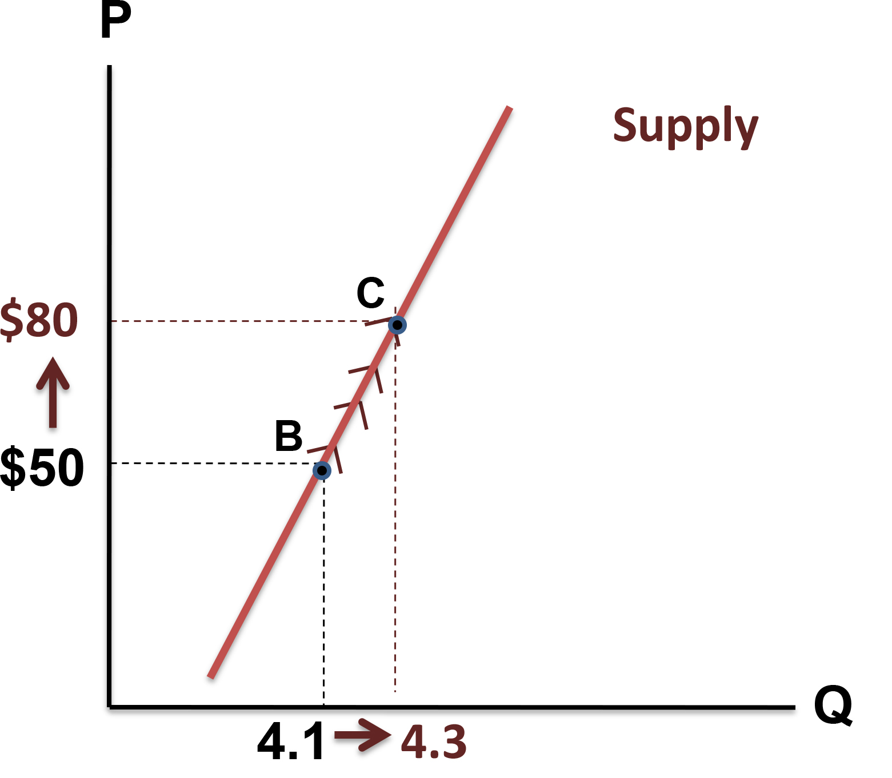
Movement Along a Supply Curve
A change in price causes a movement along the supply curve.
Access the text alternative for slide images.

Slide 22
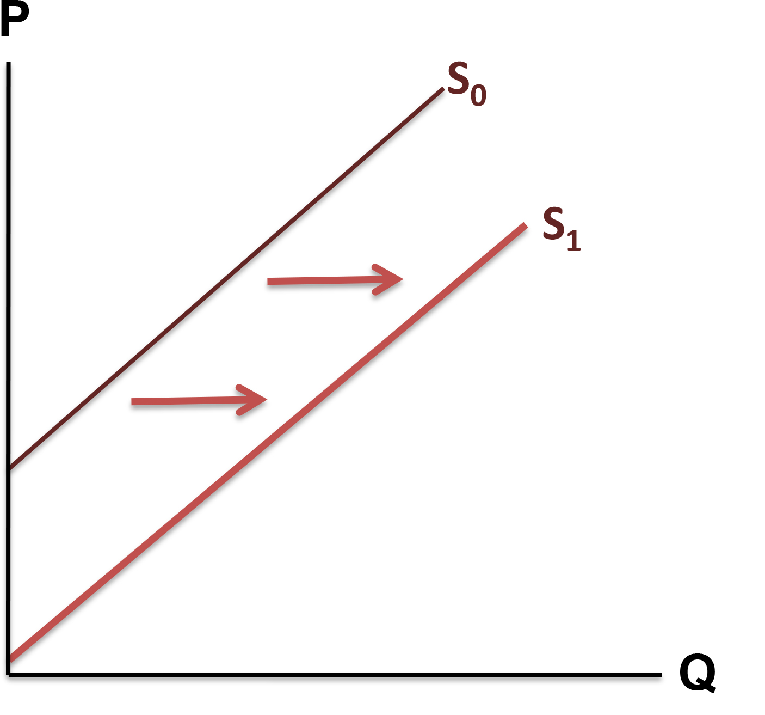
Shift in Supply
A change in a shift factor causes a shift in supply.
Access the text alternative for slide images.

Slide 23
Factors in Supply Shift
Important shift factors of supply include:
Price of inputs (resources).
Technology.
Expectations.
Taxes and subsidies.
Number of producers
Notes:
There are 3 types of resources (inputs or factors of production) for which the firm should pay costs: Labor (wage is the cost), Land (rent is the cost), Capital (interest rate is the cost).
Go back to 2nd must-watch video and watch the rest.

Slide 24
Market Supply: Price per Movie
Price (per movie) | Ann’s Supply | + Barry’s supply | + Charlie’s supply | = Market supply
$1.00 | 1 | 0 | 0 | 1
$3.00 | 3 | 2 | 0 | 5
$5.00 | 5 | 4 | 0 | 9
$7.00 | 7 | 5 | 2 | 14
Notes:
This table show how we arrive at the market supply from individual supply schedules.

Slide 25
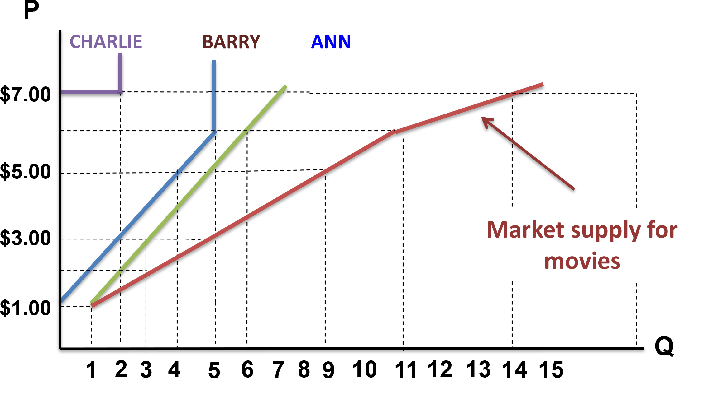
Market Supply Curve: Movies per Week
The market supply curve is the summation of all individual supply curves.
Access the text alternative for slide images.

Slide 26
Equilibrium
Equilibrium is a concept in which opposing dynamic forces cancel each other out.
In the free market, the forces of supply and demand interact to determine:
Equilibrium quantity is the amount bought and sold at equilibrium price.
Equilibrium price is the price toward which the invisible hand drives the market.
Notes:
At equilibrium, there is no tendency for price to change!

Slide 27
The Interaction of Supply and Demand
If there is an excess supply (a surplus), quantity supplied is greater than quantity demanded.
If there is an excess demand (a shortage), quantity demanded is greater than quantity supplied.
Prices adjust and tend to rise when there is excess demand and fall when there is excess supply to reach an equilibrium.

Slide 28
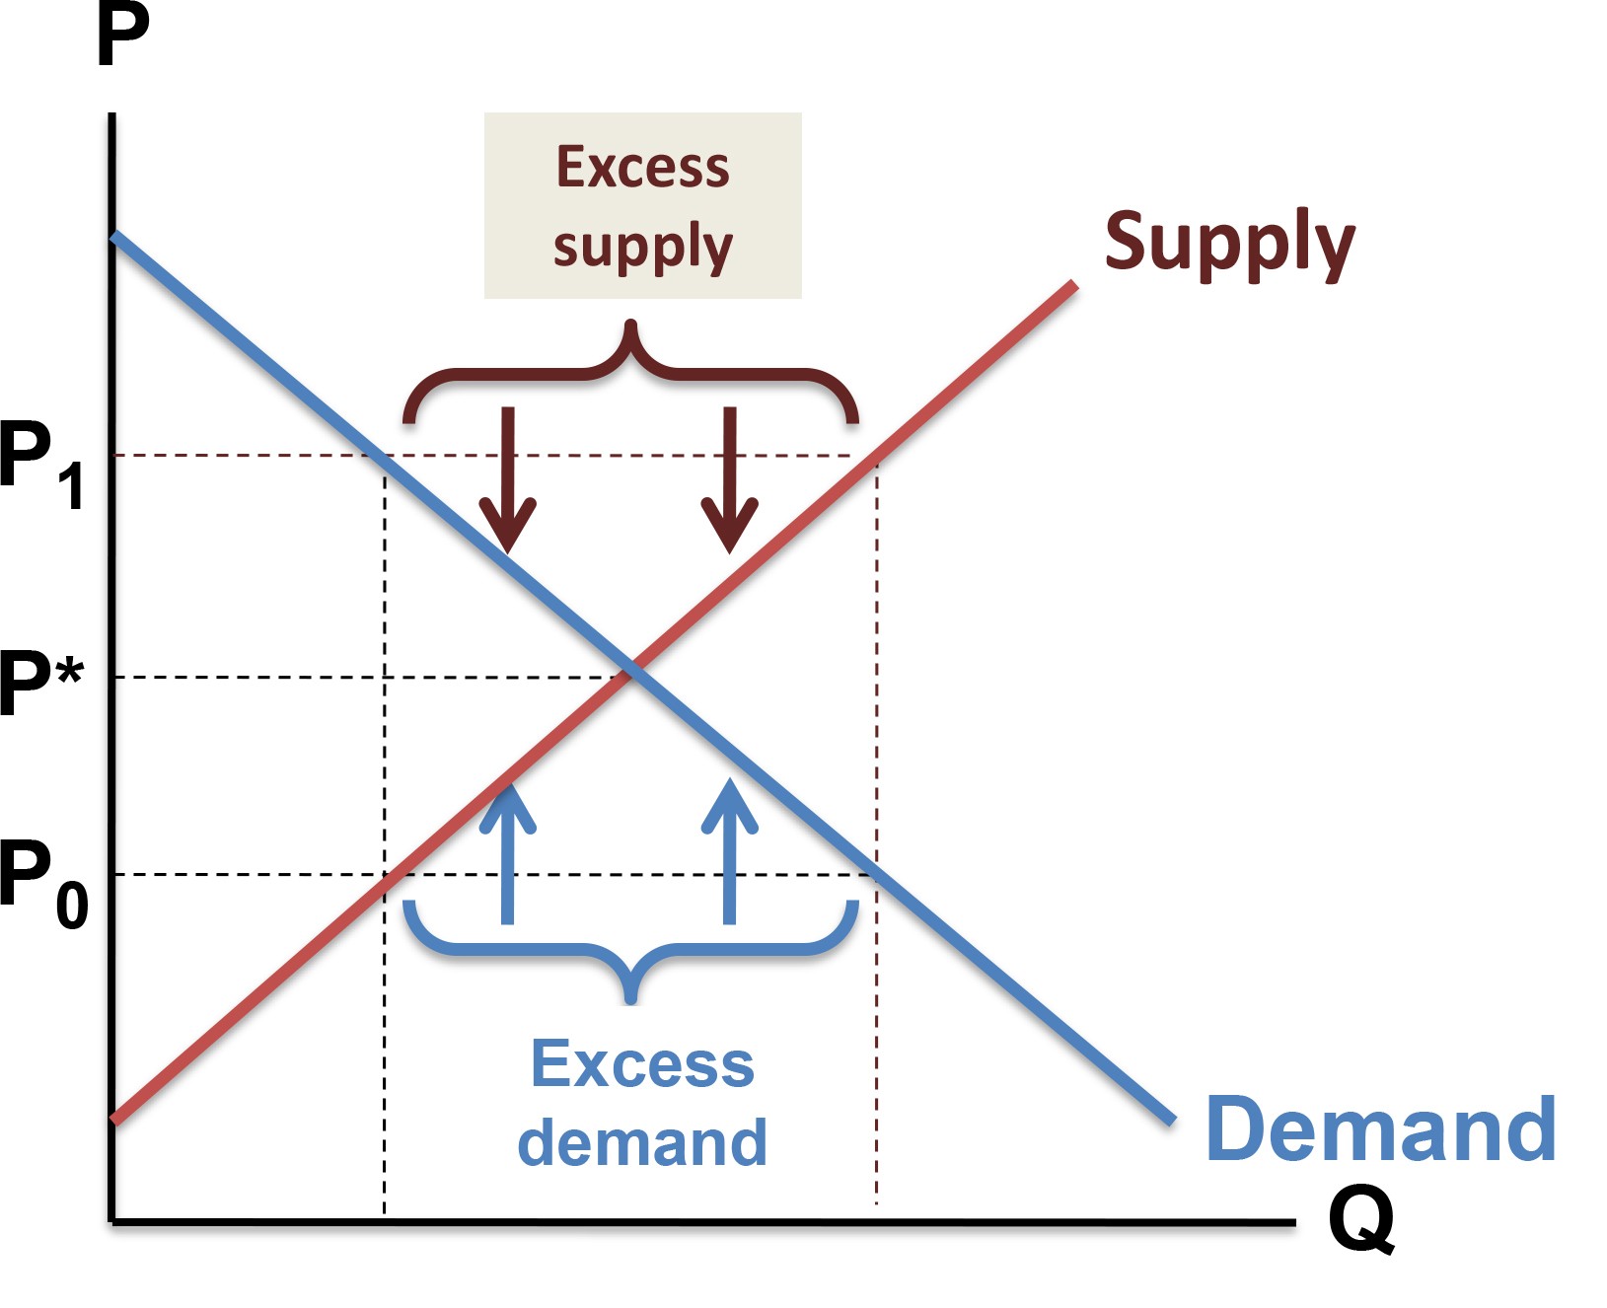
The Interaction of Supply and Demand: Graphed
Excess supply causes downward pressure on price.
Excess demand causes upward pressure on price.
Access the text alternative for slide images.

Slide 29
Shifts in either supply or demand change equilibrium price.
An increase in demand or a decrease in supply:
    Creates excess demand at the original equilibrium price.
    Excess demand increases price until a new higher equilibrium prince is reached.
A decrease in demand or an increase in supply:
    Creates excess supply at the original equilibrium price.
    Excess supply decreases price until a new lower equilibrium price is reached.
Notes:
Must-watch video 3: https://www.youtube.com/watch?v=V0tIOqU7m-c

Slide 30
Limitations of Supply/Demand Analysis
Sometimes supply and demand are interconnected.
The other things held constant assumption is not likely to hold when the goods represent a large percentage of the entire economy.
The fallacy of composition is the false assumption that what is true for a part will also be true for the whole.
Notes:
A famous example of fallacy of composition: standing up at a football game. If an individual fan stands up, other things equal, he or she will be better able to see the action on the field. But if everyone stands up, that will no longer be true. The view may be just as obstructed as before.
There is a one-page text about these concepts I posted on odtuclass. Please read that!

