Slide 1
Econ 202
Macroeconomic Theory I
Lecture Notes-Chapter 18
The Open Economy and the Balance of Payments

Slide 2
Source: World Bank WDI

Slide 3
Source: World Bank WDI

Slide 4
Source: WB WDI

Slide 5
Source: TÜİK

Slide 6
Source: TÜİK

Slide 7
Exchange rates
Nominal exchange rate (E): Price of the foreign currency in terms of domestic currency
For example,
  E=1.18 at the beginning of 2008 means that
  1 USD=1.18 TL at the beginning of 2008; or similarly
  1 TL= 1/E = 1/1.18 USD =0.85 USD
  E’=42 now in December 2025 means that
  1 USD=42 TL in December 2025 or similarly
  1 TL= 1/E’= 1/42 USD = 0,024 USD
What does this mean? The price of USD in terms of TL has increased, or, the price of TL in terms of USD has decreased: TL has lost value or depreciated against USD (or, USD has appreciated/gained value against TL)

Slide 8
Depreciation vs. appreciation
Depreciation of domestic currency: a decrease in the price of domestic currency in terms of foreign currency (or an increase in the price of foreign currency in terms of domestic currency, an increase in E)
Appreciation of domestic currency: an increase in the price of domestic currency in terms of foreign currency (or a decrease in the price of foreign currency in terms of domestic currency, a decrease in E)

Slide 9
The nominal exchange rate
For example, E is the price of 1 US $ in terms of TL:
1US$=1,5 TL; here E=1,5
Depreciation of domestic currency—decrease in the value (price) of domestic currency in terms of foreign currency
Appreciation of domestic currency—increase in the value (price) of domestic currency in terms of foreign currency

Slide 10
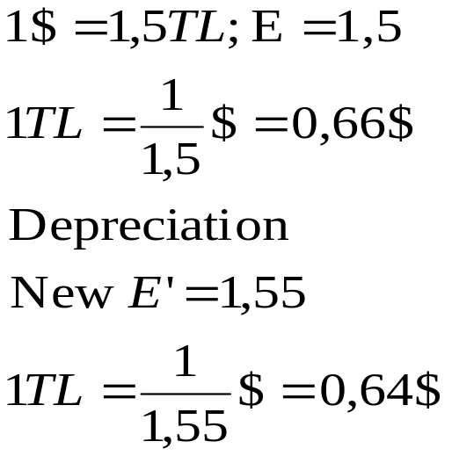
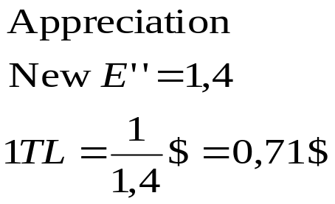
The nominal exchange rate
Let
If the exchange rate E increases from 1,5 to 1,55, the TL depreciates against the US$
If the exchange rate E decreases from 1,5 to 1,4, the TL appreciates against the US$

Slide 11
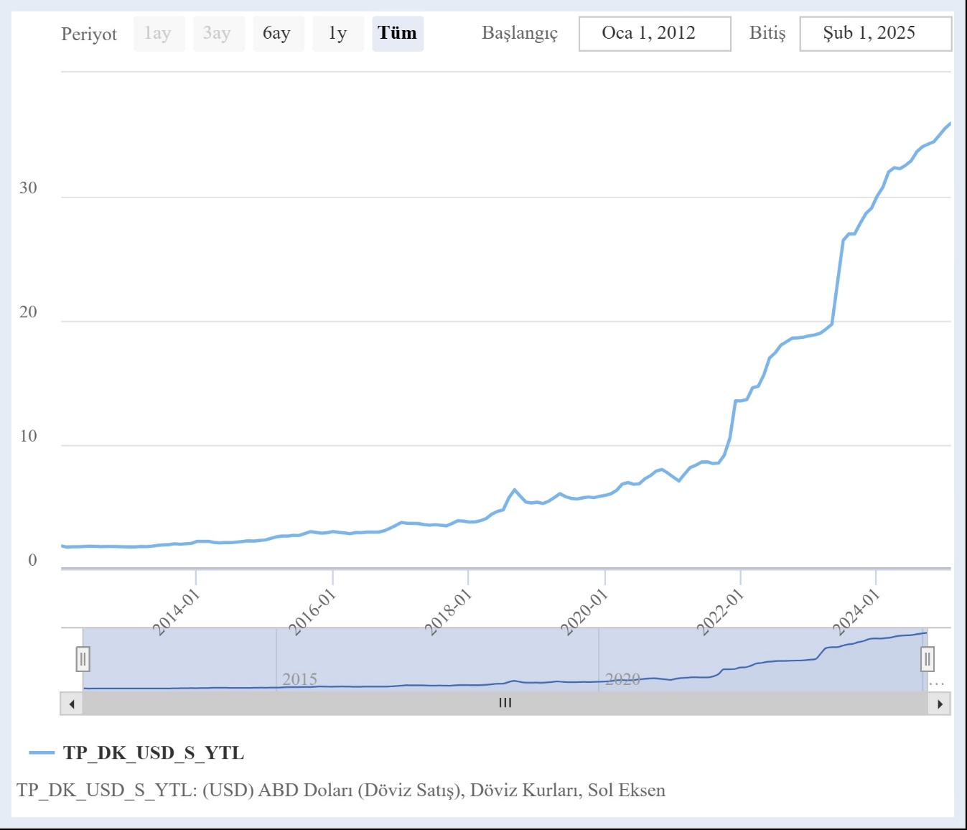
Nominal exchange rates
(monthly averages)
USD
2012-2024
Source: CBRT EVDS

Slide 12
The real exchange rate
What is the real exchange rate?
Real exchange rate is the measure of the relative price / or, relative value of foreign goods in terms of domestic goods
Example:
  Turkey produces Arçelik washing machines, Germany produces Bosch washing machines
  The price of a Bosch washing machine in Germany is 1,000 euros
  Let 1 euro=1,8 TL; then the TL price of a Bosch washing machine is 1,000x1,8=1,800 TL
  Let an Arçelik washing machine is 900 TL in Turkey

Slide 13
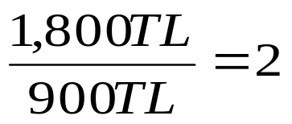
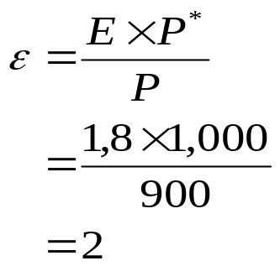
The real exchange rate
Then, the price of a foreign (Bosch) washing machine in terms of domestic (Arçelik) washing machine is
Or, in the real exchange rate notation,
2 is the relative price of a Bosch washing
machine in terms of an Arçelik washing
machine; in other words 2 is the real exchange rate between Turkey and Germany: 1 unit of a good in Germany is as valuable as 2 units of the same good in Turkey
Notes:
e.g. when we import 1 Bosch washing machine from Germany, we give up the income to be generated by producing 2 Arçelik washing machines in Turkey!

Slide 14
Equilibrium in the financial markets
Domestic bonds versus foreign bonds
Now in the open economy (which is also open in financial markets), financial investors have the choice of investing in domestic as well as in foreign bonds, depending on whichever has the highest expected rate of return.
In equilibrium (where the financial investor is indifferent between holding domestic versus foreign bonds), domestic and foreign bonds have the SAME EXPECTED RATE OF RETURN
  No arbitrage possibilities between the two financial assets remain
Notes:
If there is disequilibrium, as we will see, the financial investor will prefer one asset over the other, i.e. is not indifferent between alternative assets

Slide 15
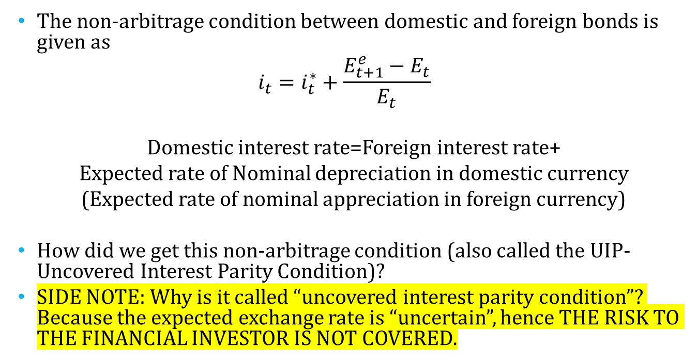
Equilibrium in the financial markets
The non-arbitrage condition between domestic and foreign bonds is given as
$$i_{t}=i_{t}^{∗}+\frac{E_{t+1}^{e}−E_{t}}{E_{t}}$$
Domestic interest rate=Foreign interest rate+
Expected rate of Nominal depreciation in domestic currency
(Expected rate of nominal appreciation in foreign currency)
How did we get this non-arbitrage condition (also called the UIP-Uncovered Interest Parity Condition)?
SIDE NOTE: Why is it called “uncovered interest parity condition”? Because the expected exchange rate is “uncertain”, hence THE RISK TO THE FINANCIAL INVESTOR IS NOT COVERED.
Uncovered Interest
Parity Condition

Slide 16

Uncovered Interest Parity Condition
Let TL be the domestic currency, US dollar $ be the foreign currency
Suppose that you have 1 TL to invest;
The gross expected rate of return on 1TL invested in a TL-denominated 1-period bond at time t, yields
(1+i_{t} ) TL at time (t+1)

Slide 17
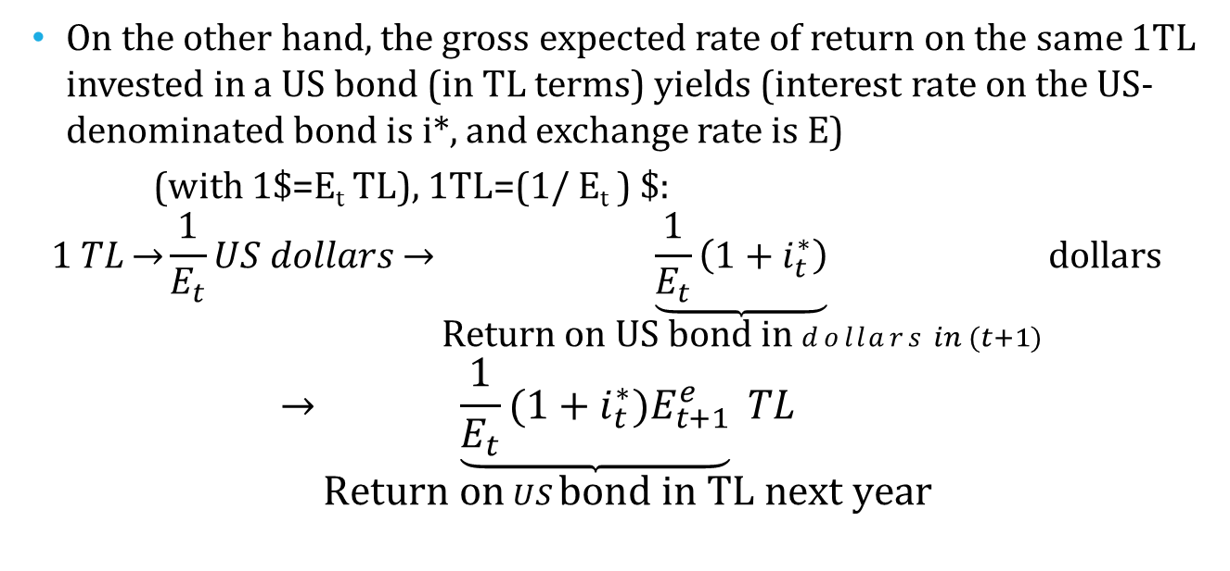
Uncovered Interest Parity Condition
On the other hand, the gross expected rate of return on the same 1TL invested in a US bond (in TL terms) yields (interest rate on the US-denominated bond is i*, and exchange rate is E)
(with 1$=E_{t} TL), 1TL=(1/ E_{t} ) $:
$$1 TL\overset{→}{}\frac{1}{E_{t}}US dollars\overset{→}{}\underset{\text{Return} \text{on} \text{U}\text{S} \text{bond} \text{in} dollars in (t+1)}{\underbrace{\frac{1}{E_{t}}\left(1+i_{t}^{∗}\right)}}dollars$$
$$\overset{→}{}\underset{\text{Return} \text{on} US \text{bond} \text{in} \text{TL} \text{next} \text{year}}{\underbrace{\frac{1}{E_{t}}(1+i_{t}^{∗})E_{t+1}^{e}} TL}$$

Slide 18
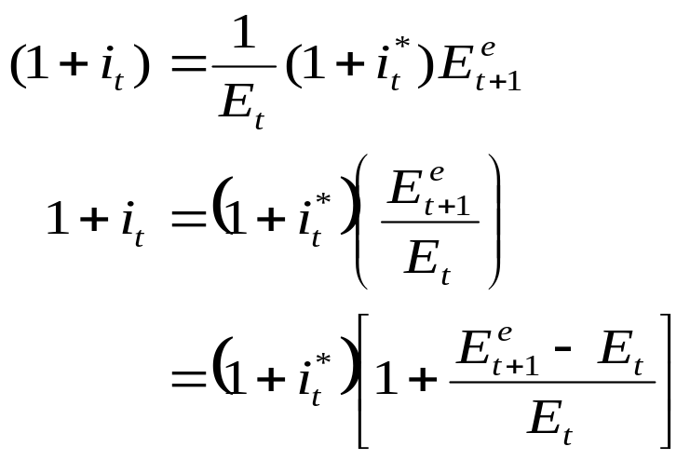
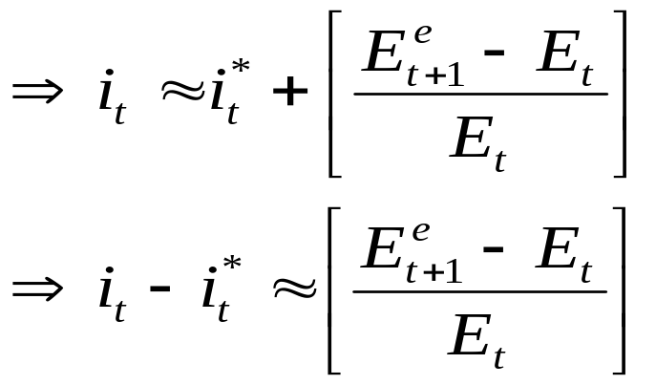
Uncovered Interest Parity Condition
Uncovered Interest Parity (UIP) condition requires:
  The expected rate of return on 1 TL invested on a TL bond
  =
  The expected rate of return on 1TL invested on a US bond
Uncovered Interest Parity Condition

Slide 19
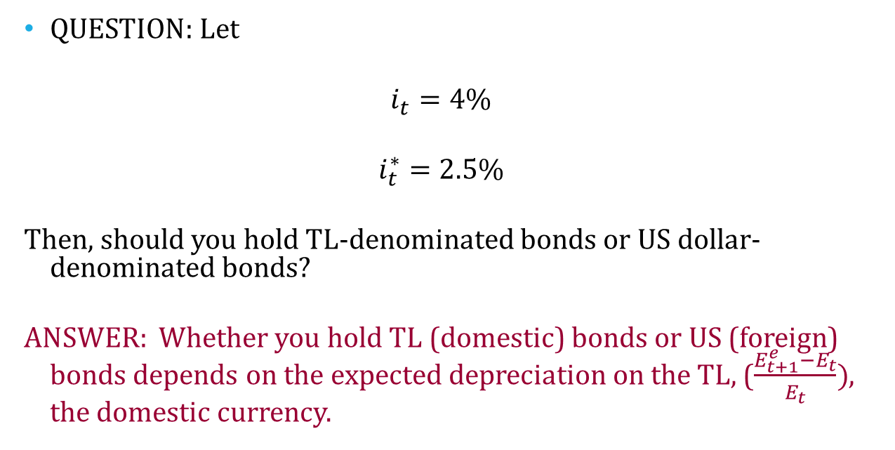
Uncovered Interest Parity Condition
QUESTION: Let
$$i_{t}=4\%$$
$$i_{t}^{∗}=2.5\%$$
Then, should you hold TL-denominated bonds or US dollar-denominated bonds?
ANSWER: Whether you hold TL (domestic) bonds or US (foreign) bonds depends on the expected depreciation on the TL, ($\frac{E_{t+1}^{e}−E_{t}}{E_{t}})$, the domestic currency.

Slide 20
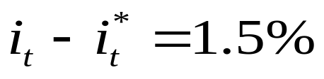
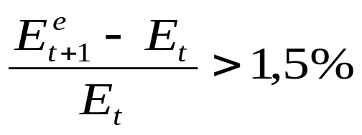
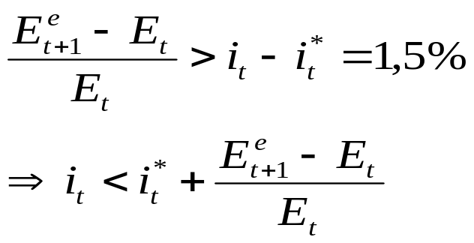
Uncovered Interest Parity Condition
Note that
Now, if you expect that the TL to depreciate (the US dollar to appreciate) by more than 1,5%, i.e.
then

Slide 21
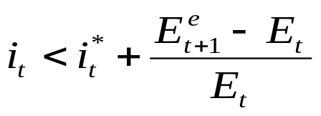
Uncovered Interest Parity Condition
Note that if
Then investing in a US (foreign) bond is more attractive than investing in a TL (domestic) bond. It is expected that the US
dollar will appreciate at a higher rate than the interest difference next year (when you liquidate the bond, the gain is higher than the interest difference), hence you have an advantage in holding a US bond versus a TL bond from today.
This is a disequilibrium situation.

Slide 22


Uncovered Interest Parity Condition
On the other hand, if you expect that the TL to depreciate (the US dollar to appreciate) by less than 1,5%, i.e.
then

Slide 23
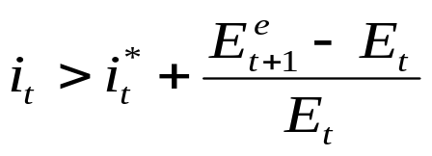
Uncovered Interest Parity Condition
Note that if
Then investing in a TL (domestic) bond is more attractive than investing in a US (foreign) bond. Next year the TL might even appreciate, valued at a higher price against the dollar!
This is a disequilibrium situation.

Slide 24
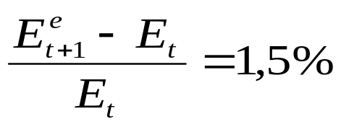

Uncovered Interest Parity Condition
Lastly if
It is expected that the TL depreciates exactly by 1,5%.
Then investing in a TL (domestic) bond is no more attractive than investing in a US (foreign) bond. The financial investor is indifferent between the two assets.
This is an equilibrium situation.

Slide 25
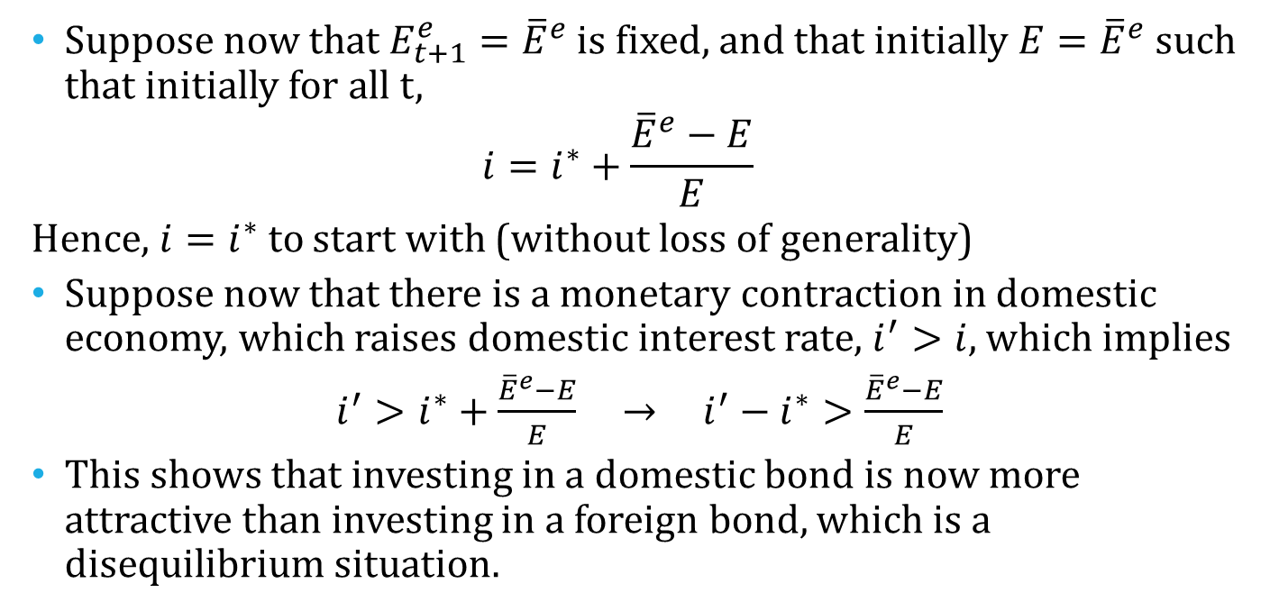
Disequilibrium in international financial markets
Suppose now that $E_{t+1}^{e}={\overline{E}}^{e}$ is fixed, and that initially $E={\overline{E}}^{e}$ such that initially for all t,
$$i=i^{∗}+\frac{{\overline{E}}^{e}−E}{E}$$
Hence, $i=i^{∗}$ to start with (without loss of generality)
Suppose now that there is a monetary contraction in domestic economy, which raises domestic interest rate, $i^{′}>i$, which implies
$i^{′}>i^{∗}+\frac{{\overline{E}}^{e}−E}{E}$ → $i^{′}−i^{∗}>\frac{{\overline{E}}^{e}−E}{E}$
This shows that investing in a domestic bond is now more attractive than investing in a foreign bond, which is a disequilibrium situation.

Slide 26
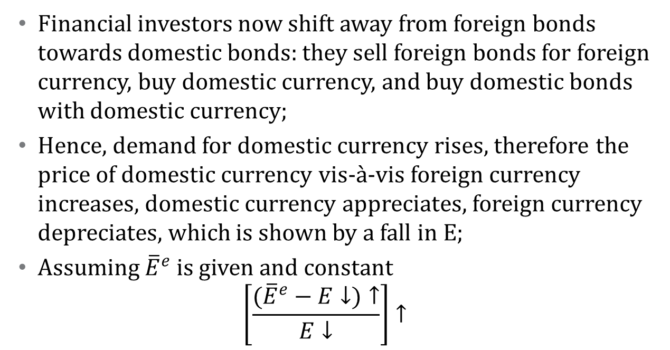
Disequilibrium in international financial markets
Financial investors now shift away from foreign bonds towards domestic bonds: they sell foreign bonds for foreign currency, buy domestic currency, and buy domestic bonds with domestic currency;
Hence, demand for domestic currency rises, therefore the price of domestic currency vis-à-vis foreign currency increases, domestic currency appreciates, foreign currency depreciates, which is shown by a fall in E;
Assuming ${\overline{E}}^{e}$ is given and constant
$$\left[\frac{({\overline{E}}^{e}−E↓)↑}{E↓}\right]↑$$

Slide 27
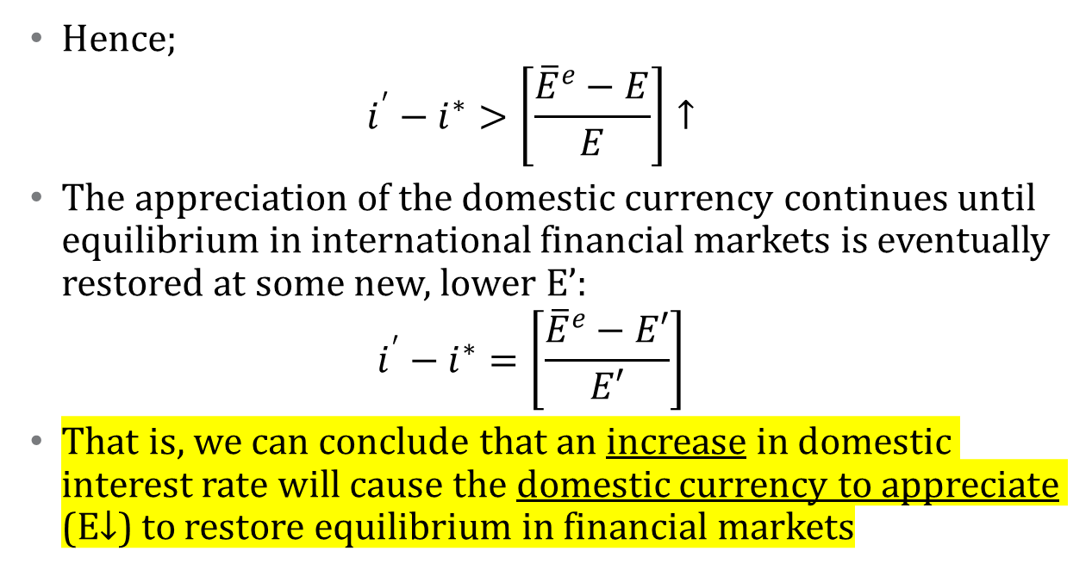
Disequilibrium in international financial markets
Hence;
$$i^{′}−i^{∗}>\left[\frac{{\overline{E}}^{e}−E}{E}\right]↑$$
The appreciation of the domestic currency continues until equilibrium in international financial markets is eventually restored at some new, lower E’:
$$i^{′}−i^{∗}=\left[\frac{{\overline{E}}^{e}−E′}{E′}\right]$$
That is, we can conclude that an increase in domestic interest rate will cause the domestic currency to appreciate (E↓) to restore equilibrium in financial markets

Slide 28
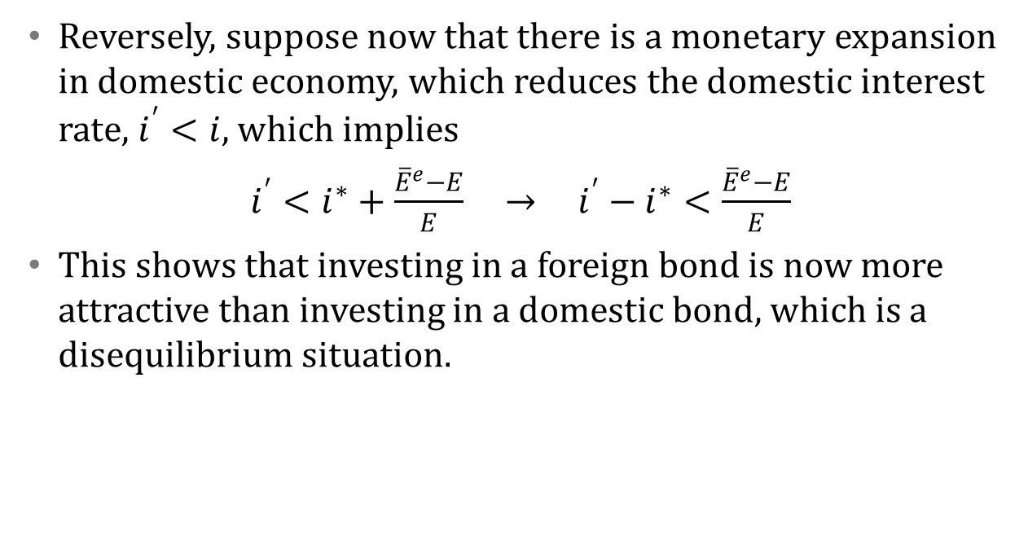
Disequilibrium in international financial markets
Reversely, suppose now that there is a monetary expansion in domestic economy, which reduces the domestic interest rate, $i^{′}<i$, which implies
$i^{′}<i^{∗}+\frac{{\overline{E}}^{e}−E}{E}$ → $i^{′}−i^{∗}<\frac{{\overline{E}}^{e}−E}{E}$
This shows that investing in a foreign bond is now more attractive than investing in a domestic bond, which is a disequilibrium situation.

Slide 29

Disequilibrium in international financial markets
Financial investors now shift away from domestic bonds towards foreign bonds: they sell domestic bonds for domestic currency, buy foreign currency, and buy foreign bonds with foreign currency;
Hence, demand for foreign currency rises, therefore the price of foreign currency vis-à-vis domestic currency increases, domestic currency depreciates, foreign currency appreciates, which is shown by an increase in E;
Assuming ${\overline{E}}^{e}$ is given and constant
$$\left[\frac{({\overline{E}}^{e}−E↑)↓}{E↑}\right]↓$$

Slide 30
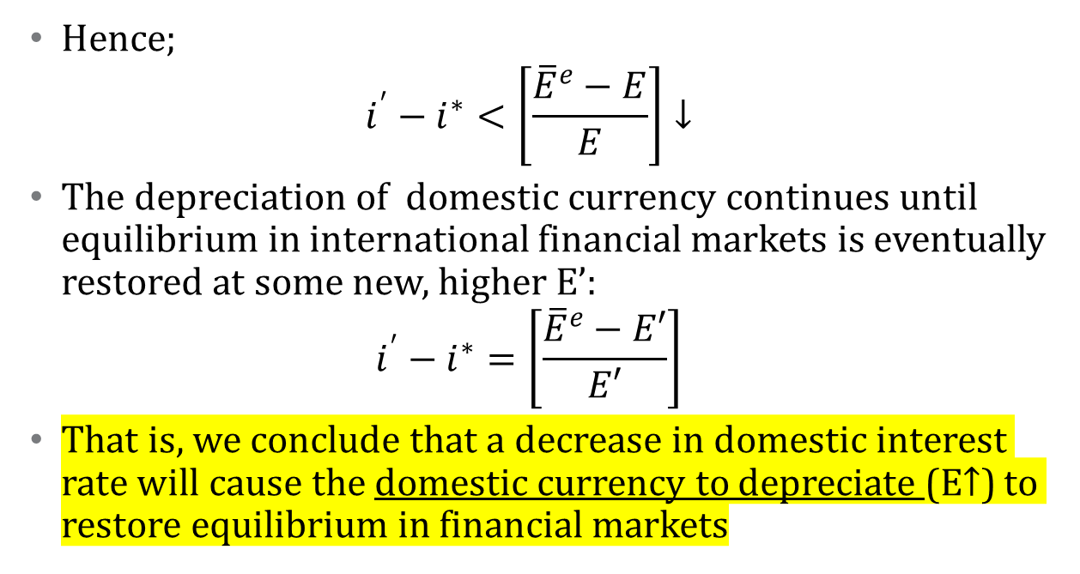
Disequilibrium in international financial markets
Hence;
$$i^{′}−i^{∗}<\left[\frac{{\overline{E}}^{e}−E}{E}\right]↓$$
The depreciation of domestic currency continues until equilibrium in international financial markets is eventually restored at some new, higher E’:
$$i^{′}−i^{∗}=\left[\frac{{\overline{E}}^{e}−E′}{E′}\right]$$
That is, we conclude that a decrease in domestic interest rate will cause the domestic currency to depreciate (E↑) to restore equilibrium in financial markets

Slide 31
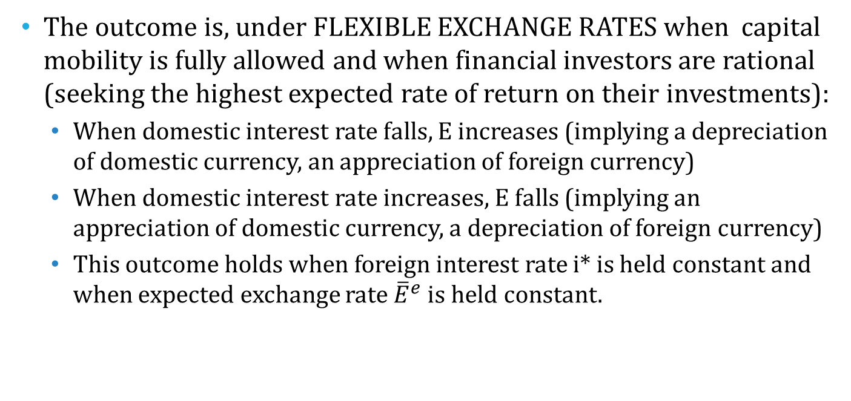
Equilibrium in international financial markets
The outcome is, under FLEXIBLE EXCHANGE RATES when capital mobility is fully allowed and when financial investors are rational (seeking the highest expected rate of return on their investments):
  When domestic interest rate falls, E increases (implying a depreciation of domestic currency, an appreciation of foreign currency)
  When domestic interest rate increases, E falls (implying an appreciation of domestic currency, a depreciation of foreign currency)
  This outcome holds when foreign interest rate i* is held constant and when expected exchange rate ${\overline{E}}^{e}$ is held constant.

Slide 32
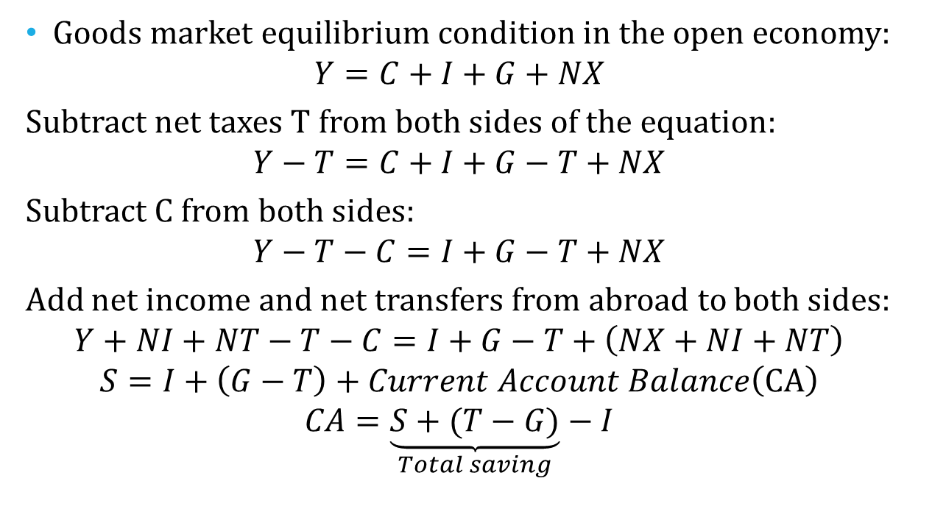
Saving, Investment and the Current Account Balance
Goods market equilibrium condition in the open economy:
$$Y=C+I+G+NX$$
Subtract net taxes T from both sides of the equation:
$$Y−T=C+I+G−T+NX$$
Subtract C from both sides:
$$Y−T−C=I+G−T+NX$$
Add net income and net transfers from abroad to both sides:
$$Y+NI+NT−T−C=I+G−T+\left(NX+NI+NT\right)$$
$$S=I+\left(G−T\right)+Current Account Balance\left(CA\right)$$
$$CA=\underset{Total saving}{\underbrace{S+(T−G)}}−I$$

Slide 33
Saving, Investment and the Current Account Balance
Current Account Balance=(Private Saving + Public Saving)-Investment
The country runs a current account surplus (CA>0) as long as it saves more (both private and public) by more than it invests (this implies a net lending to the rest of the world);
The country runs a current account deficit (CA<0) as long as it saves (both private and public) by less than it invests (this implies a net borrowing from the rest of the world)

Slide 34
Saving, Investment and the Current Account Balance
Current Account : Deficit →
Capital and Financial Account: Surplus (net borrowing from the rest of the world: net inflow of capital to the country; Sum of Capital and financial inflows are larger than outflows)
Current Account: Surplus →
Capital and Financial Account: Deficit (net lending to the rest of the world: net outflow of capital from the country; Sum of Capital and financial outflows are larger than inflows)

Slide 35
Balance of Payments
Balance of payments accounts summarize a country’s transactions with the rest of the world, both in terms of trade flows and financial flows.
Balance of payments components:
  Current Account
  Capital & Financial Account

Slide 36
Balance of Payments
Current Account
  Exports-Imports=Trade Balance on Goods and Services (Merchandise trade & services trade—services trade includes patents, property rights and other intellectual property rights)
  Net income received= Income received on holdings of foreign assets by TR residents minus income received on holdings of TR assets by foreigners (interest income/primary income in TR BoP)
  Net current transfers received (personal transfers including workers remittances & foreign aid/Secondary income in TR BoP)

Slide 37
Balance of Payments
Capital Account (Gross acquisitions and disposals of non-produced non-financial assets/Üretilmeyen ve finansal olmayan varlıklar—franchising; purchase and sale of trademarks)
Financial Account
  Net Foreign Direct Investment (equity capital, other capital and real estate)
  Net Portfolio Investment (firm securities and government’s debt securities)
  Net Other Investment (commercial loans)
Current Account + Capital&Financial Account
Change in Reserve Assets (official reserves of the CB)

Slide 38
Balance of Payments
Current Account deficit is financed or funded by Financial Account and Changes in reserve assets
If changes in Reserve assets is larger than (Current account deficit+Financial account), then there is an inflow which is unaccounted for; i.e.
If there is any discrepancy between these, it is due to «funds unaccounted for» i.e. Funds which we do not know the source of. This is net errors and omissions.

Slide 39
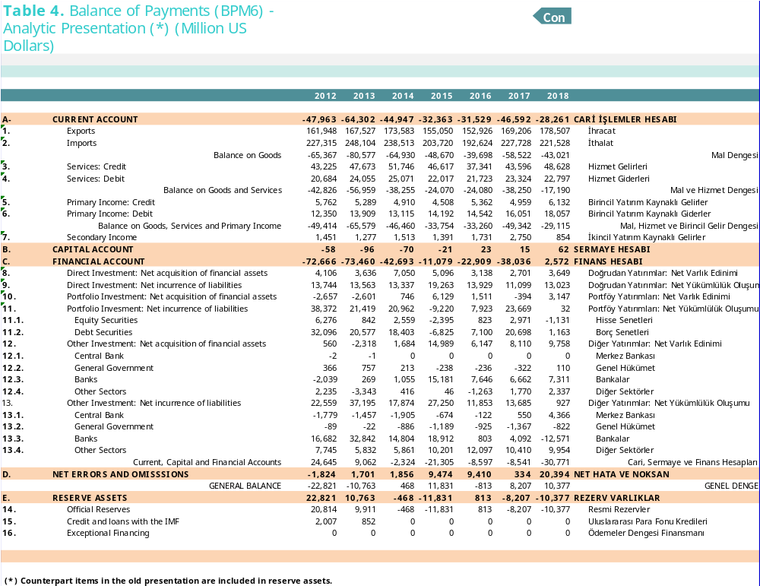
Assets net of liabilities (net assets)

Slide 40
Balance of Payments Accounts
Summary of BoP for Turkey, 2017 (bill. USD)
Current Account | -46,592
Balance on Goods | -58,522
Exports of goods | 169,206
Imports of goods | 227,728
Balance on Goods and Services | -38,250
Balance on Goods, Services and Primary Income | -49,342
Current Transfers (Secondary Income) | 2.750
Capital & Financial Account | 38.051
Net Errors and Omissions | 334
General Balance | 8.207
Reserve Assets (Change in..) | -8.207
Liabilities net of assets (our net debt)
Current Account+Capital & Financial Account
= -46,592 + 38,051 = -8,541 (this much of Current Account is not yet financed)
Changes in reserves-(Current Account+Capital & Financial Account) =-8,207-(-8,541)= 334 mill. USD is net errors & omissions (financing unaccounted for)
Current Account deficit is 46,592 bil. USD
It is financed by 38,051 bil. USD foreign borrowing (liabilities net of assets)
The decrease in official reserves is 8,207 bill. USD
The difference is net errors and omissions (in 2017 case, 334 mill. USD)

