Slide 1
CHAPTER 8
Market Failure versus Government Failure
Eleventh Edition

Slide 2
Market Failures
A market failure is a situation in which the invisible hand pushes in such a way that individual decisions do not lead to socially desirable outcomes.
They can be caused by:
    Externalities.
    Public goods.
    Imperfect information.
Government failures are when the government intervention actually makes the situation worse.
Notes:
In this set, we will cover only externalities and public goods. The rest of the chapter (in the textbook) is NOT included.

Slide 3
Externalities
Externalities are the effects of a decision on a third party that are not taken into account by the decision-maker.
(For instance, if you smoke next to me, your smoking decision has a negative externality-I am affected badly by it).
(For instance, if you chose not to wear a mask during times of covid, it has a negative externality. I am affected badly by it).
Negative externalities occur when the effects are detrimental to others. Example: Second-hand smoke and carbon monoxide emissions.
Positive externalities occur when the effects are beneficial to others. Example: Education.
Notes:
Must watch video 1: https://www.youtube.com/watch?v=ha-ssoI6S0Q

Slide 4
No Externality Example 1
When there are no externalities, the supply curve S represents the marginal private cost to society and the demand curve D represents the marginal private benefit to society.
At equilibrium, the private and social benefits are equal and society is as well off as possible.

Slide 5
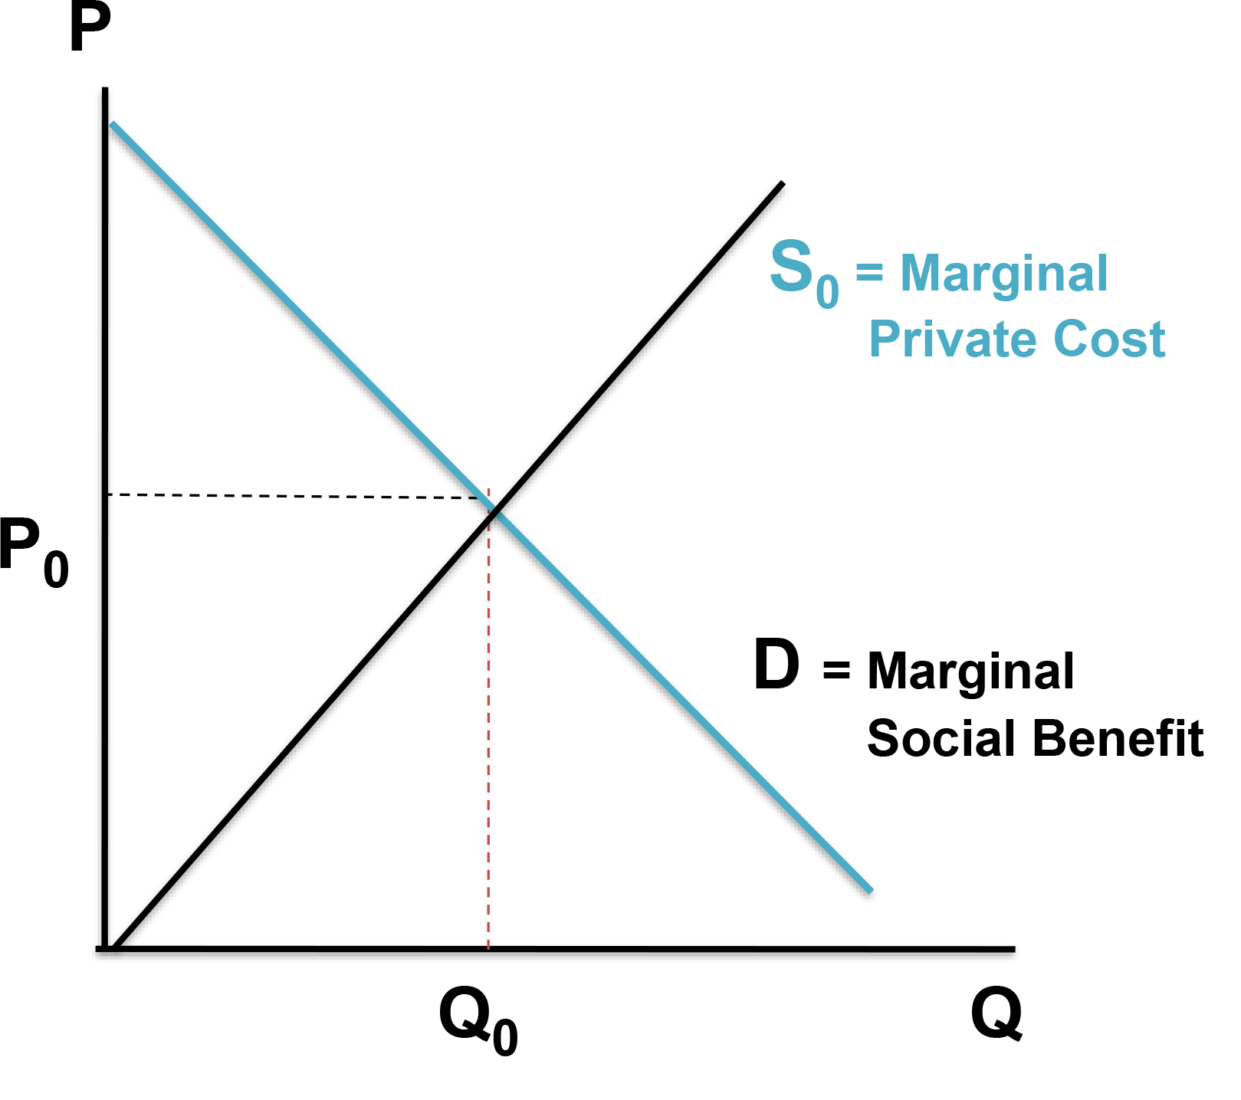
No Externality Example 2
Because there are no externalities, the supply curve and demand curve represent the marginal social cost and benefits of producing and consuming steel.
If there are no externalities, P₀Q₀ is the equilibrium.
Access the text alternative for slide images.

Slide 6
A Negative Externality Example 1
When there are negative externalities, the marginal social cost differs from the marginal private cost.
The marginal social cost includes the marginal private costs of production plus the cost of negative externalities associated with that production.
    It includes all the marginal costs that society bears.

Slide 7
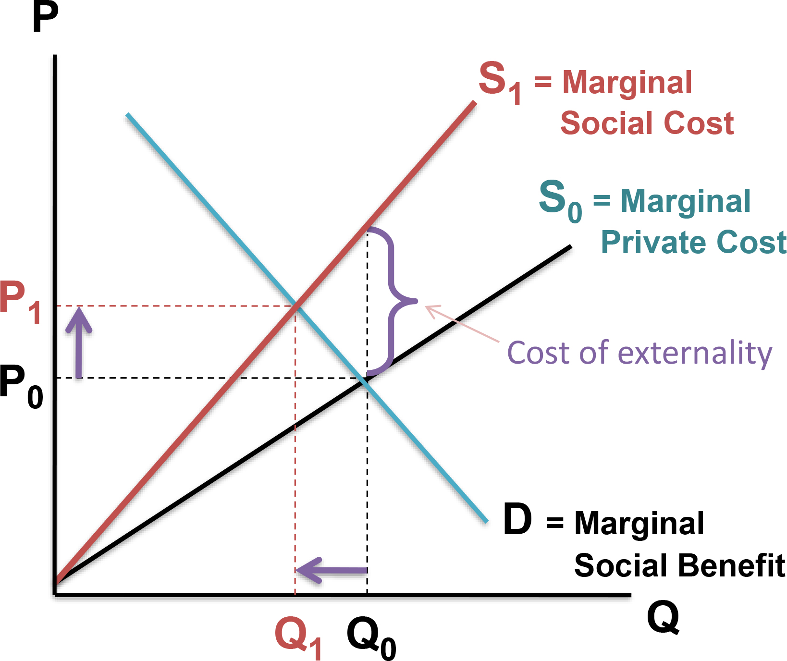
A Negative Externality Example 2
If there are no externalities, P₀Q₀ is the equilibrium.
When there is a negative externality, the marginal private cost will be below the marginal social cost and the competitive price will be too low to maximize social welfare.
Government intervention may be necessary to reduce production.
Access the text alternative for slide images.

Slide 8
A Negative Externality Example 3
When there are negative externalities, the marginal social cost differs from the marginal private cost.
The marginal social cost includes the marginal private costs of production plus the cost of negative externalities associated with that production.
    It includes all the marginal costs that society bears.

Slide 9
A Positive Externality Example 1
When there are positive externalities, the marginal social benefit differs from the marginal private benefit.
The marginal social benefit includes the marginal private benefit of consumption plus the benefits of positive externalities resulting from consuming that good.
    It includes all the marginal benefits that society receives.

Slide 10
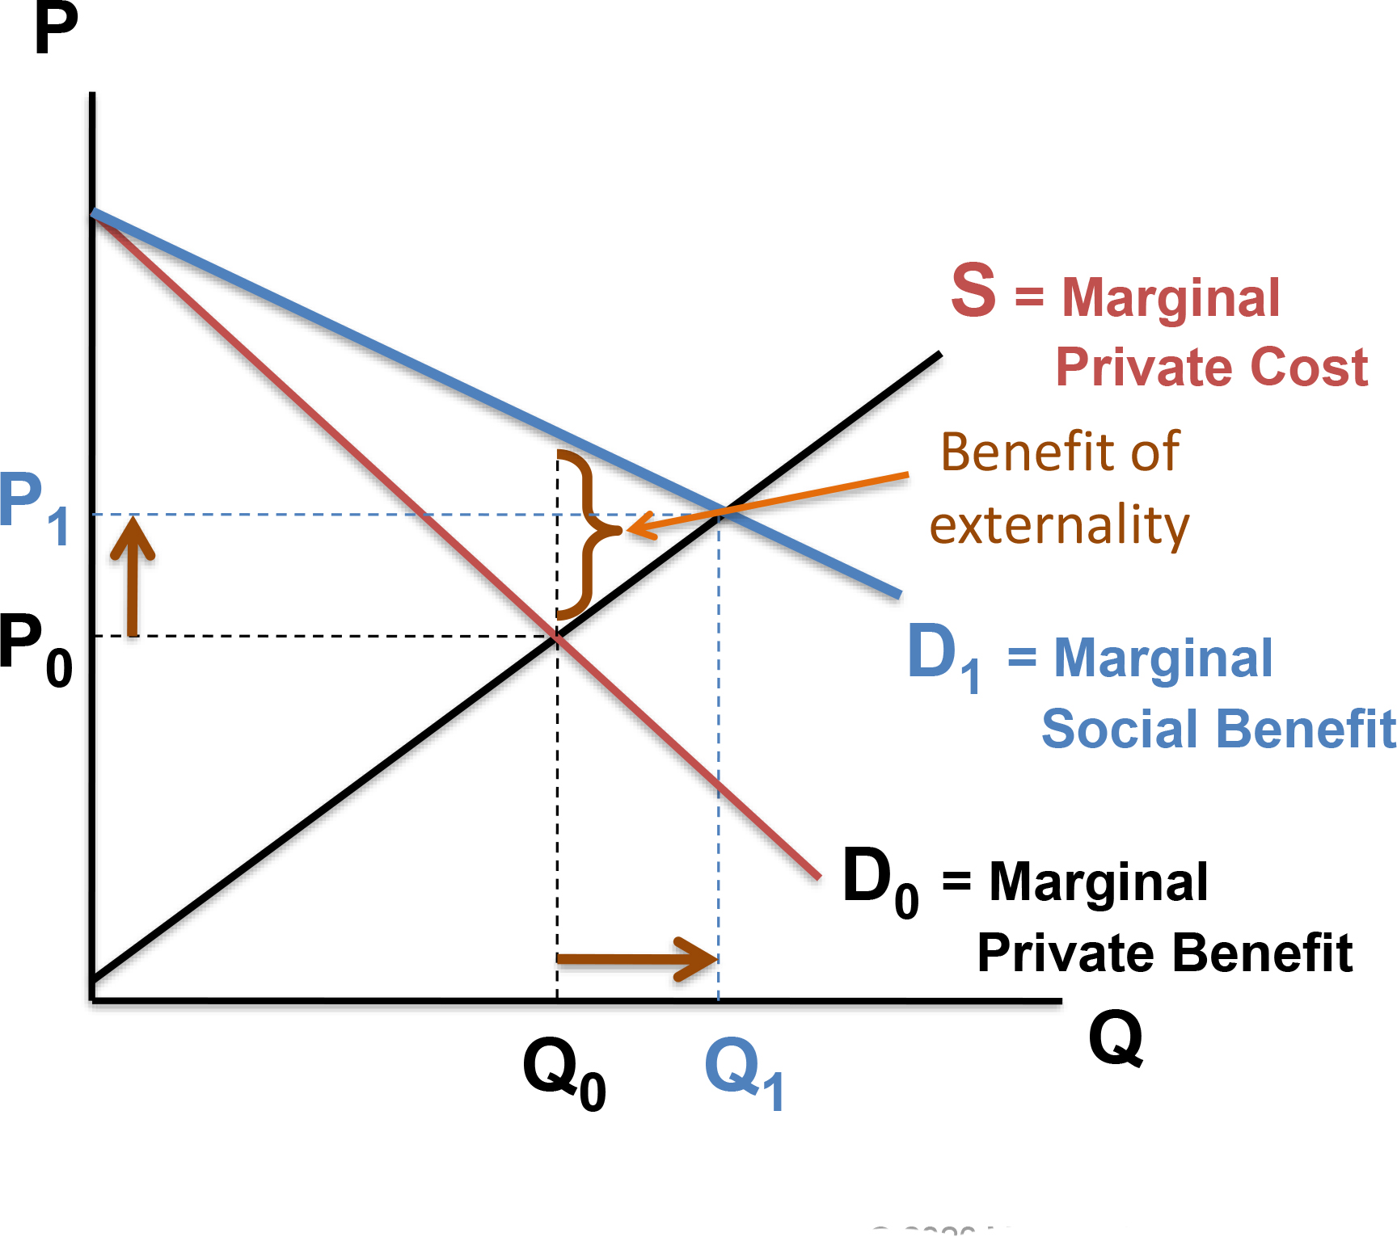
A Positive Externality Example 2
If there are no externalities, P₀Q₀ is the equilibrium.
When there is a positive externality, the marginal social benefit will be above the marginal private benefit and the market price will be too low to maximize social welfare.
Government intervention may be necessary to increase consumption.
Access the text alternative for slide images.

Slide 11
Alternative Methods of Dealing with Externalities
Direct regulation is when the government directly limits the amount of a good people are allowed to use.
Incentive policies:
    Tax incentives are programs using a tax to create incentives for individuals to structure their activities in a way that is consistent with the desired ends.
    Market incentives are plans requiring market participants to certify that they have reduced total consumption by a certain amount.
    Voluntary reductions.

Slide 12
Voluntary Reductions
Voluntary reductions allow individuals to choose whether to follow what is socially optimal or what is privately optimal.
The socially conscious will often become discouraged and quit contributing when they believe a large number of people are free riding.
Free rider problem is individuals’ unwillingness to share the cost of a public good.

Slide 13
The Optimal Policy
An optimal policy is one in which the marginal cost of undertaking the policy equals the marginal benefit of that policy.
Resources are being wasted if a policy isn’t optimal.
For example, the optimal level of pollution is not zero pollution, but the amount where the marginal benefit of reducing pollution equals the marginal cost.

Slide 14
Public Goods vs. Private goods
A public good is nonexclusive and nonrival.
    Nonexclusive: No one can be excluded from its benefits.
    Nonrival: Consumption by one does not preclude consumption by others.
Many goods provided by the government have public-good aspects to them.
There are no pure public goods; national defense is the closest example.
Notes:
A private good is only supplied to the individual who bought it. It is rival and exclusive—meaning when I purchase an apple, I can prevent other people from eating it (exclusive) and when I eat it, it is not possible for others to eat it (rival).
Must-watch video 2: https://www.youtube.com/watch?v=13JOGWzY8kE
https://www.youtube.com/watch?v=nsWuzS_dEM8

Slide 15
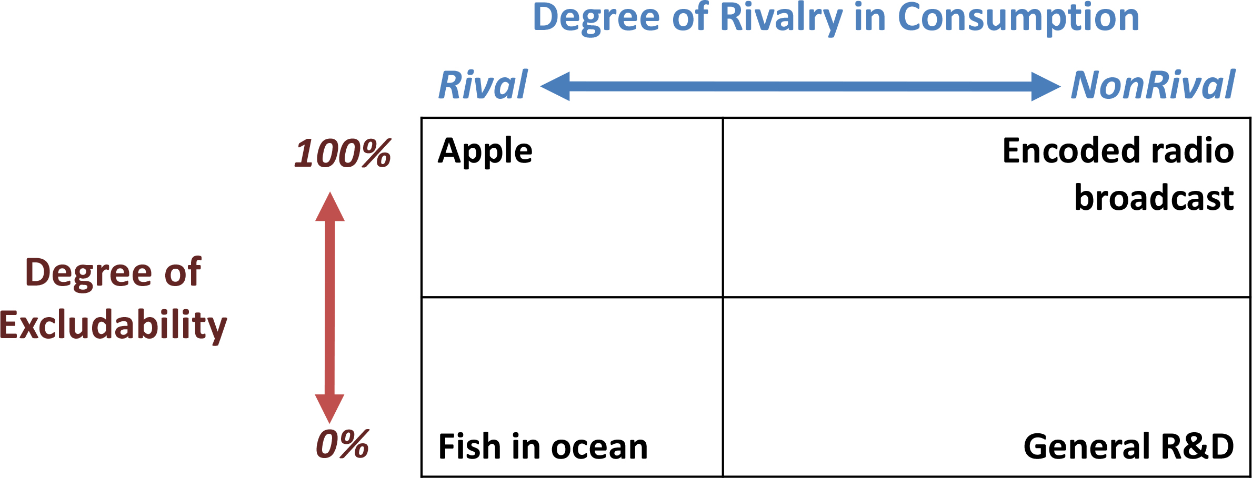
Excludability and Rivalry
The public-/private-good differentiation is seldom clear-cut.
Some economists prefer to classify goods according to their degree of rivalry and excludability.
Access the text alternative for slide images.
Notes:
Highly suggested video: https://www.youtube.com/watch?v=13JOGWzY8kE&t=364s

Slide 16
A NOTE ON MICROECONOMICS
The theorem of “invisible hand” describes an almost utopic situation, a unicorn ☺ It assumes a world in which there is
--perfect competition
--no market failure (the topic of this chapter)
Perfect competition assumes three things:
-many sellers and buyers (each small in the size of market)
-identical (homogenous) goods (everyone sells the same apple)
-no barriers to entry (anyone can enter the market)

Slide 17
A NOTE ON MICROECONOMICS-2
These three assumptions imply that in perfect competition, firms have no market power!
(they have no ability to affect the price, they are price takers)
Because they have no market power, when firms try to maximize utility (and consumers try to maximize satisfaction) we end up in an allocatively efficient outcome: MB=MC
In real life, these assumptions (or at least some of them) do not hold. So we have firms having market power (price makers). Examples of such market structures: oligopolies, monopolistic competition, monopoly
In these markets, we deviate from allocative efficiency. The quantity exchanged in these markets generally leads to MB is greater than MC
Notes:
Elaborate: Think about a negative outcome of perfect competition!
Elaborate: Think about the result of firms’ having market power for consumers and producers!

