Slide 1

ECON 202
FALL 2025-26
MACROECONOMIC THEORY I
COURSE LECTURE NOTES
CHAPTER 4-FINANCIAL MARKETS

Slide 2
THE DEMAND FOR MONEY
What does “money” mean?
  She makes a lot of “money”..versus
  She has a lot of “money”.
In the first use of the term “money”, it means “income”, what you earn from regular work plus interest and dividend earnings.
  Income is a “flow” variable, measured per unit in time (per week, per month, per year)
  Out of your income, you have savings and/or consumption, which are both flow variables
  Other examples: GDP, investment, government spending..

Slide 3
THE DEMAND FOR MONEY
In the second use of the term “money”, it means “wealth”, the total value of all your financial assets net of your financial liabilities.
  Wealth is “stock” variable: you accumulate wealth over time
  Other stock variables: capital stock, debt..
Investment
Savings
Wealth
Capital stock

Slide 4
THE DEMAND FOR MONEY
Money is one of two ways to hold wealth (money versus bonds). A stock variable
Money pays no interest and there are 3 motives for holding money:
  Transactions motive;
  Precautionary motive;
  Speculative motive
The most important motive to hold money is the transactions motive. Accordingly, there are two types of transactions money: currency and checkable (demand) deposits.

Slide 5
THE DEMAND FOR MONEY
Wealth
Money
(non-interest bearing asset)
Bonds
(interest-bearing asset)
How much to hold from each (money vs. bonds) depends on two factors:
  Your transactions level
  The interest rate

Slide 6
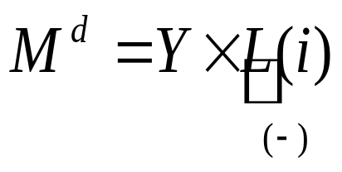
THE DEMAND FOR MONEY
The demand for money function
Here, Y is the nominal (monetary) value of income, L(i) is a negative function if interest rate (i.e. some function of liquidity preference), and M^{d} is the nominal value of quantity of money demanded.
Nominal value of quantity of money demanded is positively related to income, negatively related to interest rate.

Slide 7
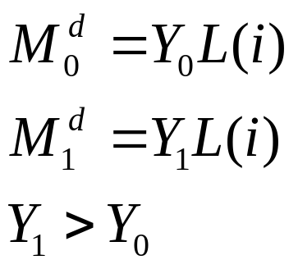
THE DEMAND FOR MONEY
i
M
Along a given money demand function,
for a given income level, an increase in
the interest rate on bonds lowers the
quantity of money demanded;
For a given interest rate, as people’s
incomes increase, their transactions
level increases, and they want to hold
more transactions money to carry out
these transactions.
M₁^{d}
M₀^{d}

Slide 8
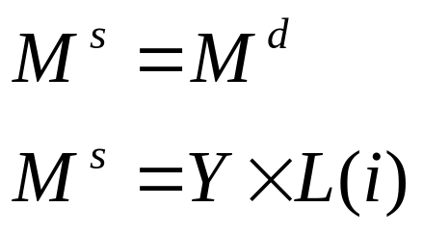
THE MONEY MARKET EQUILIBRIUM
For a money market to exist, we now introduce the MONEY SUPPLY.
For simplicity, we assume that the MONEY SUPPLY is fixed, unless there is a policy change.
Currently, suppose all money is currency (transactions money is only defined as currency)
In money market equilibrium,
That is, for a given income level, quantity of money demanded is equal to quantity of money demanded at some interest rate, i.

Slide 9
THE MONEY MARKET EQUILIBRIUM
Equilibrium at the money market occurs at i₀
Meaning of equilibrium in the money market: there exists a unique interest rate at which the quantity of money people want to hold is exactly equal to the available supply of money.
i
M^{s}
i₀
M^{d}
M ^{s}=M ^{d}
M

Slide 10
CHANGES IN THE EQUILIBRIUM
Increase in people’s monetary value of income
People want to consume more
Increase in transactions demand for money
At original interest rate, there is excess demand for money
The money market is in disequilibrium as quantity of money demanded exceeds quantity of money supplied
i
M^{s}
i₁
i₀
M₁^{d}
M₀^{d}
M ^{s}
M
Excess demand for money

Slide 11
CHANGES IN EQUILIBRIUM
There is excess demand for money;
Since there is only a limited supply of money, people sell their bonds to acquire money in return;
As they sell their bonds, price of bonds decline;
As price of bonds decline, interest rates rise;
Interest rates rise until a new equilibrium is established.
Question: How is there a negative relationship between price of bonds and interest rates? ..

Slide 12
CHANGES IN THE EQUILIBRIUM
Increase in nominal money supply
This can occur via expansionary monetary policy change
At original interest rate, there is excess supply of money
The money market is in disequilibrium as quantity of money supplied exceeds quantity of money demanded
i
M^{s0}
M^{s1}
i₀
i₁
M₀^{d}
M^{s0}
M^{s1}
M
Excess supply of money

Slide 13
CHANGES IN EQUILIBRIUM
There is excess supply of money;
Money supply is more than people want to hold for transactions purposes;
They buy bonds with the excess supply of money;
As they buy bonds, price of bonds starts to increase;
As price of bonds increases, interest rates decline

Slide 14
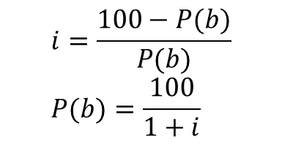
CHANGES IN EQUILIBRIUM
Negative relationship between price of bonds and interest rates:
  Let the face value of a one-year bond is 100 TL (promises to pay in one year);
  Buy the bond for P(b) TL today, then its rate of return in one year is
  As price incerases, interest rate declines, or vice versa.
$$i=\frac{100−P(b)}{P(b)} \\ P(b)=\frac{100}{1+i}$$

Slide 15
CHANGES IN THE MONEY SUPPLY
In our analysis so far, all money is currency;
If the Central Bank wants to change the money supply, it expands or contracts the currency volume.
Most widely used monetary policy tool to change the money supply is the OPEN MARKET OPERATIONS: sale or purchase of government bonds by the Central Bank for the purposes of regulating the money supply in the system
  The Central Bank buys (purchases) bonds at the open market in order to expand the money supply;
  The Central Bank sells bonds at the open market in order to contract the money supply.

Slide 16
CHANGES IN THE MONEY SUPPLY
Monetary policy objective: expand the money supply
After 1 billion TL open market purchase:
Balance Sheet of the CB before the Change
Assets | Liabilities
Bonds | Money (currency)
Balance Sheet of the CB after the Monetary Policy Change
Assets | Liabilities
+1 billion TL of bonds | +1 billion TL of currency
Currency created by the CB to pay for the 1 billion TL worth of bonds from the open market

Slide 17
CHANGES IN THE MONEY SUPPLY
Monetary policy objective: contract the money supply
After 1 billion TL open market sale:
Balance Sheet of the CB before the Change
Assets | Liabilities
Bonds | Money (currency)
Balance Sheet of the CB after the Monetary Policy Change
Assets | Liabilities
- 1 billion TL of bonds | - 1 billion TL of currency
1 billion TL worth of currency withdrawn from the system as people pay for the bonds

Slide 18
THE MONEY SUPPLY
Alternative measures (definitions) of money supply:
M1=currency in circulation+checkable deposits
M2=M1+small denomination time deposits+ saving deposits+ money market deposit accounts
M3=M2+large denomination time deposits (including public deposits)
M2Y=M2+foreign exchange deposits
THROUGHOUT, WHEN WE REFER TO MONEY SUPPLY, WE WILL MEAN M1, THE NARROWEST DEFINITION OF MONEY

Slide 19
THE MONEY SUPPLY
Balance Sheet of the Commercial Banking System
Assets | Liabilities
Loans | Checkable deposits
Bonds
Reserves
Balance Sheet of the Central Bank
Assets | Liabilities
Bonds | Currency
 | Reserves
CENTRAL BANK MONEY = CURRENCY + RESERVES

Slide 20
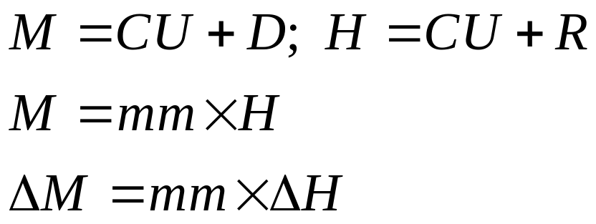
THE MONEY SUPPLY
Currency (CU) Demand Deposits (D)
= Money Supply (M)
= Central Bank Money (CBM) or
High Powered Money (H)
Currency (CU) Reserves (R)

Slide 21
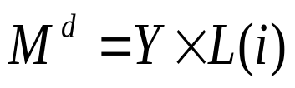
THE MONEY SUPPLY
Wealth
Money
Bonds
Currency
Demand (checkable) deposits

Slide 22
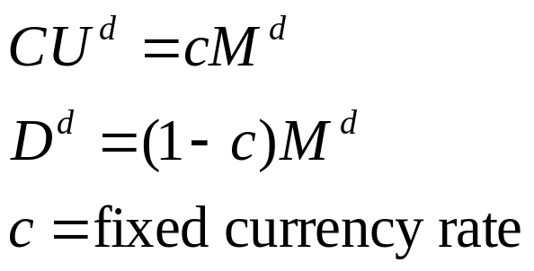
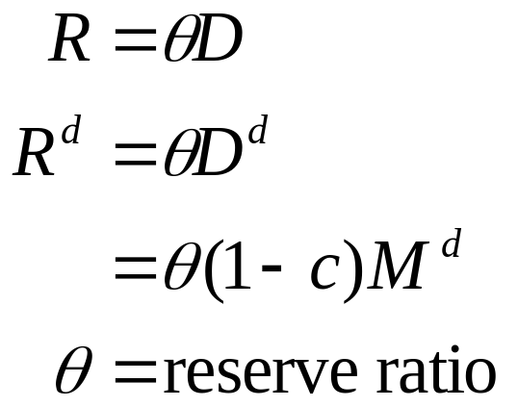
THE MONEY SUPPLY
People hold a fixed fraction (c) of their
money holdings in currency, the rest
(1-c) fraction in demand deposits
R is the bank reserves, R^{d} is the demand for
Reserves, which is a fraction of the total money
demand

Slide 23
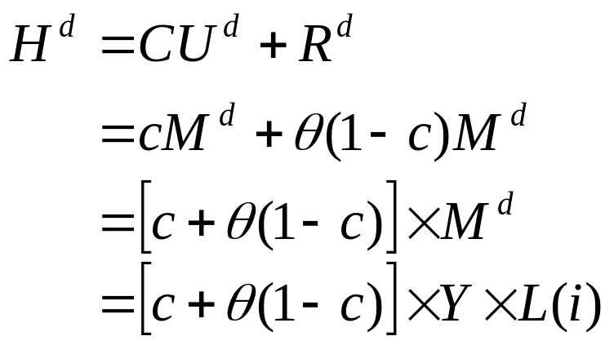
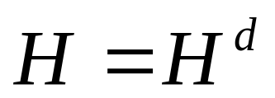
THE MONEY SUPPLY
Demand for Central Bank Money (High Powered Money)
In equilibrium,
H is the supply of CBM, directly controlled by the Central Bank; H^{d} is the demand for the CBM.

Slide 24
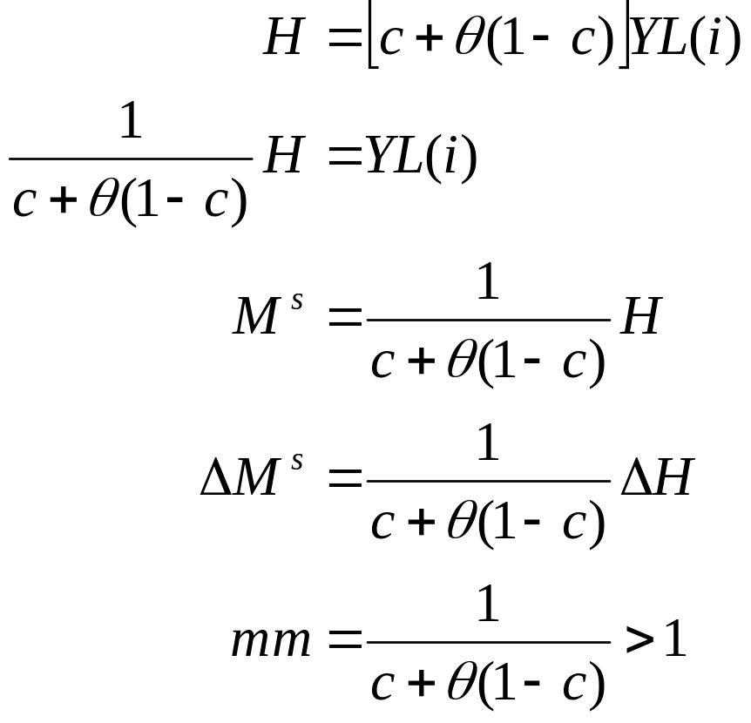

THE MONEY SUPLY
In equilibrium,
Money multiplier

Slide 25
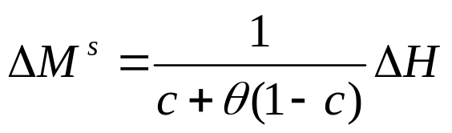
THE MONEY SUPPLY
Given
The Central Bank can affect the money supply by
  Changing the Central Bank Money (by changing reserves)
  Changing the money multiplier (by changing the reserve ratio)
Three major policy tools available to the CB:
  Open market operations (changes the reserves)
  Changing the required reserve ratio (changes the multiplier)
  Changing the discount rate (changes the reserves)

Slide 26
THE MONEY SUPPLY-OMO
The Central Bank’s objective is to increase the money supply:
  To this end, the Central Bank buys (purchases) bonds from the public
  The Central Bank conducts an open market purchase of 1000 TL
  Initially, people put this 1000 TL into their deposits, increasing the bank reserves by 100 TL at first (RRR is 10%)
  However, through the commercial banks’ power of creating money, the increase in money is not limited to this;
  The money multiplier process works as follows:

Slide 27
THE MONEY SUPPLY- OMO
Bank Name | Increase in Deposits | Increase in Reserves | Increase in loans
İş Bank | 1,000 | 100 | 900
Yapı Kredi | 900 | 90 | 810
VakıfBank | 810 | 81 | 729
Ziraat Bank | 729 | 72,9 | 656,1
: | : | : | :
: | : | : | :
Rest of rounds | 6,561 | 656,1 | 5904,9
Totals | 10,000 | 1,000 | 9,000
Initial injection (or, initial withdrawal)=
Change in reserves = Change in Central Bank Money= ΔH=1,000

Slide 28
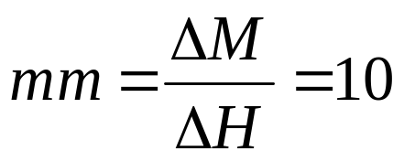
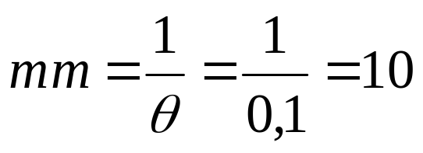
THE MONEY SUPPLY
Change in deposits = Change in Money Supply
=ΔM=10,000
The money multiplier:
Or, with c=0 (people do not hold currency, only demand deposits),
There is no change in currency holdings, change in money supply is due only to the change in deposits.

Slide 29
MONETARY POLICY TOOLS-
OPEN MARKET OPERATIONS
CENTRAL BANK’S BALANCE SHEET
ASSETS | LIABILITIES
Bonds 100 | 20 Reserves
 | 80 Currency
COMMERCIAL BANKS’ BALANCE SHEET
ASSETS | LIABILITIES
Reserves 20 | 100 Deposits
Loans 80
CITIZEN MEHMET’S BALANCE SHEET
ASSETS | LIABILITIES
Deposits 5 | 5 Net Worth
 | 0 Debt

Slide 30
MONETARY POLICY TOOLS-
OPEN MARKET OPERATIONS
Initially, money supply is
M1=currency + deposits = 80 + 100= 180
Reserve ratio is 20%
Now, the Central Bank sells 5 TL worth of bonds to citizen Mehmet via his bank İş Bankası (part of the commercial banking system)
To pay for the bonds, Mehmet withdraws 5 TL from his deposit at İş Bankası
This withdrawal reduces the reserves of İş Bankası by 5 TL
How does this open market sale by the CB affect the money supply?

Slide 31
MONETARY POLICY TOOLS-
OPEN MARKET OPERATIONS
CENTRAL BANK’S BALANCE SHEET
ASSETS | LIABILITIES
Bonds 95 | 15 Reserves
 | 80 Currency
COMMERCIAL BANKS’ BALANCE SHEET
ASSETS | LIABILITIES
Reserves 15 | 95 Deposits
Loans 80
CITIZEN MEHMET’S BALANCE SHEET
ASSETS | LIABILITIES
Deposits 0 | 5 Net Worth
Bonds 5 | 0 Debt

Slide 32
MONETARY POLICY TOOLS-
OPEN MARKET OPERATIONS
However, here something seems to be wrong.
The reserve ratio is given by 20 %, however, in the balance sheet above, reserves of 15 TL is not 20 % of 95 TL deposits
15 TL of reserves can only support 75 TL of deposits (15 TL is 20% of only 75 TL)
Hence, deposits and loans must be reduced accordingly.

Slide 33
MONETARY POLICY TOOLS-
OPEN MARKET OPERATIONS
CENTRAL BANK’S BALANCE SHEET
ASSETS | LIABILITIES
Bonds 95 | 15 Reserves
 | 80 Currency
COMMERCIAL BANKS’ BALANCE SHEET
ASSETS | LIABILITIES
Reserves 15 | 75 Deposits
Loans 60
CITIZEN MEHMET’S BALANCE SHEET
ASSETS | LIABILITIES
Deposits 0 | 5 Net Worth
Bonds 5 | 0 Debt

Slide 34
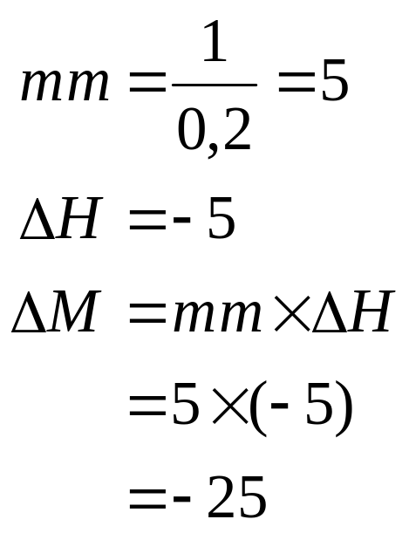
MONETARY POLICY TOOLS-
OPEN MARKET OPERATIONS
New money supply after the open market sale:
  M1’=currency+ deposits = 80+ 75= 155
ΔM=M1’-M1=155-180=-25

Slide 35
MONETARY POLICY TOOLS-
CHANGE THE RESERVE REQUIREMENT RATIO
Initially, rrr= 20%
M1= currency+deposits=100+500=600
CENTRAL BANK’S BALANCE SHEET
ASSETS | LIABILITIES
Bonds 200 | 100 Reserves
 | 100 Currency
COMMERCIAL BANKS’ BALANCE SHEET
ASSETS | LIABILITIES
Reserves 100 | 500 Deposits
Loans 400

Slide 36
MONETARY POLICY TOOLS-
CHANGE THE RESERVE REQUIREMENT RATIO
After the policy change, rrr’= 12,5%
M1= currency+deposits=100+800=900
CENTRAL BANK’S BALANCE SHEET
ASSETS | LIABILITIES
Bonds 200 | 100 Reserves
 | 100 Currency
COMMERCIAL BANKS’ BALANCE SHEET
ASSETS | LIABILITIES
Reserves 100 | 800 Deposits
Loans 700

Slide 37
MONETARY POLICY TOOLS-
CHANGE THE RESERVE REQUIREMENT RATIO
Increase in the money supply is 300 TL
A drop in rrr allowed the commercial banks to accept a higher volume of deposits against the SAME volume of reserves as before (same ΔH but different mm)
  With the fall in rrr, the same amount of reserves now support a higher amount of deposits!..
A fall in rrr signals an expansion in money supply
Conversely, a rise in rrr implies a contraction in money supply

Slide 38
MONETARY POLICY TOOLS-
CHANGE THE DISCOUNT RATE
Case 1: No bank borrowing from the CB
M1= currency+deposits=80+400=480
CENTRAL BANK’S BALANCE SHEET
ASSETS | LIABILITIES
Bonds 160 | 80 Reserves
 | 80 Currency
COMMERCIAL BANKS’ BALANCE SHEET
ASSETS | LIABILITIES
Reserves 80 | 400 Deposits
Loans 320

Slide 39
MONETARY POLICY TOOLS-
CHANGE THE DISCOUNT RATE
Case 2: Lower discount rate. Banks borrow 20 TL from the CB.
M1’= currency+deposits=80+500=580
CENTRAL BANK’S BALANCE SHEET
ASSETS | LIABILITIES
Bonds 160 | 100 Reserves
Loans to commercial banks 20 | 80 Currency
COMMERCIAL BANKS’ BALANCE SHEET
ASSETS | LIABILITIES
Reserves 100 | 500 Deposits
Loans 420 | 20 Owed to the CB

Slide 40
MONETARY POLICY TOOLS
EXPANSIONARY MONETARY POLICY
  Open market purchase (increases reserves)
  A fall in reserve requirement ratio (increases the money multiplier)
  A fall in discount rate (increases reserves)
Increase in money supply
CONTRACTIONARY MONETARY POLICY
  Open market sales (decreases reserves)
  A rise in reserve requirement ratio (decreases the money multiplier)
  A rise in discount rate (decreases reserves)
Decrease in money supply

