Slide 1
CHAPTER 2
The Production Possibility Model, Trade, and Globalization
© McGraw Hill LLC. All rights reserved. No reproduction or distribution without the prior written consent of McGraw Hill LLC.

Slide 2
Learning Objectives
Demonstrate trade-offs with a production possibility curve.
Relate the concepts of comparative advantage and efficiency to the production possibility curve.
State how, through comparative advantage and trade, countries can consume beyond their individual production possibilities.
Explain how globalization is guided by the law of one price.

Slide 3
The Production Possibility Model (1 of 2)
A production possibility model conveys the trade-offs society faces.
The production possibility model can be presented both in a table and in a graph.
Through specialization and trade, individuals, firms, and countries can achieve greater levels of output than they could otherwise achieve.

Slide 4
The Production Possibility Model (2 of 2)
A production possibility curve (PPC) is a curve measuring the maximum combination of outputs that can be obtained from a given number of inputs.
It gives you a visual picture of the trade-off embodied in a decision.
A PPC is created from a production possibility table by mapping the table in a two-dimensional graph.

Slide 5
Application: A Production Possibility Table for Grades in Economics and History
The following content is arranged like a table.
History
Economics
Hrs of Study | Grade
20 | 98
18 | 94
10 | 78
4 | 66
0 | 58
Hrs of Study | Grade
0 | 40
2 | 46
10 | 70
16 | 88
20 | 100

Slide 6
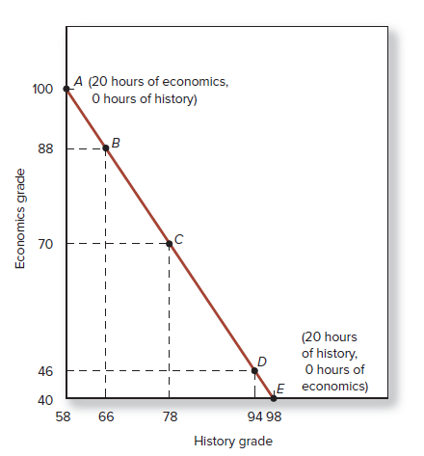
Application: A Production Possibility Curve
A PPC demonstrates:
There is a limit to what you can achieve, given existing institutions, resources, and technology.
Every choice you make has an opportunity cost.
Access the text alternative for slide images.

Slide 7
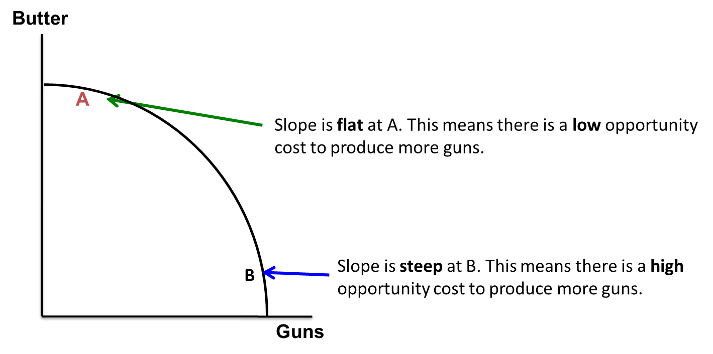
Increasing Opportunity Costs of the Tradeoff
The principle of increasing marginal opportunity cost tells us that opportunity costs increase the more you concentrate on the activity.
In order to get more of something, generally one must give up ever increasing quantities of something else.
Access the text alternative for slide images.

Slide 8
Application: A Production Possibility Table for Guns and Butter
The table shows the trade-of between production of guns and butter.
% of Resources Devoted to Guns | Number of Guns | % of Resources Devoted to Production of Butter | Pounds of Butter | Row
0 | 0 | 100 | 15 | A
20 | 4 | 80 | 14 | B
40 | 7 | 60 | 12 | C
60 | 9 | 40 | 9 | D
80 | 11 | 20 | 5 | E
100 | 12 | 0 | 0 | F
The following content is arranged like a table.

Slide 9
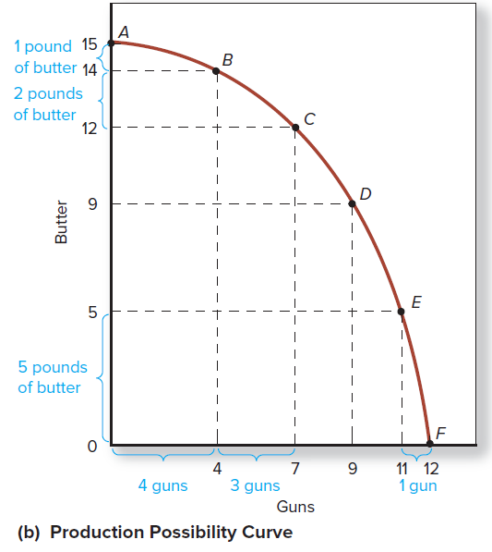
Application: A Production Possibility Curve for Guns and Butter
Opportunity cost of choosing guns over butter increases as you increase the production of guns.
Production possibilities curves typically bow outward because some resources are better suited for certain kinds of goods than other kinds of goods.
Access the text alternative for slide images.

Slide 10
Comparative Advantage
The reason we must give up more and more butter as we produce more guns is that some resources are relatively better suited to producing guns, while others are relatively better suited to producing butter.
A resource has a comparative advantage if it is better suited to the production of one good than to the production of another good.

Slide 11
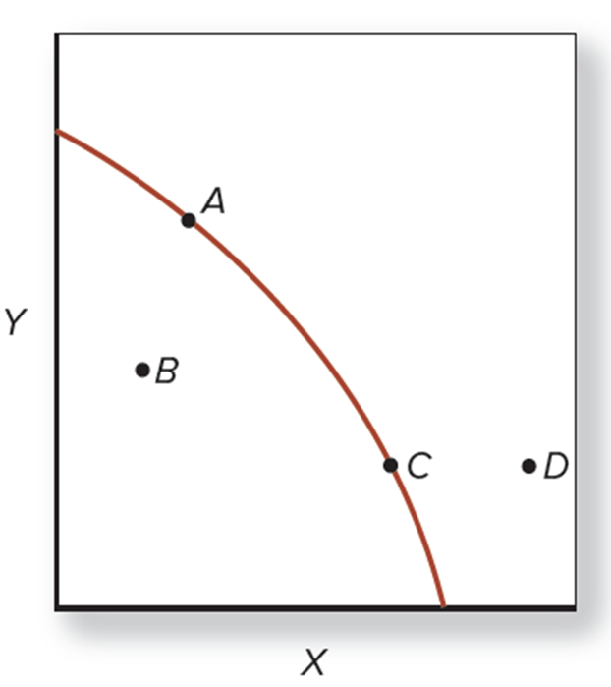
Efficiency
Productive efficiency is achieving as much output as possible from a given amount of inputs or resources.
Inefficiency is getting less output from inputs that, if devoted to some other activity, would produce more output.
Points A and C are points of efficiency.
Point D is unattainable with given amounts of inputs.
Point B is a point of inefficiency.
Access the text alternative for slide images.

Slide 12
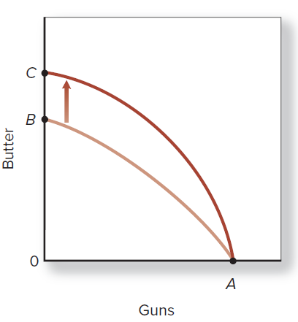
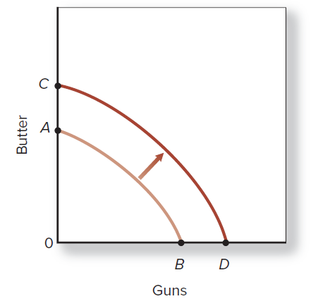
Efficiency and Technological Change
Neutral technological increase or an increase in resources.
Biased technological increase.
Access the text alternative for slide images.

Slide 13
Distribution and Productive Efficiency
The productive possibility curve focuses on efficiency and ignores distribution.
If a method of production will change income distribution, we cannot determine if that method is efficient or not.
    Efficiency has meaning when analyzing a particular goal.
In our society, most people prefer more to less, and many policies have relatively small distribution effects.

Slide 14
Trade and Comparative Advantage
The PPC is bowed outward because individuals specialize in the production of goods for which they have a comparative advantage.
For a society to produce on its PPC, individuals must produce those goods for which they have a comparative advantage and trade for other goods.
According to Adam Smith, humankind’s proclivity to trade leads to individuals using their comparative advantage.

Slide 15
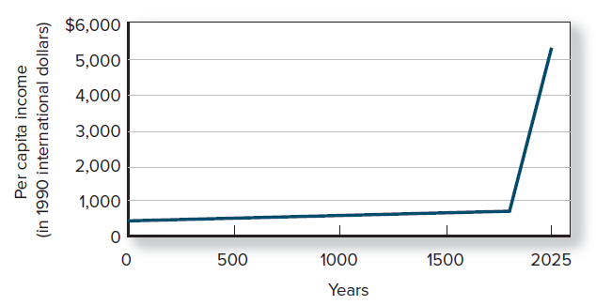
Markets, Specialization, and Growth
Growth in per capita income during the past 1,700 years.
Access the text alternative for slide images.
Sources: OECD/Angus Maddison 1995, Monitoring the World Economy, OECD Publishing, Paris; Angus Maddison, “Poor until 1820,” The Wall Street Journal, January 11, 1999; and author extrapolations.

Slide 16
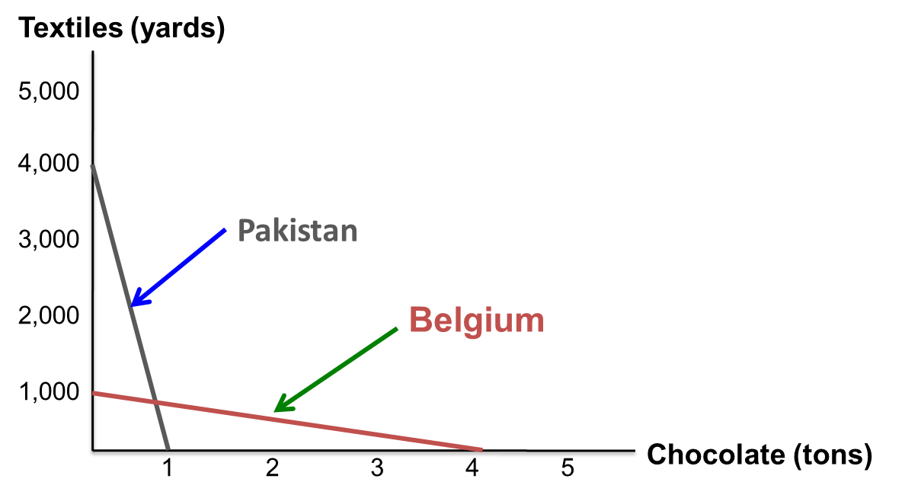
The Benefits from Trade (1 of 2)
When people freely enter into trade, both parties can be expected to benefit from trade.
Without trade, each country can only consume those combinations of goods along their PPCs.
Access the text alternative for slide images.

Slide 17
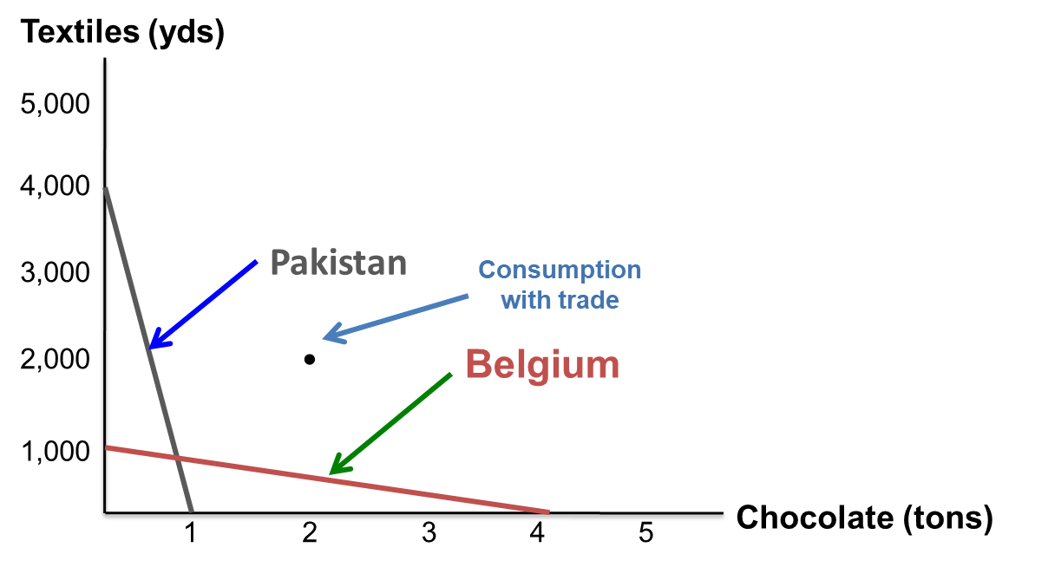
The Benefits from Trade (2 of 2)
Why should Pakistan specialize in textiles and Belgium specialize in chocolates?
If each country specializes according to comparative advantage and trades, they can consume beyond their “no-trade” PPCs.
Access the text alternative for slide images.

Slide 18
Application: U.S. Textile Production and Trade
Two hundred years ago, the United States had a comparative advantage in textile production.
Now, countries with cheaper labor, such as Bangladesh, have the comparative advantage in textiles.
The gains from trade are higher wages for Bangladesh workers and lower-priced cloth for U.S. consumers.

Slide 19
Globalization
Globalization is the increasing integration of economies, cultures, and institutions across the world.
Globalization has two effects on firms:
    A positive effect: Globalization provides larger markets than the domestic economy.
    A negative effect: The global economy increases the number of competitors for the firm.

Slide 20
Exchange Rates and Comparative Advantage
The U.S. comparative advantage in innovation results in higher wages in the United States.
As industries mature, they move to low-wage areas.
In order to regain our comparative advantage, the U.S. wage premium will have to decline. The U.S. exchange rate will likely decline or there will be large increases in foreign wages-or both.
Exports will then be cheaper for foreigners and foreign products imported will be more expensive.

Slide 21
The Law of One Price
The law of one price states that wages of workers in one country will not differ significantly from the wages of (equal) workers in another institutionally similar country.
If the U.S. loses its comparative advantage based on technology and institutional structure, U.S. wages will decrease relative to wages in many other countries.
The reality is that the U.S. has been living better than it could have otherwise precisely because of trade.

Slide 22
Application: A Production Possibility Curve - Text Alternative
Return to parent-slide containing images.
The horizontal axis ranges from 58 through 98. The vertical axis ranges from 40 through 100.
The data is as follows:
The curve decreases from (58, 100) at A (20 hours of economics, 0 hours of history) to (98, 40) at E (20 hours of history, 0 hours of economics) through (66, 88) at B, (78, 70) at C, and (94, 46) at D.
Note: All data is approximate.
Return to parent-slide containing images.

Slide 23
Increasing Opportunity Costs of the Tradeoff - Text Alternative
Return to parent-slide containing images.
The graph plots a concave down curve that falls with increasing steepness from the vertical axis to the horizontal axis. The curve falls through two points, A at the top and B at the bottom.
Point A is labeled, slope is flat at A. This means there is a low opportunity cost to produce more guns.
Point B is labeled, slope is steep at B. This means there is a high opportunity cost to produce more guns.
Return to parent-slide containing images.

Slide 24
Application: A Production Possibility Curve for Guns and Butter - Text Alternative
Return to parent-slide containing images.
The horizontal axis ranges from 0 through 12. The vertical axis ranges from 0 through 15.
On horizontal axis 0 through 4 represents 4 guns, 4 through 7 represents 3 guns, and 11 through 12 represents 1 gun. On vertical axis 0 through 5 represents 5 pounds of butter, 12 through 14 represents 2 pounds of butter, and 14 through 15 represents 1 pound of butter.
The data is as follows:
The curve decreases from (0, 15) at A to (12, 0) at F through (4, 14) at B, (7, 12) at C, (9, 9) at D, and (11, 5) at E.
Note: All data is approximate.
Return to parent-slide containing images.

