Slide 1
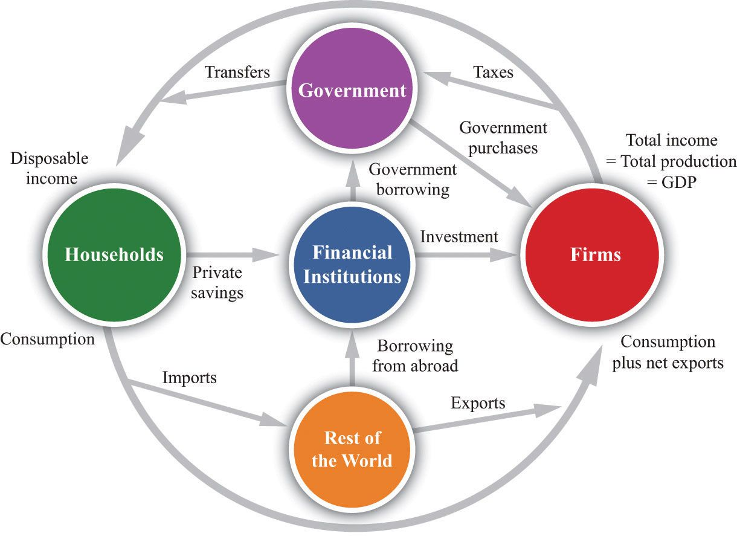
ECON 202
MACROECONOMIC THEORY I
FALL 2025-26
COURSE LECTURE
GOODS MARKET AND THE SHORT-RUN ANALYSIS

Slide 2
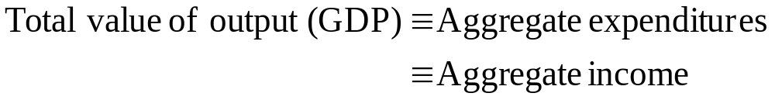
THE COMPOSITION OF GDP
NATIONAL INCOME IDENTITY

Slide 3
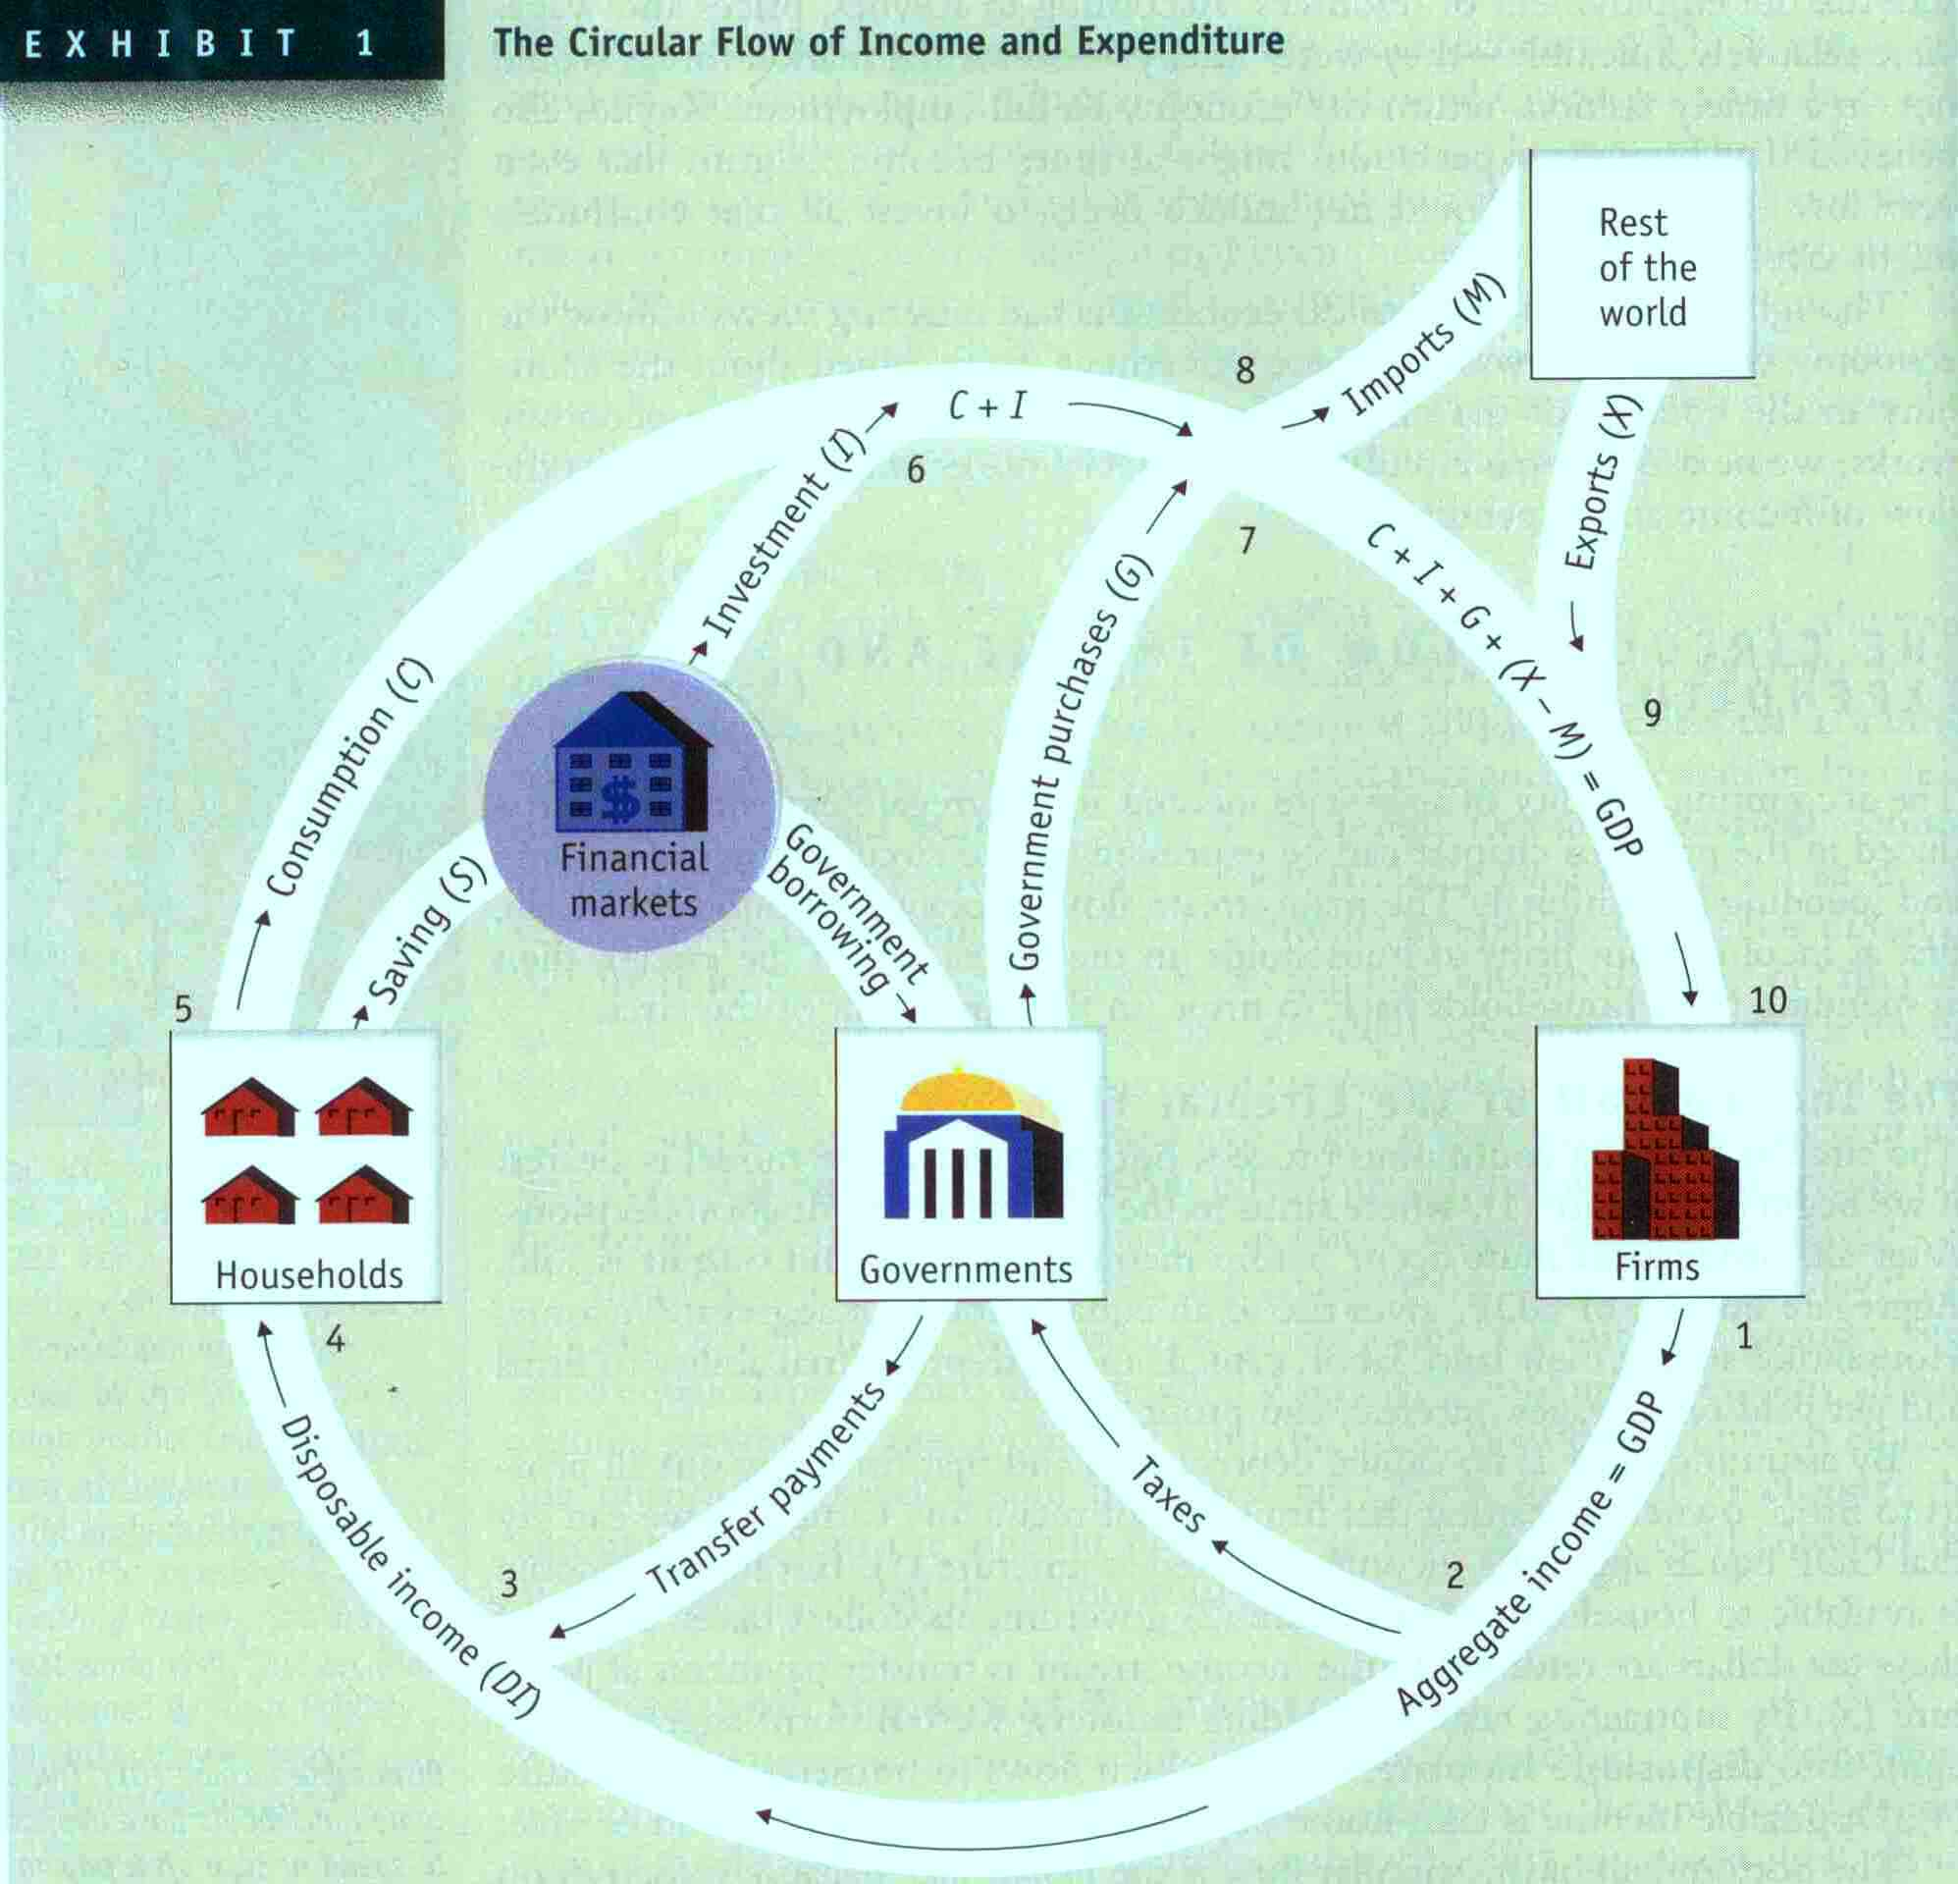
McEachern, W. Economics, A Contemporary Introduction, 4e, SW Publishing, 1995.

Slide 4
THE COMPOSITION OF GDP
Consumption (C)—consists of goods and services purchased directly by consumers, anything from food to airline tickets, tourism, new cars, etc. Consumption makes up for the largest share in aggregate expenditures.
Investment (I)—also called the fixed business investment. It is the sum of non-residential and residential investment
  Non-residential investment is the purchase of new machinery, equipment, plants by businesses
  Residential investment is the purchase of new houses and apartment buildings

Slide 5
THE COMPOSITION OF GDP
Government spending (G)—includes purchases of goods and services by central government and local municipalities. The purchases may range from airplanes for the government officials to office supplies.
  The G does NOT include government transfers, such as Social Security payments or unemployment insurance. WHY NOT? Because such payments by the government DOES NOT GENERATE INCOME for anyone by production of goods and services. By making a transfer, the government does not purchase any goods or services hence generate any income.

Slide 6
THE COMPOSITION OF GDP
So far, C+I+G gives us the domestic expenditures on goods and services (domestic demand for all goods).
From C+I+G, we subtract imports, M, purchases of foreign goods and services by domestic consumers, businesses and government. We subtract M because imported goods are produced elsewhere, they do not generate income domestically (domestic demand for domestically produced goods).
To C+I+G-M, we add exports, X, purchases of domestically produced goods and services by foreigners. Why? Because exported goods are produced domestically and they generate income to someone domestically (aggregate demand-both foreign and domestic- for domestically produced goods).

Slide 7
THE COMPOSITION OF GDP
The difference between exports and imports is the NET EXPORTS (NX)=X-M or the trade balance
If X>M, then the country runs a trade surplus
If X<M, then the country runs a trade deficit
If X=M, there is trade balance

Slide 8
McEachern, W. Economics, A Contemporary Introduction, 4e, SW Publishing, 1995.

Slide 9
THE COMPOSITION OF GDP
Question: What if, in a given year, the value of production of goods and services exceed that year’s sales (expenditures)?
Answer: The goods that are unsold are added to the inventory, which is part of investment, I.
  This way, the upper half is always equivalent to the lower half.
The same logic works for the case where production is less than the expenditures or sales
  In that case, there is a decrease in inventories, or there is negative inventory investment, which is subtracted from the total investment, I.

Slide 10
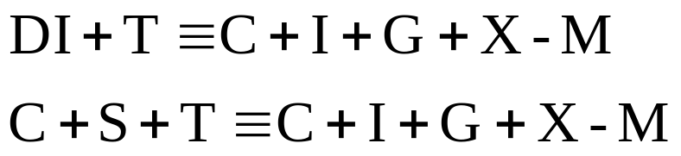

THE COMPOSITION OF GDP
In the lower half of the circular flow, aggregate income is disposable income plus net taxes (taxes net of transfers)
As given in the circular flow, aggregate income arising form the production equals the aggregate expenditure on that production
That is,
Subtract C from both sides, and add M to both sides,
Leakages=Injections

Slide 11
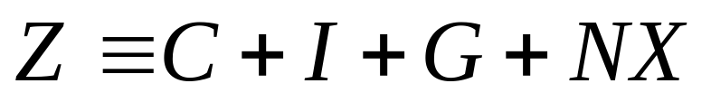
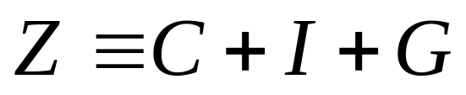
COMPONENTS OF AGGREGATE DEMAND
Aggregate demand, Z, is defined as
Assume a closed economy, where X=0 and M=0 , then the aggregate demand is

Slide 12
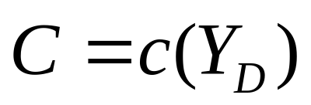
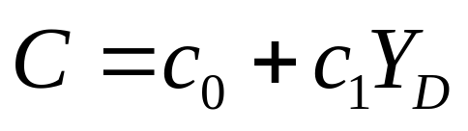
COMPONENTS OF AGGREGATE DEMAND
CONSUMPTION (C): Consumption depends on many factors, but first and foremost it depends on disposable income, Y_{D} (=Y-T):
Consumption function is given by
This consumption function captures the short-run behavior of consumers. Let the functional form be given by (a linear function)

Slide 13
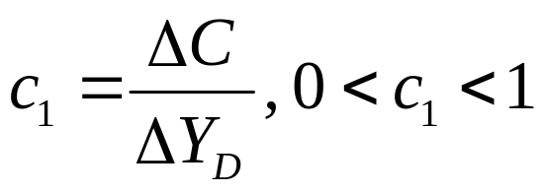
COMPONENTS OF AGGREGATE DEMAND
c₀ : what people would consume if their disposable income were equal to zero.
c₁ : marginal propensity to consume (out of disposable income)
The marginal propensity to consume indicates that a 1 unit increase in disposable income leads to a c₁ unit increase in consumption

Slide 14
COMPONENTS OF AGGREGATE DEMAND
Plot of the consumption function:
C
Slope of the consumption function
is the MPC or c₁
c₀
Y_{D}

Slide 15
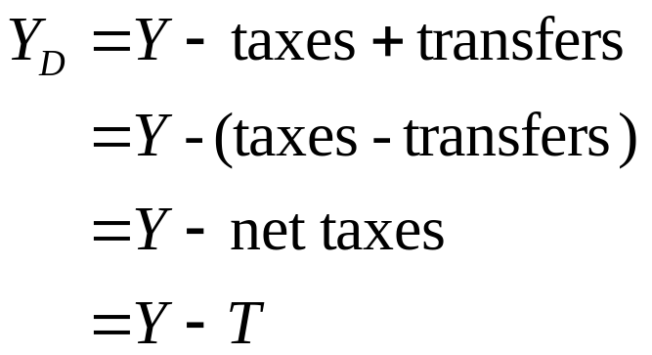
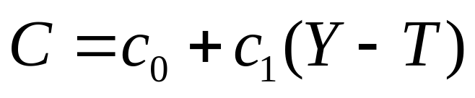
COMPONENTS OF AGGREGATE DEMAND
What is disposable income?
Express C as a function of aggregate income, Y:

Slide 16
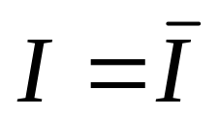
COMPONENTS OF AGGREGATE DEMAND
INVESTMENT (I): For the time being, investment is exogenously given and a constant value,
GOVERNMENT SPENDING (G): Together with T, the net taxes, G represents the government’s fiscal policy, the choice of spending and taxing by the government. The fiscal policy will be exogenous, and G and T are constant values.

Slide 17
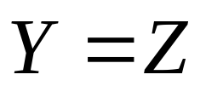
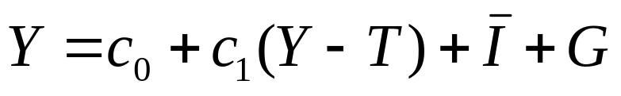
EQUILIBRIUM IN THE GOODS MARKET
Equilibrium in the goods market occurs at the equilibrium of aggregate supply of output and aggregate demand
There exists a unique Y which solves the above equality.
Now, solve for this Y (aggregate income which makes it possible to have equilibrium in the goods market)
Equilibrium Condition in the goods market

Slide 18
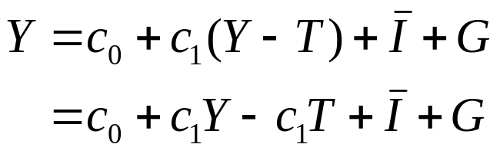
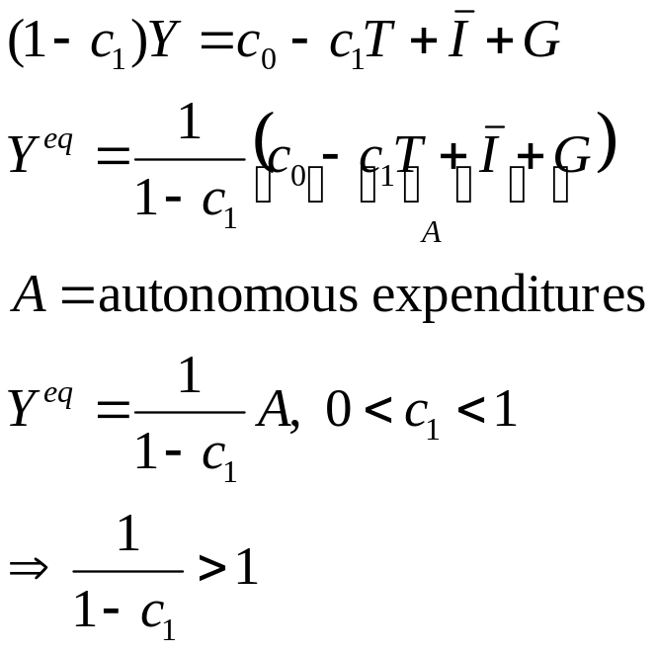
EQUILIBRIUM IN THE GOODS MARKET

Slide 19
EQUILIBRIUM IN THE GOODS MARKET
Graphical representation of the goods market equilibrium
Z,Y
Y
45 degree line
Z
Y^{eq}
Aggregate demand
A
Equilibrium point in goods market
Y=Z
Y^{eq}
Income, Y

Slide 20
EQUILIBRIUM IN THE GOODS MARKET
Graphical representation of the goods market equilibrium
Z,Y
(45 degree line)
Y
Z >Y
Z
Y^{eq}
Z< Y
A
Y¹
Y^{eq}
Y²
Income, Y

Slide 21
EQUILIBRIUM IN THE GOODS MARKET
Equilibrium in the goods market occurs where Y=Z ;
If Z>Y,
  It means that aggregate expenditures (or sales) are greater than aggregate supply of output at given income level;
  Then, firms reduce inventories to meet the high sales, and increase output;
If Z<Y,
  It means that aggregate expenditures (sales) are smaller than aggregate supply of output at given income level;
  Then, firms accumulate inventories; as they accumulate inventories, they reduce output

Slide 22


EQUILIBRIUM IN THE GOODS MARKET
Now suppose that there is an increase in any one of the components of A, the autonomous expenditures
Let’s say that there is an increase in government spending G by
Then, since everything else remains the same,
Then, from the equilibrium output Y^{eq}

Slide 23
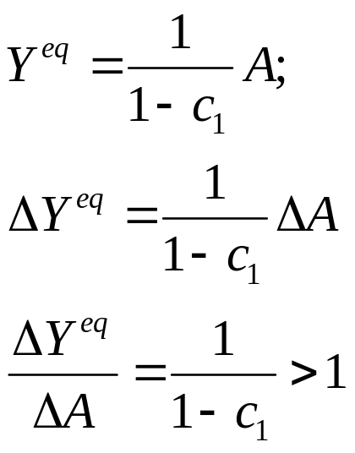
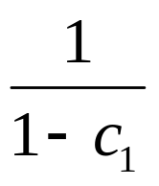
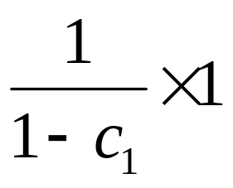
EQUILIBRIUM IN THE GOODS MARKET
is called the
Simple Multiplier
This means that for a 1 unit increase in A (autonomous expenditures),
equilibrium output will increase by

Slide 24
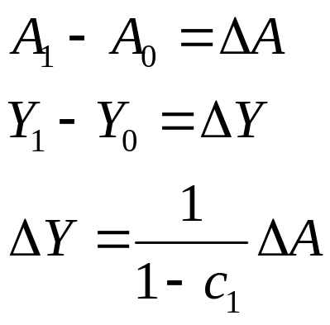
THE SIMPLE MULTIPLIER
Graphical representation of the simple multiplier
Z,Y
Y
Z₁
Z₀
A₁
A₀
Y₀
Y₁
Income, Y

Slide 25
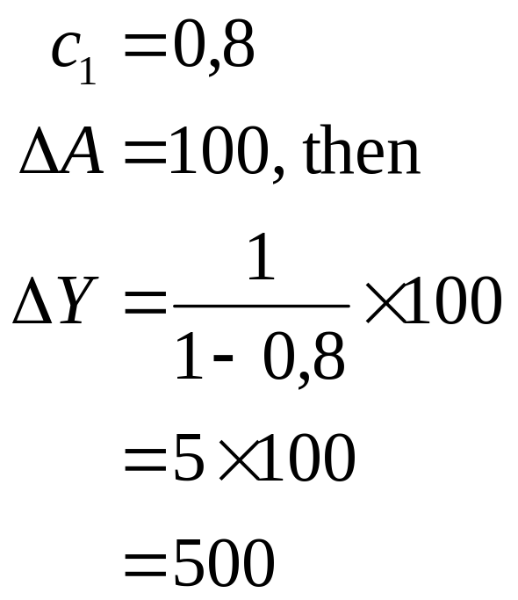
THE SIMPLE MULTIPLIER
For example,
If A increases by 100 units, Y in eqm. increases by 500 units..

Slide 26


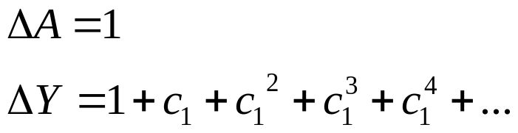
THE SIMPLE MULTIPLIER
The idea of the multiplier
c₁
Z,Y
c₁
Y
Z₁
Z₀
1
1
A₁
A₀
Y₀
Y₁
Income, Y
Notes:
A 1 unit increase in aggregate demand leads to a 1 unit increase in output, 1 unit increase in income
A 1 unit increase in income leads to a c1 unit increase in C and AD and a c1 unit increase in output and income
A c1 unit increase in income leads to a c1^2 unit increase in C and AD and a c1^2 unit increase in output and income
A c1^2 unit increase in income leads to a c1^3 unit increase in C and AD and c1^3 unit increase in output and income....

Slide 27
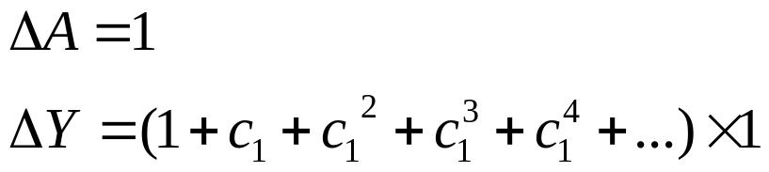
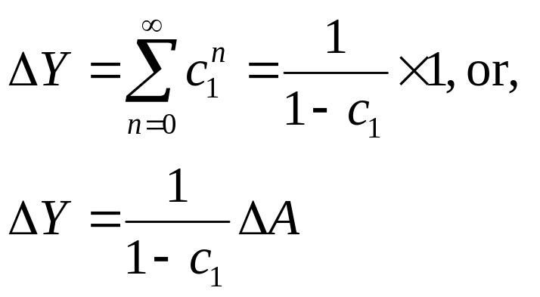
THE SIMPLE MULTIPLIER
This is the sum of an infinite geometric series, then
in general

Slide 28
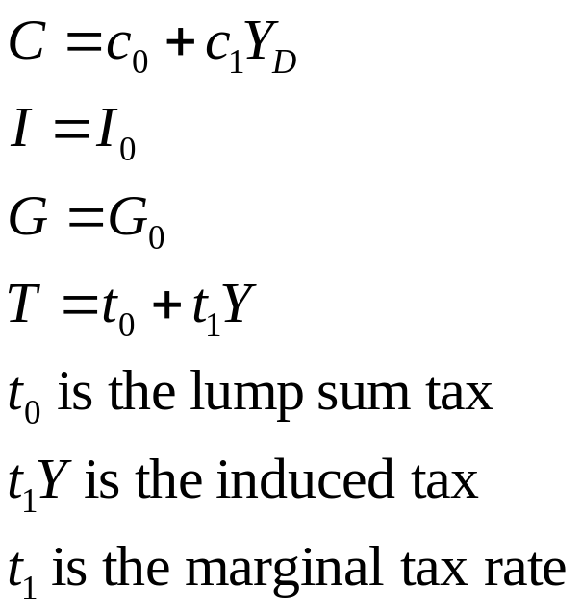
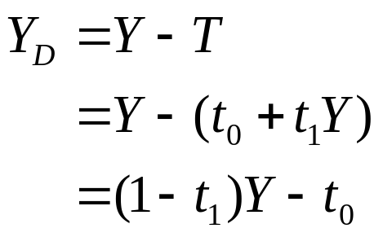
THE MULTIPLIER
Let

Slide 29
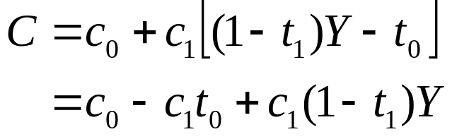
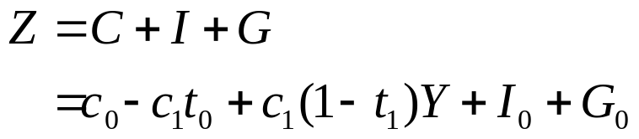
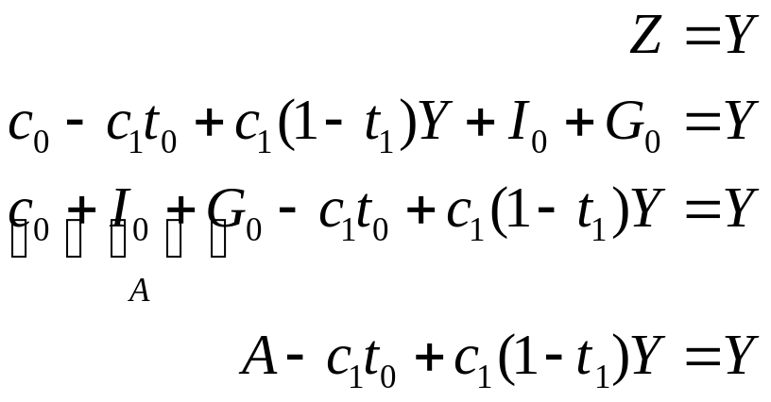
THE MULTIPLIER
In equilibrium,

Slide 30
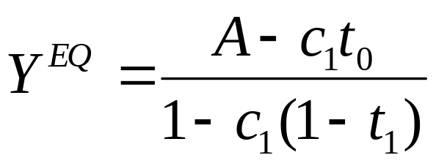
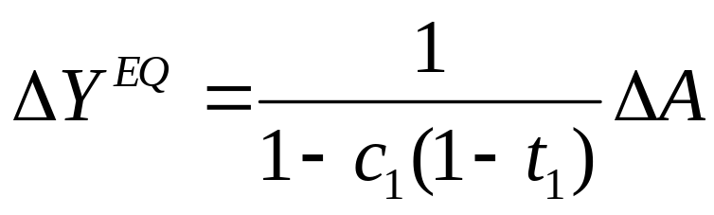
THE MULTIPLIER
As before, solve for Y in equilibrium;
Changes in autonomous expenditures A, ∆A:
Here, the marginal tax rate affects the magnitude of the multiplier.

Slide 31
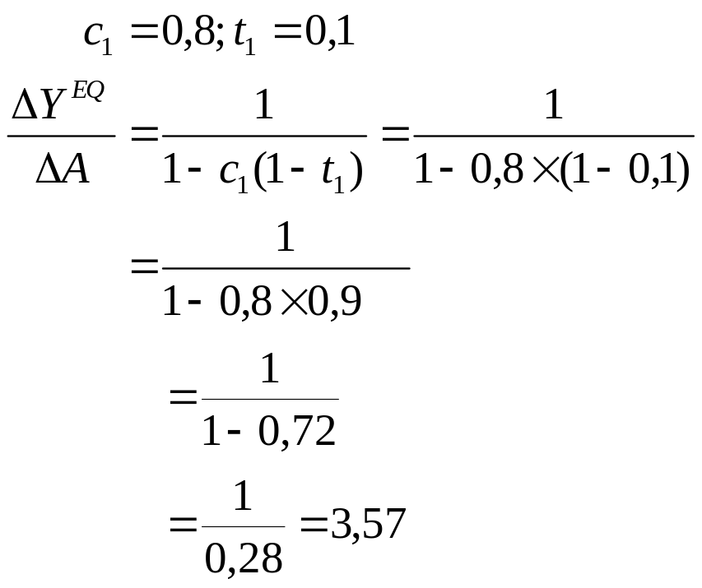
THE MULTIPLIER
Let
Then, for a 100 TL increase in G, equilibrium Y increases by 3,57x100 = 357 TL

Slide 32
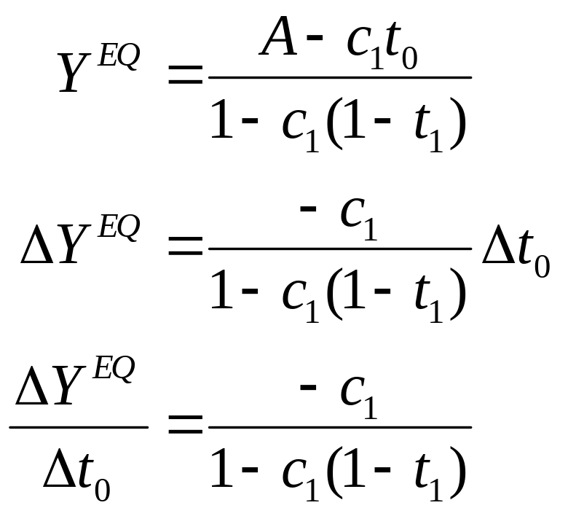
THE MULTIPLIER
Changes in autonomous tax, t₀ : ∆t₀
The Simple Tax Multiplier

Slide 33
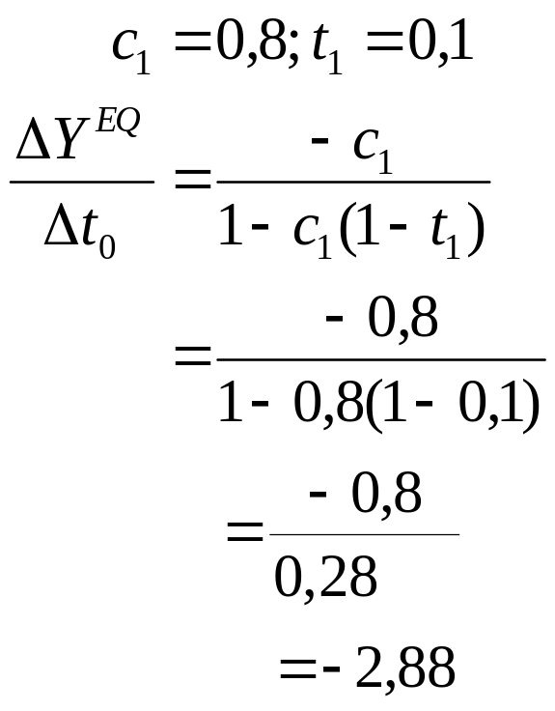
THE MULTIPLIER
Let
For a 100 TL increase in autonomous (lump sum) tax, equilibrium Y decreases by 288 TL

Slide 34
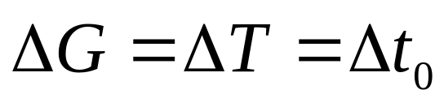
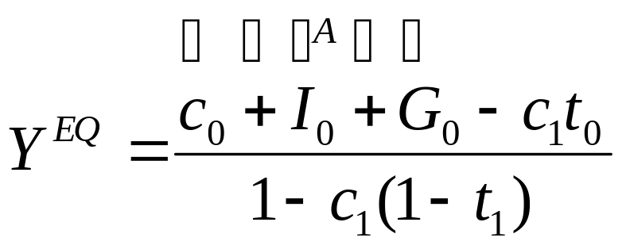
THE MULTIPLIER
Balanced budget multiplier:
Government may decide to change G and lump sum tax simultaneously by the same amount, so that the budget balance remains the same:
Then, recall

Slide 35
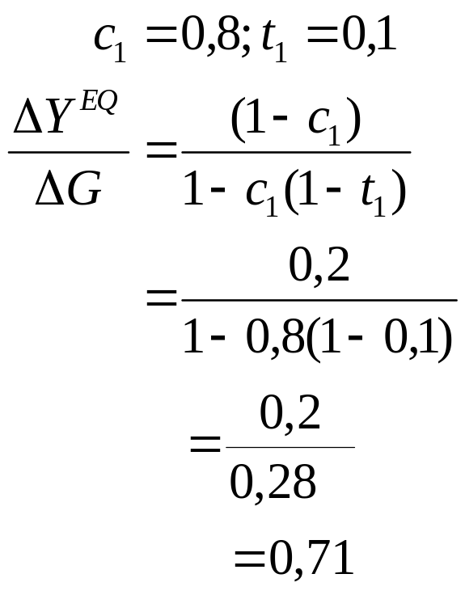
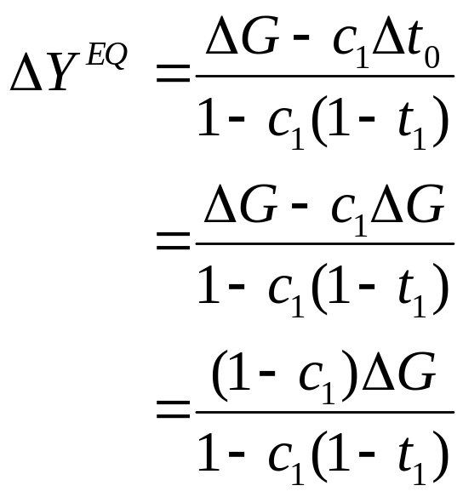
THE MULTIPLIER
A 100 TL increase in both G and lump sum tax will lead to a
71 TL increase in equilibrium Y.

Slide 36
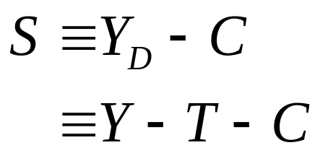
INVESTMENT EQUALS SAVING
So far, we have constructed the equilibrium in the goods market as the equality of production and demand for goods.
Alternatively, equilibrium in the goods market can also be represented by another identity, saving equals investment..
Private saving (S) by households is defined as

Slide 37
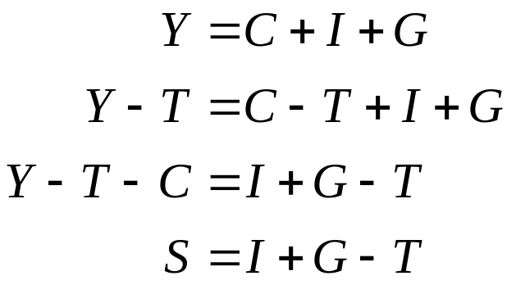
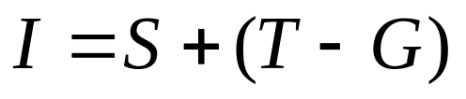
INVESTMENT EQUALS SAVING
Equilibrium in the goods market:
Or, equivalently;
The left-hand side is investment
The right-hand side is private saving plus public saving

Slide 38
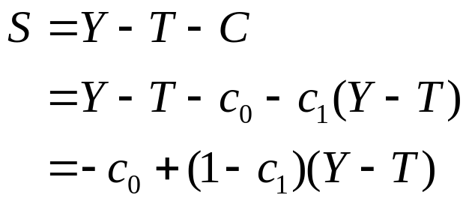
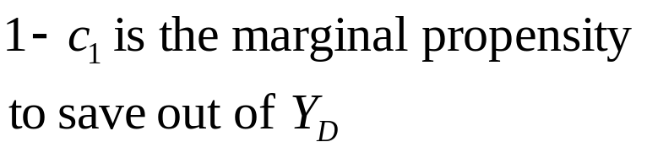
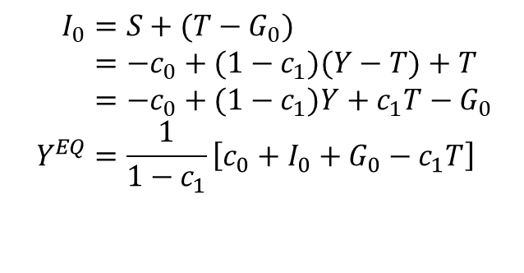
INVESTMENT EQUALS SAVING
Alternative way of finding the equilibrium income:
In equilibrium in the goods market;
$$I_{0}=S+(T−G_{0}) \\ =−c_{0}+(1−c_{1})(Y−T)+T−G_{0} \\ =−c_{0}+(1−c_{1})Y+c_{1}T−G_{0} \\ Y^{EQ}=\frac{1}{1−c_{1}}\left[c_{0}+I_{0}+G_{0}−c_{1}T\right]$$

Slide 39
INVESTMENT EQUALS SAVING
Plot of the saving function:
S
Slope of the saving function
is the MPS or 1-c₁
Y_{D}
-c₀

Slide 40
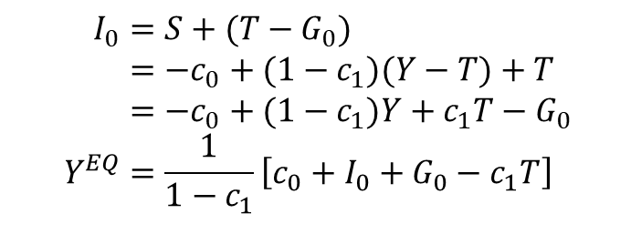
INVESTMENT EQUALS SAVING
Alternative way to show the goods market equilibrium:
S,I
Total saving function
$$I_{0}=S+(T−G_{0}) \\ =−c_{0}+(1−c_{1})(Y−T)+T−G_{0} \\ =−c_{0}+(1−c_{1})Y+c_{1}T−G_{0} \\ Y^{EQ}=\frac{1}{1−c_{1}}\left[c_{0}+I_{0}+G_{0}−c_{1}T\right]$$
I₀
Y^{EQ}
Y
-c₀ +c₁ T-G

Slide 41
THE PARADOX OF THRIFT
Question: Is saving more always beneficial?
Let, at a given level of income, people decide to save more exogenously.
In other words, people decrease c₀ and hence decrease consumption exogenously, letting them to save more at a given disposable income level.
The following graph shows the ultimate effects on output, income and saving :

Slide 42

THE PARADOX OF THRIFT
Increase in saving by a decrease in c₀ :
S,I
At equilibrium,
I=S+T-G
People save more at
initial income level
I₀
$$↓C+\overline{I}+G=Y↓$$
Y^{EQ’}
Y^{EQ}
Y
-c’₀ +c₁ T-G
At the new eqm. income drops;
Saving level is the same as before
-c₀ +c₁ T-G

Slide 43
THE PARADOX OF THRIFT
In the short run,
  Exogenously higher savings, which implies exogenously lower consumption;
  Through the multiplier effect in goods market, there is lower income and output
Higher savings may lead to a recession in output in the short run;
Since equilibrium income is now lower, an attempt to increase savings actually led to no change in savings (this is the paradox);
Also, in the short run model that we have, investment demand does not change in the short run.

