Slide 1
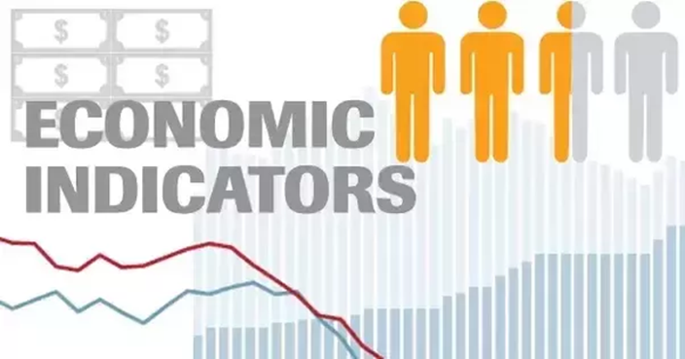
Selected Macroeconomic Variables, Turkey
METU Economics
ECON 202
Macroeconomic Theory I
Fall 2025

Slide 2
Measuring GDP
The aim of national accounting is to obtain a measure of the total quantity of goods and services produced for the market in a given country over a given period of time.
Gross Domestic Product (GDP) is the monetary value of final output produced during a given period of time within the borders of a country.
GDP in Turkey is published on a quarterly basis by TurkSTAT (Turkish Statistical Instutute)

Slide 3
Source: World Bank WDI

Slide 4

Real GDP growth rate (annual) = $\frac{y_{t}−y_{t−1}}{y_{t−1}}×100$

Slide 5
Source: World Bank WDI

Slide 6
Source: World Bank WDI

Slide 7
Measuring GDP
There are 3 ways (methods) by which we measure GDP
All 3 approaches must give exactly the same measure of GDP (provided there are no errors of measurement using any of these 3 approaches)
Production (expenditure) approach
Income approach
Value added approach

Slide 8
Measuring GDP
THE EXPENDITURE APPROACH
GDP by expenditure approach—calculates GDP as total spending on all final goods and services production in the economy.
Total Expenditure= C+I+G+X-M

Slide 9
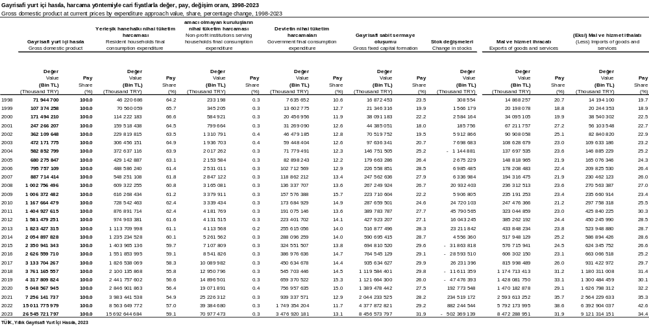
Total Expenditure =GDP= G+C+I+X-M
Source: TurkSTAT

Slide 10
Measuring GDP
THE INCOME APPROACH
GDP by income approach—adds up all the incomes received by the economic agents contributing to production.
  Compensation of employees (wages, salaries, and benefits) +
  Proprietor’s income (self-employed firm owners)+
  Rental income +
  Corporate profits +
  Net interest +
  Indirect business taxes (sales and excise (gider) tax paid by businesses) +
  Depreciation (consumption of fixed capital)

Slide 11
GDP by Income Approach
Gross domestic product by income approach, 2009-2023 |  |  |  |  |  |  |  |  |  | (Bin TL - Thousand TRY)
İşlem Transaction | 2013 | 2014 | 2015 | 2016 | 2017 | 2018 | 2019 | 2020 | 2021 | 2022^{(r)} | 2023
Gayrisafi yurt içi hasıla Gross domestic product | 1 823 427 315 | 2 054 897 828 | 2 350 941 343 | 2 626 559 710 | 3 133 704 267 | 3 761 165 557 | 4 317 809 824 | 5 048 567 945 | 7 256 141 737 | 15 011 775 979 | 26 545 721 797
Ürün üzerindeki vergi eksi sübvansiyonlar Taxes less subsidies on products | 224 388 005 | 236 275 921 | 277 920 704 | 309 629 285 | 353 894 906 | 389 174 707 | 429 859 515 | 560 550 420 | 767 597 025 | 1 574 989 184 | 3 008 482 459
Gayrisafi katma değer Gross value added | 1 599 039 310 | 1 818 621 907 | 2 073 020 639 | 2 316 930 424 | 2 779 809 362 | 3 371 990 850 | 3 887 950 309 | 4 488 017 525 | 6 488 544 712 | 13 436 786 794 | 23 537 239 337
İşgücüne yapılan ödemeler Compensation of employees | 506 358 759 | 590 557 990 | 683 728 668 | 840 205 090 | 947 014 585 | 1 129 021 664 | 1 350 548 967 | 1 478 627 920 | 1 946 220 352 | 3 535 880 036 | 7 661 316 760
Üretim üzerindeki vergiler Taxes on production | 12 301 467 | 14 155 765 | 15 875 026 | 16 925 864 | 20 364 515 | 22 689 295 | 26 892 613 | 30 741 992 | 38 354 154 | 53 895 157 | 118 515 955
Üretim üzerindeki sübvansiyonlar Subsidies on production | 7 093 085 | 17 030 439 | 20 864 617 | 32 815 637 | 45 923 868 | 56 495 913 | 64 182 929 | 101 256 304 | 135 867 792 | 152 355 772 | 467 904 738
İşletme artığı/karma gelir; brüt Gross operating surplus/mixed income | 1 087 472 169 | 1 230 938 591 | 1 394 281 562 | 1 492 615 107 | 1 858 354 130 | 2 276 775 804 | 2 574 691 658 | 3 079 903 917 | 4 639 837 998 | 9 999 367 373 | 16 225 311 361
Sabit sermaye tüketimi Consumption of fixed capital | 255 084 375 | 297 304 279 | 343 126 391 | 392 797 734 | 472 155 653 | 607 495 417 | 731 463 547 | 867 564 168 | 1 247 632 286 | 2 784 479 303 | 5 170 478 350
İşletme artığı/karma gelir; net Net operating surplus/mixed income | 832 387 794 | 933 634 312 | 1 051 155 171 | 1 099 817 373 | 1 386 198 477 | 1 669 280 387 | 1 843 228 111 | 2 212 339 749 | 3 392 205 711 | 7 214 888 070 | 11 054 833 011
Source: TurkSTAT

Slide 12
Source: TurkSTAT

Slide 13
Measuring GDP
THE VALUE ADDED APPROACH
To calculate the GDP using the value added approach, we add the value of all goods and services produced in the economy by all sectors and then subtract the value of all intermediate goods used in production to obtain the value added.
If we did not subtract the value of intermediate goods, we would be double-counting.
  We use the Input-Output Tables to calculate the sectoral value added.

Slide 14
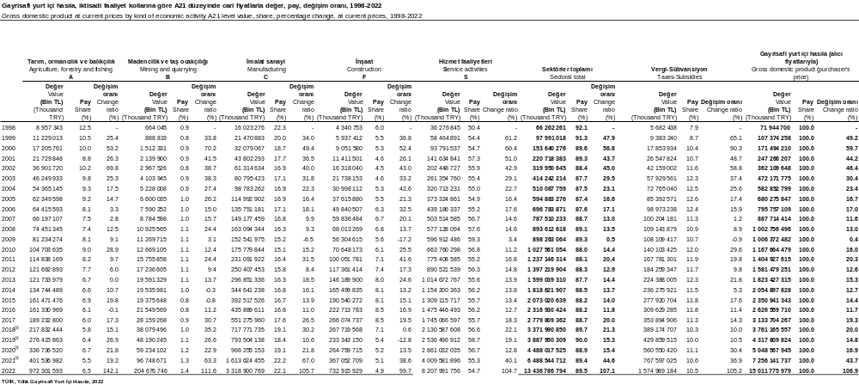
Source: TurkSTAT

Slide 15
Labor market measurement
Population
Non-institutional civilian population
Population not eligible for work
Labor force
Not in the labor force
Employed
Unemployed

Slide 16

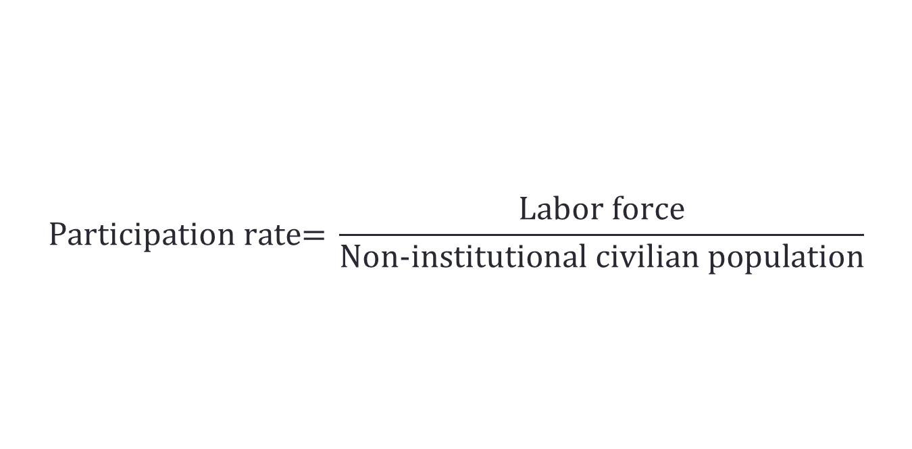
Labor market measurement
$$\text{Participation} \text{rate}\text{= }\frac{\text{Labor} \text{force}}{\text{Non}\text{−}\text{institutional} \text{civilian} \text{population}}$$
$$\text{Unemployment} \text{rate}\text{= }\frac{\text{Number} \text{of} \text{unemployed}}{\text{Labor} \text{force}}$$

Slide 17
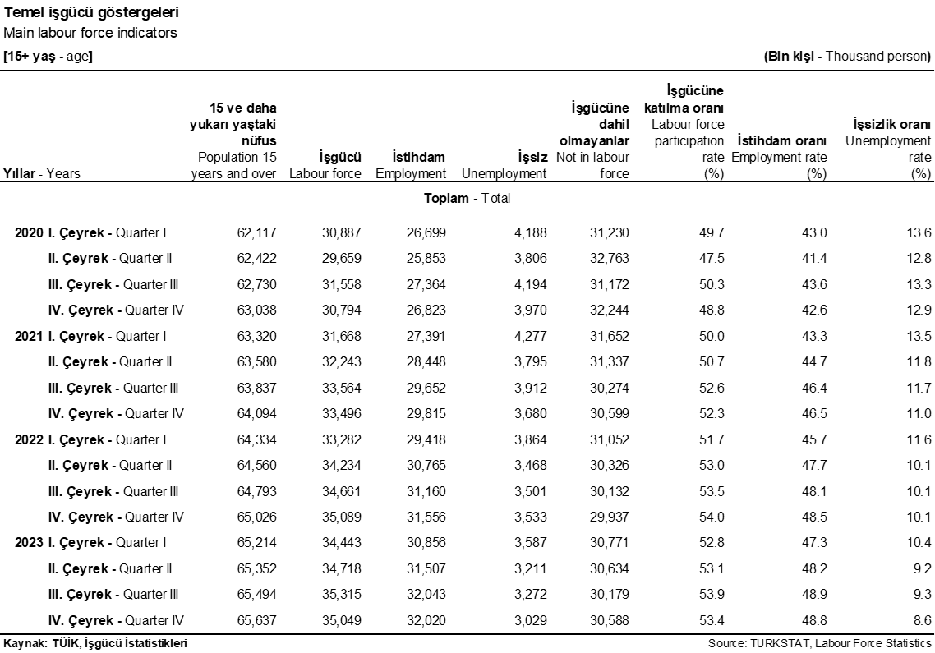
Labor force status of non-institutional population

Slide 18
Source: World Bank WDI

Slide 19
Source: World Bank WDI

Slide 20
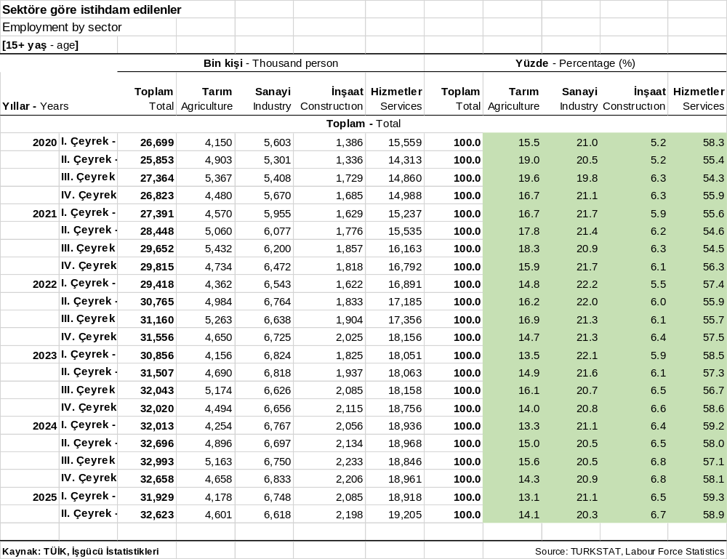

Slide 21
Source: World Bank WDI

Slide 22
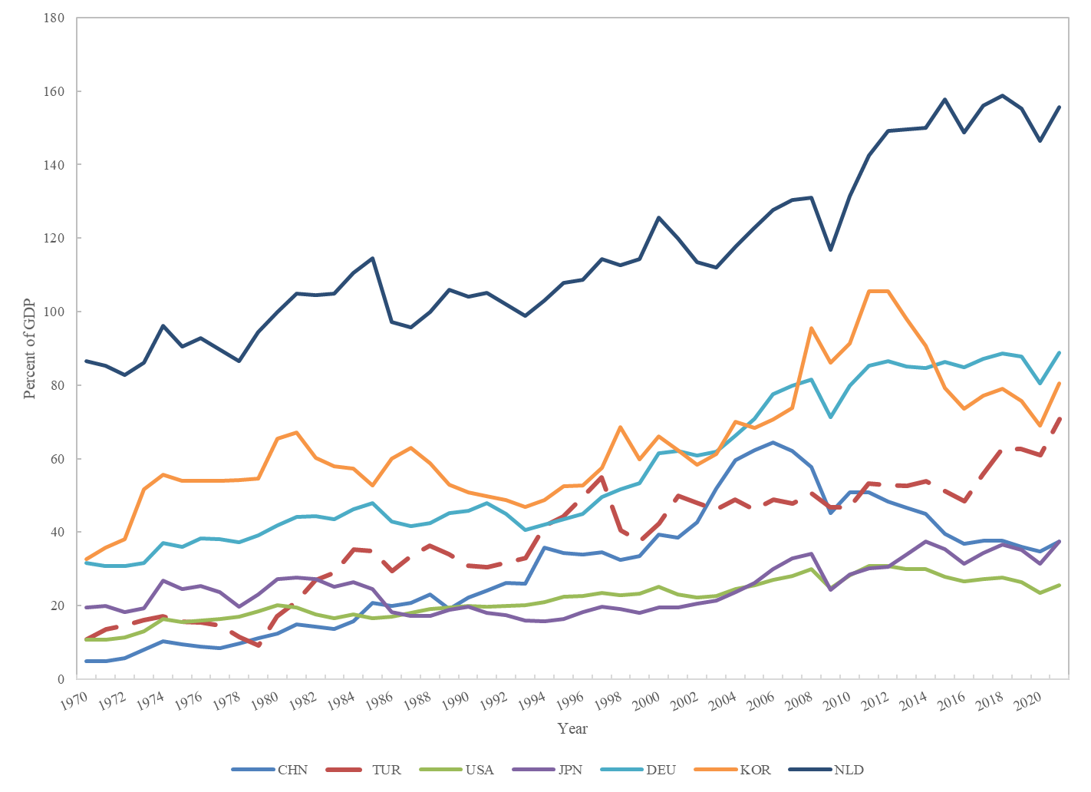
Degree of openness in selected countries
Source: World Bank WDI

Slide 23
Source: World Bank WDI

Slide 24
İhracat, sektörel paylar
İthalat, sektörel paylar
Kaynak: TÜİK

Slide 25
ISIC code |  | Share in total manufacturing exports (%)
34 | Manufacture of motor vehicles, trailers and semi-trailers | 14.5
29 | Manufacture of machinery and equipment n.e.c. | 10.9
27 | Manufacture of basic metals | 9.7
15 | Manufacture of food products and beverages | 8.5
24 | Manufacture of chemicals and chemical products | 7.7
17 | Manufacture of textiles | 7.3
36 | Manufacture of furniture; manufacturing n.e.c. | 6.3
18 | Manufacture of wearing apparel; dressing and dyeing of fur | 6.0
28 | Manufacture of fabricated metal products, except machinery and equipment | 5.0
31 | Manufacture of electrical machinery and apparatus n.e.c. | 5.0
25 | Manufacture of rubber and plastics products | 4.8
23 | Manufacture of coke, refined petroleum products and nuclear fuel | 3.9
26 | Manufacture of other non-metallic mineral products | 2.8
35 | Manufacture of other transport equipment | 2.5
21 | Manufacture of paper and paper products | 1.6
33 | Manufacture of medical, precision and optical instruments, watches and clocks | 0.8
20 | Manufacture of wood and of products of wood and cork | 0.8
19 | Tanning and dressing of leather; manufacture of luggage, handbags, saddlery, harness and footwear | 0.7
32 | Manufacture of radio, television and communication equipment and apparatus | 0.7
16 | Manufacture of tobacco products | 0.3
30 | Manufacture of office, accounting and computing machinery | 0.1
22 | Publishing, printing and reproduction of recorded media | 0.1
ISIC code |  | Share in total manufacturig imports (%)
27 | Manufacture of basic metals | 17.9
24 | Manufacture of chemicals and chemical products | 16.1
34 | Manufacture of motor vehicles, trailers and semi-trailers | 12.9
29 | Manufacture of machinery and equipment n.e.c. | 11.5
23 | Manufacture of coke, refined petroleum products and nuclear fuel | 7.2
31 | Manufacture of electrical machinery and apparatus n.e.c. | 5.1
36 | Manufacture of furniture; manufacturing n.e.c. | 3.6
32 | Manufacture of radio, television and communication equipment and apparatus | 3.6
15 | Manufacture of food products and beverages | 3.3
33 | Manufacture of medical, precision and optical instruments, watches and clocks | 3.2
35 | Manufacture of other transport equipment | 3.1
25 | Manufacture of rubber and plastics products | 2.4
28 | Manufacture of fabricated metal products, except machinery and equipment | 2.0
17 | Manufacture of textiles | 1.7
21 | Manufacture of paper and paper products | 1.6
30 | Manufacture of office, accounting and computing machinery | 1.5
18 | Manufacture of wearing apparel; dressing and dyeing of fur | 1.0
26 | Manufacture of other non-metallic mineral products | 1.0
19 | Tanning and dressing of leather; manufacture of luggage, handbags, saddlery, harness and footwear | 0.8
20 | Manufacture of wood and of products of wood and cork | 0.3
16 | Manufacture of tobacco products | 0.1
22 | Publishing, printing and reproduction of recorded media | 0.1

Slide 26
İmalat sanayi ihracatı,
teknolojik sınıflandırma
İmalat sanayi ithalatı,
teknolojik sınıflandırma

Slide 27
Exchange rates
Nominal exchange rate (E): Price of the foreign currency in terms of domestic currency
For example,
  E=3.0 in January 2016 means that
  1 USD=3.0 TL in January 2016; or similarly
  1 TL= 1/E = 1/3 USD =0.33 USD
  E’=41.0 in September 2025 means that
  1 USD=41 TL in September 2025; or similarly
  1 TL= 1/E’= 1/ 41 USD = 0.0244 USD
What does this mean? The price of USD in terms of TL has increased, or, the price of TL in terms of USD has decreased: TL has lost value or depreciated against USD (or, USD has appreciated against TL)

Slide 28
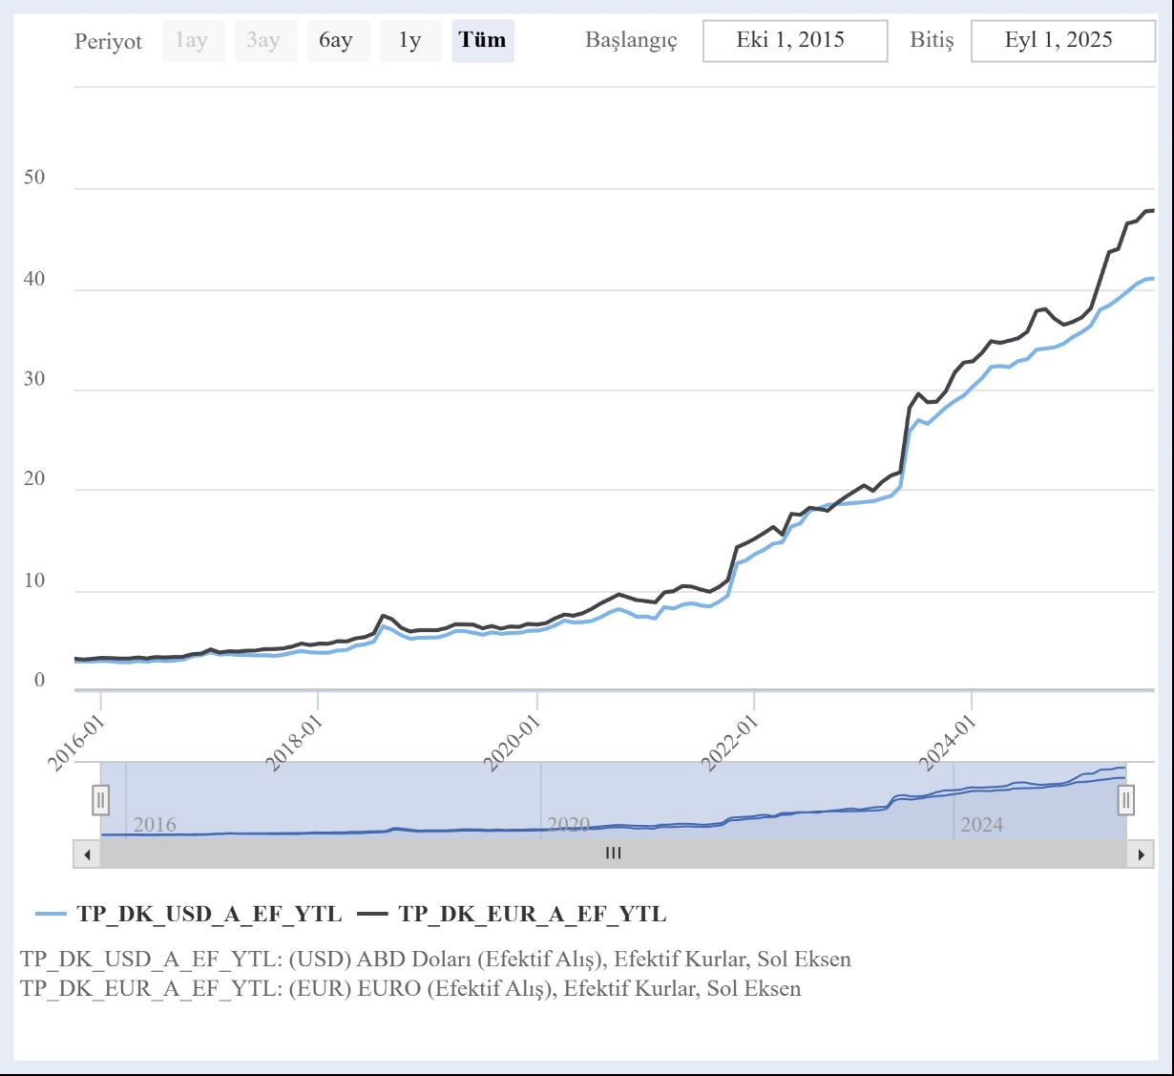
Nominal exchange rates
(monthly averages),
USD, EUR
2015-2025
Source: CBRT EVDS

Slide 29
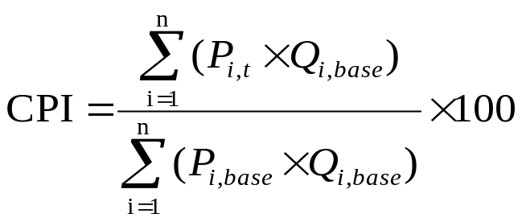

Measuring Inflation
Consumer price index (CPI) measures the value of a certain basket of goods and services in a given period (month, year, etc.) relative to the value of the same basket in some base year.
In calculating the CPI for a given year, we have a FIXED basket of goods and services (at some base year quantities), and we measure only the price changes.
Inflation rate: $\frac{{CPI}_{t}−{CPI}_{t−1}}{{CPI}_{t−1}}$x100

Slide 30
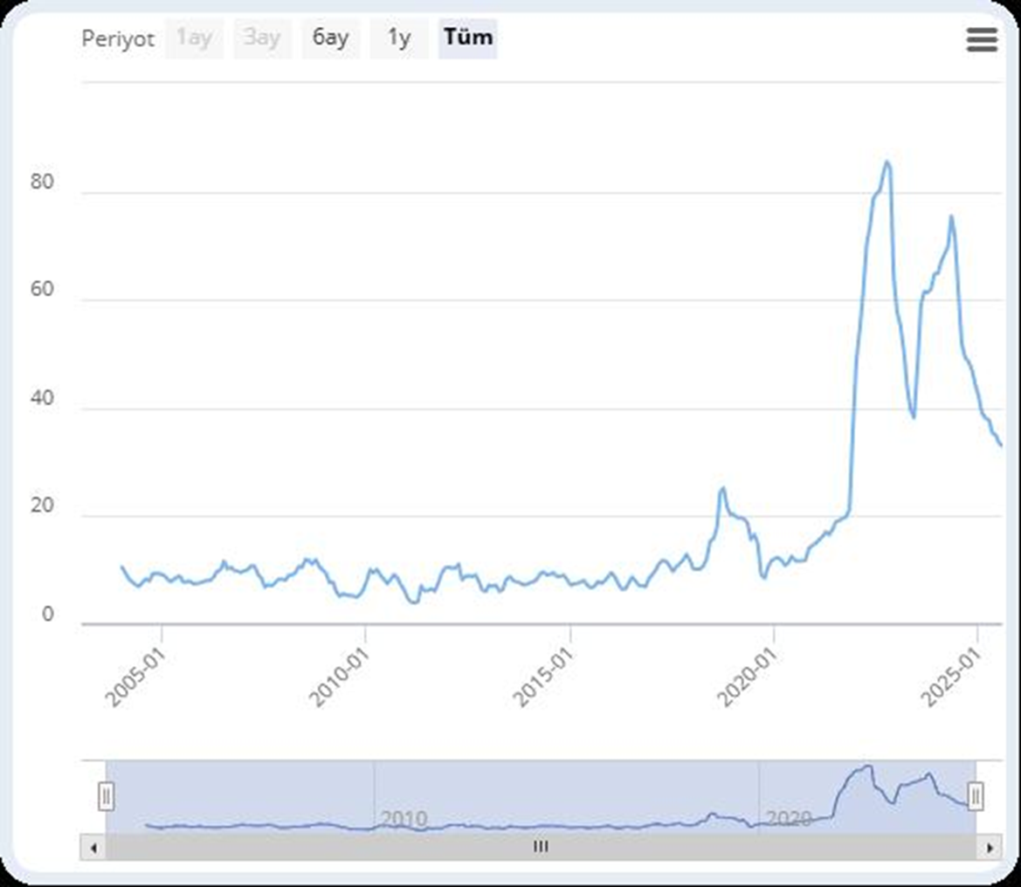
CPI annual % change
(2004.01-2025.07)
(CBRT-EVDS)

Slide 31
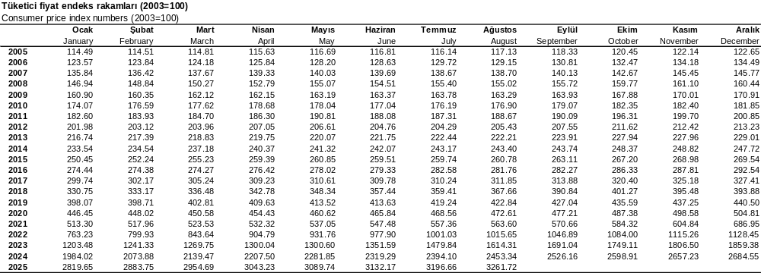
Source: TurkSTAT

Slide 32
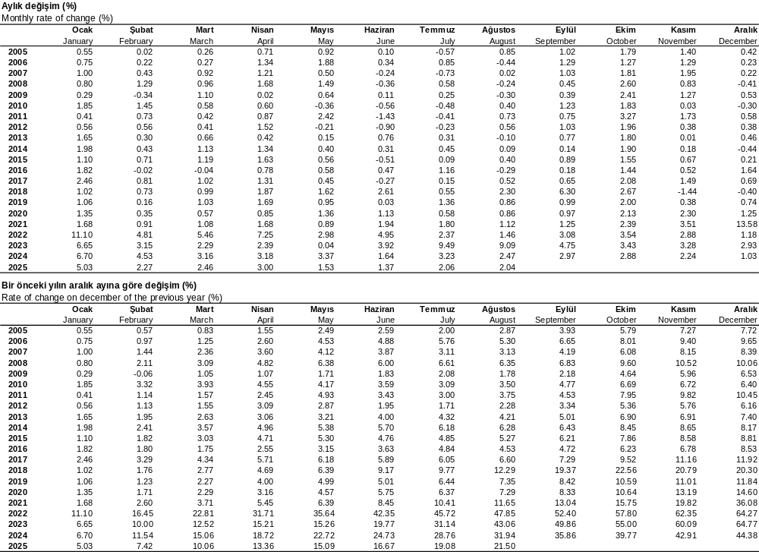
Source: TurkSTAT

Slide 33
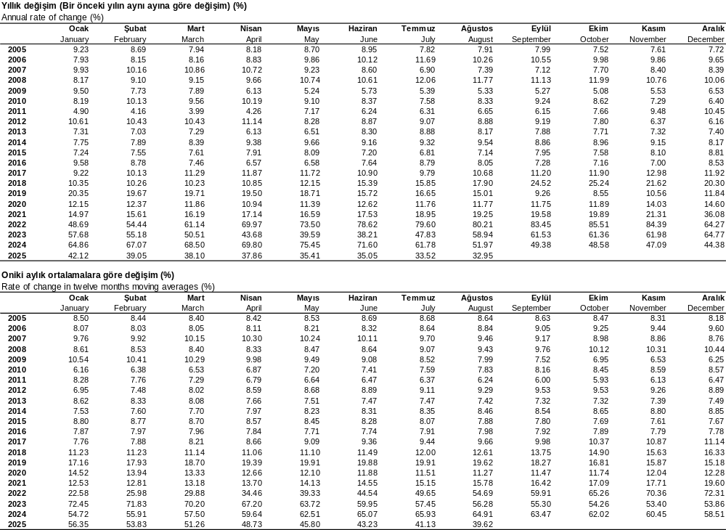
Source: TurkSTAT

Slide 34
Source: World Bank WDI

