Slide 1
CHAPTER 3
Economic Institutions
© McGraw Hill LLC. All rights reserved. No reproduction or distribution without the prior written consent of McGraw Hill LLC.

Slide 2
Learning Objectives
Define market economy and compare and contrast socialism with capitalism.
Describe the role of businesses and households in a market economy.
List and discuss the various roles of government.
Explain why global policy issues differ from national policy issues.

Slide 3
Economic Systems 1
Markets are based on institutions defined as “the formal and informal rules that constrain human economic behavior.”
Institutions include:
laws that protect property
the legal system to enforce and develop laws
political systems that develop the laws and
cultural traits of society

Slide 4
Economic Systems 2
The U.S. economy is a market economy, which is an economic system based on private property and the markets in which, in principle, individuals decide how, what, and for whom to produce.
Markets work through a system of rewards and payments
Individuals are free to do whatever they want as long as it is legal
Fluctuations in prices play a central role in coordinating individuals’ wants in a market economy

Slide 5
Capitalism and Socialism
Capitalism is an economic system based on the market in which the ownership of the means of production resides with a small group of individuals (called capitalists).
Socialism is an economic system based on individuals’ goodwill towards others, not on their own self-interest, and in which, in principle, society decides what, how, and for whom to produce.

Slide 6
Socialism 1
In principle socialism is where all people contribute what they can and get what they need.
The problems regarding what, how, and for whom are answered in the best interest of the individuals in society.
China and Venezuela are often identified as socialistic in the news.

Slide 7
Socialism 2
  Based on government ownership of the means of production.
  In a centrally planned socialist economy, government planning boards set society’s goals and then directed individuals and firms as to how to achieve those goals.
  Sometimes called a command economy.
People today talk little about differences in economic systems; instead, they talk about differences in institutions.

Slide 8
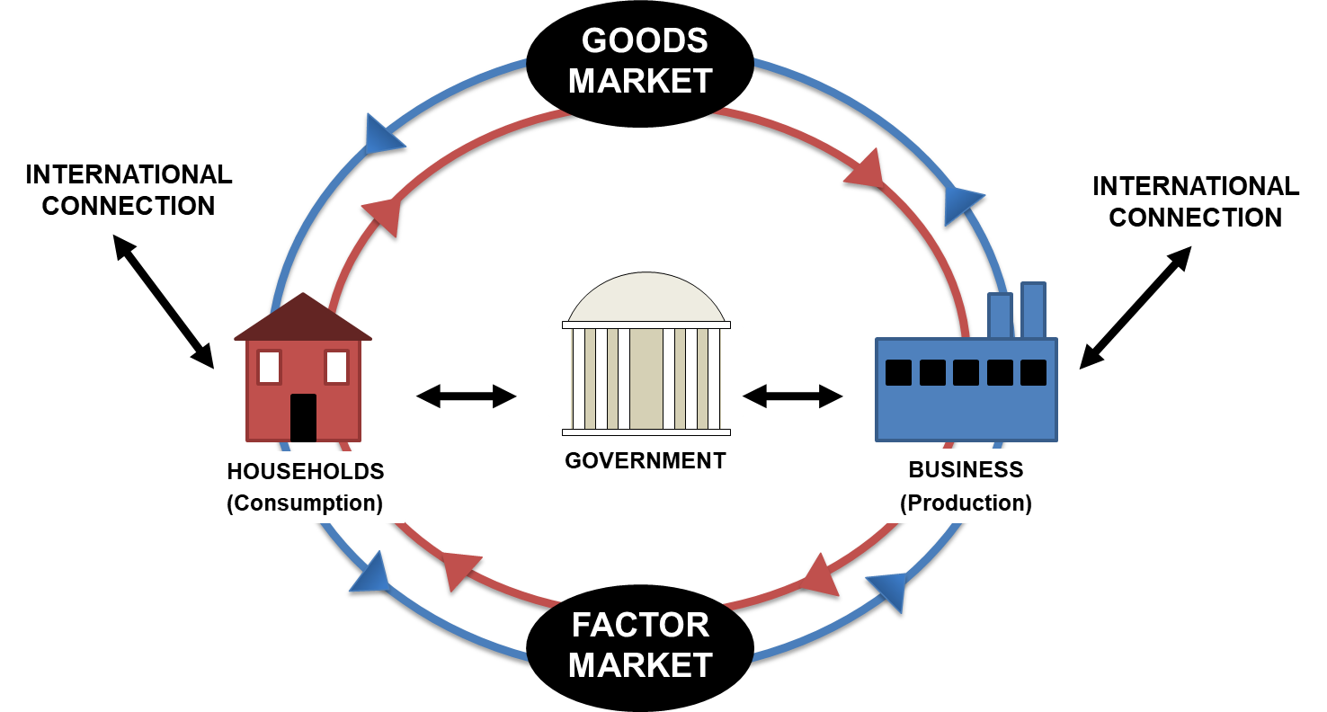
Economic Institutions in a Market Economy
U.S. economy: Connections between households, businesses and government.
Access the text alternative for slide images.

Slide 9
Business
Businesses are private producing units in our society.
Businesses in the United States decide what to produce, how much to produce, and for whom to produce it.
Businesses produce what they believe will sell and make a profit.
By channeling the desire to make a profit for the general good of society, the U.S. economic system allows the invisible hand to work.
Although businesses decide what to produce, they are guided by consumer sovereignty.

Slide 10
Forms of Business
Sole proprietorships: businesses that have only one owner
Partnerships: businesses with two or more owners
Corporations: businesses that are treated as a person, and are legally owned by their stockholders, who are not liable for the actions of the corporate “person”
Flexible-purpose Corporations, Benefit Corporations (B-corporations), L3C

Slide 11
Forms of Business: Advantages and Disadvantages
 | Advantages | Disadvantages
Sole Proprietorship | Minimum bureaucratic hassle Direct control by owner | Limited ability to get funds Unlimited personal liability
Partnership | Ability to share work and risks Relatively easy to form | Limited ability to get funds Unlimited personal liability (even for partner's blunder)
Corporation | No personal liability Increasing ability to get funds Ability to avoid personal income taxes | Legal hassle to organize Possible double taxation of income Monitoring problems
A table summarizes the advantages and disadvantages of 3 forms of business listed in column 1 with no header.

Slide 12
Households
Households are groups of individuals living together making joint decisions.
Households supply the labor with which businesses produce and government governs.
In the economy, households vote with their dollars to determine what businesses produce.
Besides being suppliers of labor, households make a significant number of the decisions that impact the economy.

Slide 13
U.S. Households as Suppliers of Labor
Total labor force: About 164 million people, just about 4% were unemployed in 2022.
Average U.S. workweek: 40 hours for men and 36 hours for women.
Median pay in the U.S.: $1,100 per week for men and $928 for women.
Average hourly wage for all workers: About $26

Slide 14
The Roles of Government
The government plays two general roles in the economy:
An actor who collects money in taxes and spends that money on projects, such as defense and education.
A referee who sets the rules that determine relations between businesses and households.

Slide 15
Government as an Actor
The United States has a federal government system, which means we have various levels of government (federal, state, and local) each with its own powers.
Together all levels of government consume about 18% of the country’s total output and employ about 22 million individuals.
The state and local levels of government employ over 19 million people and spend about $3.3 trillion a year.

Slide 16
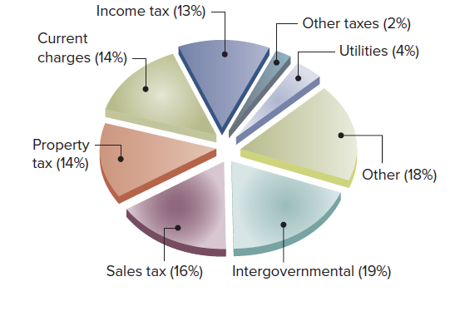
Income of State and Local Governments
Access the text alternative for slide images.
Source: State and Local Government Finance Estimates, Bureau of the Census (www.census.gov).

Slide 17
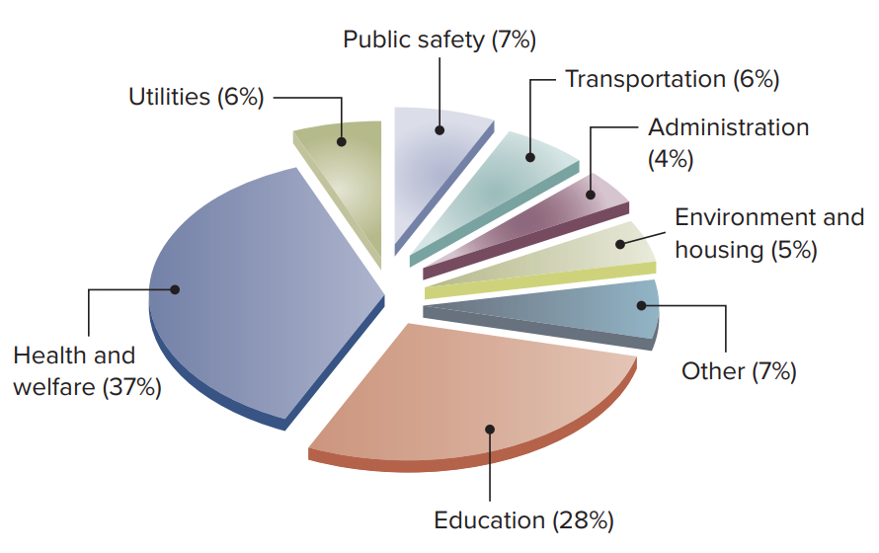
Expenditures of State and Local Governments
Access the text alternative for slide images.
Source: State and Local Government Finance Estimates, Bureau of the Census (www.census.gov).

Slide 18
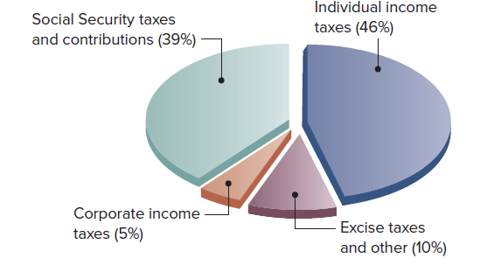
Income of the Federal Government
Access the text alternative for slide images.
Source: Bureau of Economic Analysis (www.bea.gov).

Slide 19
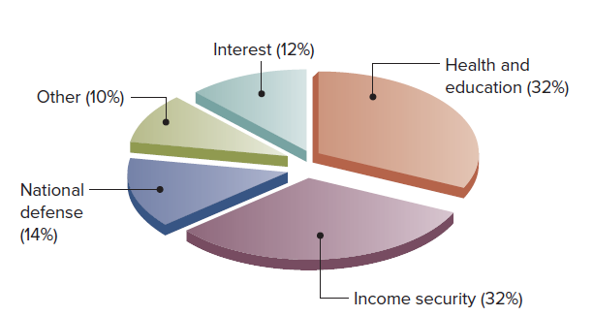
Expenditures of the Federal Government
Access the text alternative for slide images.
Source: Bureau of Economic Analysis (www.bea.gov).

Slide 20
Government as a Referee
Government sets the rules (laws) which regulate the interactions between households and businesses.
Some examples of laws:
  Businesses have to comply with equal opportunity and labor laws.
  Many working conditions are subject to government regulation, such as safety and overtime rules.
  Businesses cannot meet with other businesses to agree on prices they will charge.
  In some businesses, workers have to join a union to work at certain jobs.

Slide 21
Six Roles of a Government in a Market
In its role as both an actor and a referee, government plays a variety of specific roles in the economy.
These roles include:
Providing a stable set of institutions and rules
Promoting effective and workable competition
Correcting for externalities
Ensuring economic stability and growth
Providing public goods
Adjusting for undesirable market results

Slide 22
Externalities
Externality: the effect of a decision on a third party not taken into account by the decision maker
Positive externality: society as a whole benefits from the trade between the two parties
  Example: education
Negative externality: society as a whole is harmed by the trade between the two parties
  Example: burning coal/pollution
Macroeconomic externalities: externalities that affect the levels of unemployment, inflation, or growth in the economy as a whole

Slide 23
Public and Private Goods
Public good is a good that if supplied to one person must be supplied to all and whose consumption by one individual does not prevent its consumption by another individual
  Example: national defense
Private good is a good that, when consumed by one individual, cannot be consumed by another individual
  Example: apple

Slide 24
Demerit and Merit Goods
Demerit goods are goods or activities that government believes are bad for people even though they choose to use the good or engage in the activities
Merit goods are goods or activities that government believes are good for people even through they may choose not to engage in the activities or use the good

Slide 25
Market Failures and Government Failures
Market failures are situations in which the market does not lead to a desired result.
Government failures are situations in which the government intervenes and makes things worse.
Policy makers must decide which failure is the least problematic, a market or government failure.

Slide 26
Global Institutions and Corporations
The U.S. economy makes up about 16% of the world output and consumption, but only 6% of the world’s land mass and just over 4% of the world’s population.
U.S. economic institutions are integrated with the world’s economy.
Global corporations are corporations with substantial operations in both production and sales in more than one country.
Global corporations create jobs, bring new technologies, and provide competition for domestic companies.

Slide 27
Coordinating Global Issues 1
There is no global government to regulate global corporations, but governments have developed international institutions to promote negotiations and coordinate economic relations among countries.
Some examples of international institutions:
The United Nations is an organization designed to achieve international cooperation, but it has no ability to tax or enforce its policies on its members.
The World Bank is a multinational, international financial institution that works to secure loans for developing countries.

Slide 28
Coordinating Global Issues 2
Additional examples of international institutions:
The International Monetary Fund (IMF) is a multinational, international financial institution concerned with monetary issues.
The Group of Seven (G7) meets to promote negotiations and coordinate economic relations among nations. These seven countries include Japan, Germany, Britain, France, United States, Canada, and Italy.
The United States Mexico Canada Agreement (U S M C A), formerly called the North American Free Trade Act (N A F T A), is an organization devoted to reducing trade barriers between the United States, Mexico, Canada, and Mercosur (a trade organization for North, Central, and South American countries).

Slide 29
Accessibility Content: Text Alternatives for Images

Slide 30
Economic Institutions in a Market Economy - Text Alternative
Return to parent-slide containing images.
The government appears in the center which is linked to households (consumption) and business (production) through a two-way. The households (consumption) is linked to goods and factor market through two-way. The business (production) is linked to goods and factor market through two-way. The household (consumption) as well as business (production) are both linked to international connection through two-way.
Return to parent-slide containing images.

Slide 31
Income of State and Local Governments - Text Alternative
Return to parent-slide containing images.
The data (in percentage) is as follows:
Sales tax, 16.
Property tax, 14.
Current charges, 14.
Income tax, 13.
Other taxes, 2.
Utilities, 4.
Other, 18.
Intergovernmental, 19.
Return to parent-slide containing images.

Slide 32
Expenditures of State and Local Governments - Text Alternative
Return to parent-slide containing images.
The data (in percentage) is as follows:
Health and welfare , 37.
Utilities, 6.
Public safety, 7.
Transportation, 6.
Administration, 4.
Environment and housing, 5.
Other, 7.
Education, 28.
Return to parent-slide containing images.

Slide 33
Income of the Federal Government - Text Alternative
Return to parent-slide containing images.
The data (in percentage) is as follows:
Social Security taxes and contributions, 39.
Individual income taxes, 46.
Corporate income taxes, 5.
Excise taxes and other, 10.
Return to parent-slide containing images.

Slide 34
Expenditures of the Federal Government - Text Alternative
Return to parent-slide containing images.
The data (in percentage) is as follows:
National defense, 14.
Other, 10.
Interest, 12.
Health and education, 32.
Income security, 32.
Return to parent-slide containing images.

