Slide 1
CHAPTER 5
Using Supply and Demand
© McGraw Hill LLC. All rights reserved. No reproduction or distribution without the prior written consent of McGraw Hill LLC.

Slide 2
Learning Objectives
Apply the supply and demand model to real-world events.
Demonstrate the effect of a price ceiling and a price floor on a market.
Explain the effect of excise taxes and tariffs on a market.
Explain the effect of quantity restrictions on a market.
Explain the effect of a third-party-payer system on equilibrium price and quantity.

Slide 3
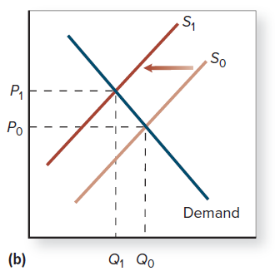
Application: Apples in the United States
A drought in California, leads farmers to leave 500,000 acres of land fallow.
The damage shifts the supply curve for apples to the left.
Price rises from P₀ to P₁ where quantity demanded = quantity supplied.
Access the text alternative for slide images.

Slide 4
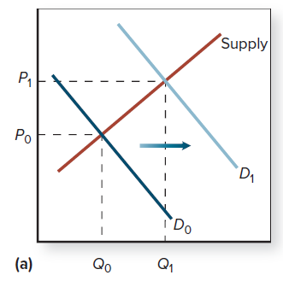
Market: Sand in the United States
The price of sand in the United States rose due to an increase in the demand for sand.
Increasing sand costs caused the demand curve to shift right.
Price for sand increased from P₀ to P₁ where Q demanded = Q supplied.
Access the text alternative for slide images.

Slide 5
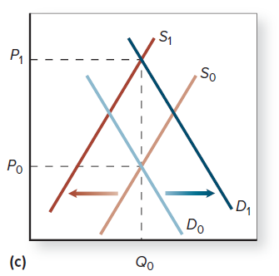
Application: Edible Oils in the World
Growing middle class in developing countries has increased demand for edible oils.
At the same time, U.S. farmers are growing more corn and less soy (less soy oil).
The result is increased prices for edible oils.
Access the text alternative for slide images.

Slide 6
A Review of Changes in Supply and Demand
 | No change in Supply | Supply increases | Supply decreases
No change in Demand | P same Q same | P down Q up | P up Q down
Demand increases | P up Q up | P ambiguous Q up | P up Q ambiguous
Demand decreases | P down Q down | P down Q ambiguous | P ambiguous Q down
A table has 3 supply features as 3 column headers and 3 demand features as 3 row headers. The corresponding 3 by 3 grid shows characteristics of P and Q.

Slide 7
Government Intervention: Price Ceilings and Price Floors
The invisible hand is not the only factor in determining prices; social and political forces also determine price.
Other factors include:
Excise taxes and tariffs
Quantity restrictions
Third-party-payer markets

Slide 8
Government Intervention: Price Ceilings
When a government wants to hold prices down to favor buyers, it imposes a price ceiling.
A price ceiling is a government-imposed limit on how high a price can be charged.
Price ceilings create shortages.
Price ceilings below equilibrium price will have an effect on the market.
With price ceilings, existing goods are no longer rationed entirely by price, so other methods of rationing arise.

Slide 9
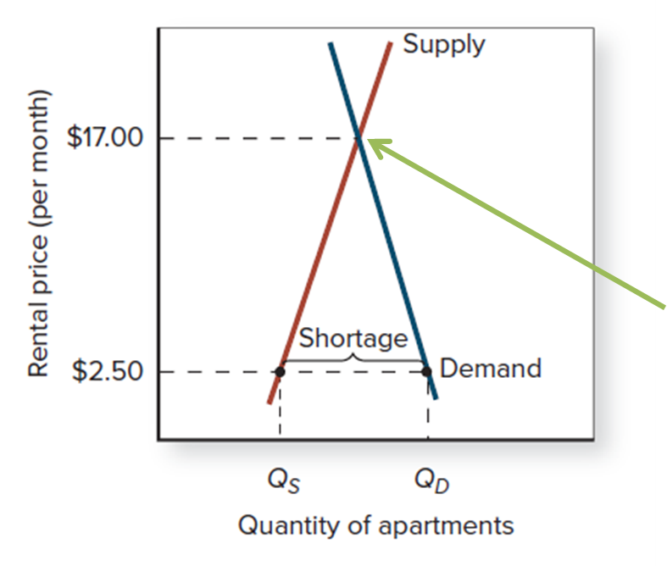
Price Ceiling: Rent Controls
After WWII, rent controls (a form of price ceiling) were put in place.
The rent controls caused a housing shortage.
There would not be a shortage if rents had been allowed to increase to the equilibrium price of $17
Access the text alternative for slide images.

Slide 10
Government Intervention: Price Floors
When a government wants to prevent a price from falling below a certain level to favor suppliers, it imposes a price floor.
A price floor is a government-imposed limit on how low a price can be charged.
Price floors create excess supply.
Price floors above equilibrium price will have an effect on the market.

Slide 11
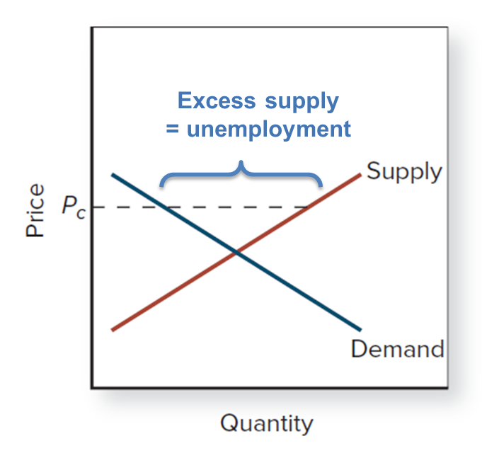
Application: A Minimum Wage
A minimum wage is a type of price floor, it is the lowest wage a firm can legally pay an employee.
Minimum wages cause unemployment.
Access the text alternative for slide images.

Slide 12
Government Intervention: Excise Taxes and Tariffs
An excise tax is a tax that is levied on a specific good.
Government impacts markets through taxation.
A tariff is an excise tax on an imported good.
The result of taxes and tariffs is an increase in equilibrium prices and reduce equilibrium quantities.

Slide 13
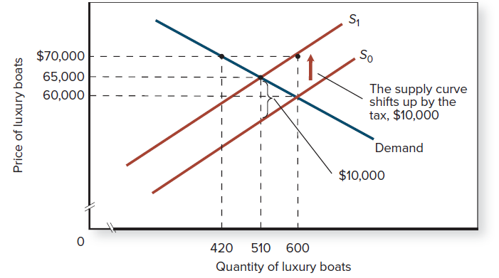
Application: The Effect of an Excise Tax
Government imposes a $10,000 luxury tax on the suppliers of boats.
The supply curve shifts up by the amount of the tax.
The price of boats rises by less than the tax to $65,000.
Access the text alternative for slide images.

Slide 14
Government Intervention: Quantity Restrictions
Government regulates markets with licenses, which limit entry into a market.
The results of limited number of licenses in a market are increases in wages and an increases in the price of obtaining the license

Slide 15
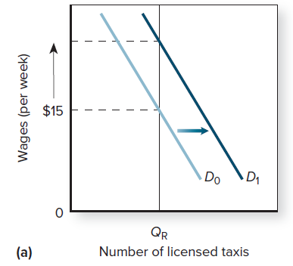
Application: The Effect of a Quantity Restriction (1 of 2)
Successful lobbying by taxi drivers in NYC resulted in quantity restrictions (medallions).
When the demand for taxi services increased, because the number of taxi licenses was limited, wages increased.
Access the text alternative for slide images.

Slide 16
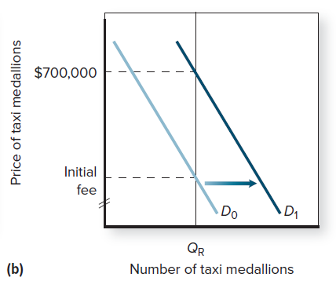
Application: The Effect of a Quantity Restriction (2 of 2)
The demand for taxi medallions also increased because wages were increasing.
But because the number of taxi licenses was limited, the price of a medallion also increased.
Access the text alternative for slide images.

Slide 17
Government Intervention: Third-Party-Payer Markets
In third-party-payer markets, the person who receives the good differs from the person paying for the good.
Under a third-party-payer system, the person who chooses how much to purchase doesn’t pay the entire cost.
Equilibrium quantity and total spending can be much higher in third-party-payer markets.
Goods from a third-party-payer system will be rationed through social and political means.

Slide 18
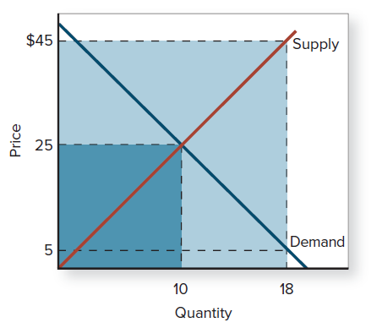
Application: Third-Party-Payer Markets
With a copayment of $5, consumers demand 18 units.
Sellers require $45 per unit for that quantity.
Total expenditures for 18 units of health care
. . . are greater than when . . .
the consumer pays the entire cost.
Access the text alternative for slide images.

Slide 19
End of Main Content
© McGraw Hill LLC. All rights reserved. No reproduction or distribution without the prior written consent of McGraw Hill LLC.

Slide 20
Accessibility Content: Text Alternatives for Images

Slide 21
Application: Apples in the United States - Text Alternative
Return to parent-slide containing images.
The vertical axis plots two values: P subscript 0 and P subscript 1. The horizontal axis plots two values: Q subscript 1 and Q subscript 0. The graph plots two parallel upward-sloping supply curves, S subscript 0 and S subscript 1. A left arrow extends between S subscript 0 and S subscript 1. A downward-sloping demand curve D falls intersecting the supply curves S subscript 1 at (Q subscript 1, P subscript 1) and S subscript 0 at ( Q subscript 0, P subscript 0).
Return to parent-slide containing images.

Slide 22
Market: Sand in the United States - Text Alternative
Return to parent-slide containing images.
The vertical axis plots two values: P subscript 0 and P subscript 1. The horizontal axis plots two values: Q subscript 0 and Q subscript 1. The graph plots two parallel downward-sloping demand curves, D subscript 0 and D subscript 1. A right arrow extends between D subscript 0 and D subscript 1. An upward-sloping supply curve rises, intersecting the demand curves D subscript 0 at (Q subscript 0, P subscript 0) and D subscript 1 at ( Q subscript 1, P subscript 1).
Return to parent-slide containing images.

Slide 23
Application: Edible Oils in the World - Text Alternative
Return to parent-slide containing images.
The vertical axis plots two values: P subscript 0 and P subscript 1. The horizontal axis plots a value: Q subscript 0. The graph plots two parallel upward-sloping supply curves, S subscript 0 and S subscript 1 and two parallel downward-sloping demand curves, D subscript 0 and D subscript 1. A left arrow extends between S subscript 0 and S subscript 1 and a right arrow extends between D subscript 0 and D subscript 1 . D subscript 0 intersects S subscript 0 at (Q subscript 0, P subscript 0) and D subscript 1 intersects S subscript 1 at (Q subscript 0, P subscript 1).
Return to parent-slide containing images.

Slide 24
Price Ceiling: Rent Controls - Text Alternative
Return to parent-slide containing images.
The vertical axis plots two values: 2.50 dollars and 17 dollars. The horizontal axis plots two values: Q subscript S and Q subscript D. The horizontal axis represents the quantity of apartments and the vertical axis represents the rental price per month. The graph plots a downward-sloping curve for demand and an upward-sloping curve for supply. The two lines intersect at a point corresponding to the rental price 17.00. The length between the two curves below the intersection, between quantities Q subscript S and Q subscript D and at price 2.50 is labeled shortage.
Return to parent-slide containing images.

Slide 25
Application: A Minimum Wage - Text Alternative
Return to parent-slide containing images.
The horizontal axis represents quantity and the vertical axis represents price. The graph plots a downward-sloping curve for demand and an upward-sloping curve for supply. A horizontal dashed line on the vertical axis depicts the price ceiling, P sub c. The demand and supply curves intersect at a point below the dashed line. The length of the horizontal dashed line, between the two curves is labeled, excess supply equals unemployment.
Return to parent-slide containing images.

Slide 26
Application: The Effect of an Excise Tax - Text Alternative
Return to parent-slide containing images.
The vertical axis plots three values: 60000 dollars, 65000, and 70000 dollars. The horizontal axis plots three values: 420, 510, and 600. The horizontal axis represents the quantity of luxury boats and the vertical axis represents the price of luxury boats. The graph plots two upward-sloping parallel supply curves, S subscript 0 and S subscript 1. S subscript 1 rises through the points (510, 65,000) and (600, 70,000). An up arrow points from S subscript 0 through S subscript 1, indicating the supply curve shifts up by the tax, 10,000 dollars. A downward-sloping demand curve falls through the point (420, 70,000) and intersects S subscript 1 at (510, 65,000) and S subscript 0 at (600, 60,000). The vertical distance between the intersecting point (510, 65,000) and the S subscript 0 curve is labeled 10,000 dollars.
Return to parent-slide containing images.

Slide 27
Application: The Effect of a Quantity Restriction (1 of 2) - Text Alternative
Return to parent-slide containing images.
The vertical axis plots a value: 15 dollars. The horizontal axis plots a value: Q subscript R. The horizontal axis represents the number of licensed taxis. The vertical axis represents wages per week. The graph plots two downward-sloping parallel demand curves. A right arrow points from D subscript 0 through D subscript 1. A vertical line is drawn from the point Q subscript R on the horizontal axis. This line intersects D subscript 0 at (Q subscript R, 15 dollars) and D subscript 1 at a higher point. An up arrow extends from the value 15 dollars on the vertical axis.
Return to parent-slide containing images.

Slide 28
Application: The Effect of a Quantity Restriction (2 of 2) - Text Alternative
Return to parent-slide containing images.
The vertical axis plots two values: initial fee and 700000 dollars. The horizontal axis plots a value: Q subscript R. The horizontal axis represents the number of taxi medallions. The vertical axis represents the price of taxi medallions. The graph plots two downward-sloping parallel demand curves. A right arrow points from D subscript 0 through D subscript 1. A vertical line is drawn from the point Q subscript R on the horizontal axis. This line intersects D subscript 0 at (Q subscript R, initial fee) and D subscript 1 at a higher point at (Q subscript R, 700,000).
Return to parent-slide containing images.

Slide 29
Application: Third-Party-Payer Markets - Text Alternative
Return to parent-slide containing images.
The vertical axis shows the price, the horizontal axis shows the quantity. This graph shows the intersection of a demand curve with a supply curve in a typical letter X formation. Price is the label for the vertical axis and spans from $0 through $45, and Quantity is labeled on the horizontal axis and spans from 0 through 18. The point of intersection of two lines has coordinates (10, 25) and is also the upper right corner of a small dark blue square that is bounded by the x- and y-axes. A larger, lighter blue square has a right upper corner with coordinates (18, $45). This is the area of the total expenditure shown by the entire shaded region and is much greater compared to total spending when the consumer pays the entire cost, shown by just the dark shaded region.
Note: All data is approximate.
Return to parent-slide containing images.

