Slide 1



ECON 202 (02)
FALL 2025
MACROECONOMIC THEORY I
CHAPTER 5-GOODS AND FINANCIAL MARKETS: THE IS-LM MODEL

Slide 2
OUTLINE
The Goods Market and The IS-Relation
  Determining output
  Deriving the IS curve
  Shifts in the IS curve
The Money Market and the LM curve
  The Demand for Money
  The Money Supply and the Money Market Equilibrium
  Shifts in the LM curve
Simultaneous Equilibria in the Money and Goods Markets
  Monetary Policy Effects
  Fiscal Policy Effects
  Special Cases: Liquidity trap, and the Classical case
  Policy Mixes
  The LM-Relation as an Interest Rate Rule

Slide 3
What this chapter is about
We introduce the interaction between the goods and the money markets in an economy
Basically, we study how interest rates and output&income are determined in the goods and money markets simultaneously
A short run analysis
What is meant by the “short run”?
  Short run is the time frame during which demand side policies (i.e. monetary and fiscal policies) could have an effect on output and income

Slide 4
The Goods Market and The IS Relation
IS-curve: a relationship which shows combinations of output and interest rate which are alternative equilibria in the goods market
  At every point on the IS curve, desired expenditures equal income, or the goods market is in equilibrium
We derive the IS curve in two steps:
  Derive the investment relation (or, the investment demand schedule)
  Replace the investment relation in the aggregate demand identity, Z≡C+I+G; and determine the combinations of income and interest rate that clear the goods market (i.e. that satisfy the national income identity).

Slide 5
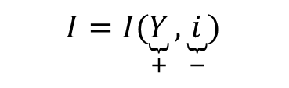
Investment Demand
So far in our analysis, we considered I to be a constant value;
However, this is not entirely realistic;
Investment demand is affected by
  Interest rate (the rate of borrowing)
  The volume of sales (income level is a proxy for the volume of sales)
Investment demand function:
For the time being, assume that I is affected only by changes in the interest rate.
$$I=I(\underset{+}{\underbrace{Y}},\underset{−}{\underbrace{i}})$$

Slide 6
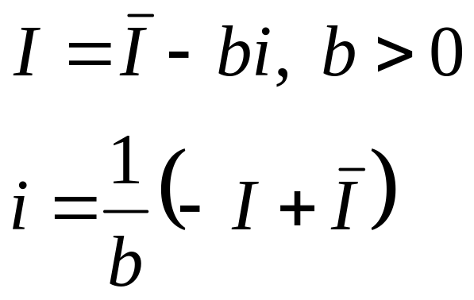
Investment Demand
Assume a linear investment demand function:
The constant parameter b measures the sensitivity of investment to changes in interest rate
  It is the slope of the investment demand function

Slide 7
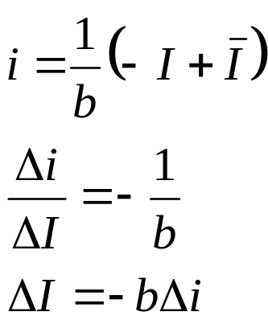
Investment Demand
i
i
Ī/b
Flat I-function
Δi
(slope)
Steep I-function
Ī
I
I
Flat I-function: b is large; I is highly
sensitive to changes in i;
Steep I-function: b is small; I is not very
sensitive to changes in i.

Slide 8
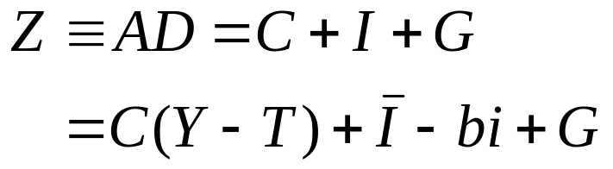
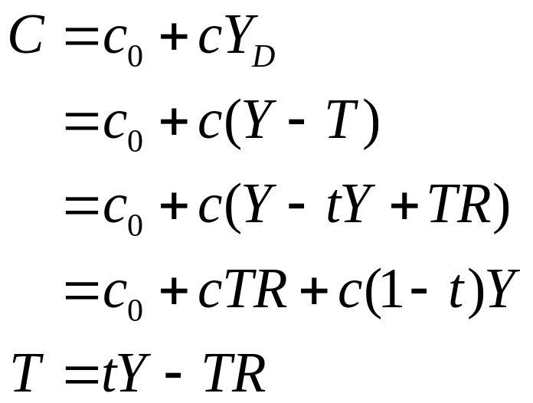
Deriving the IS-curve
Aggregate Demand:
Consumption function:

Slide 9
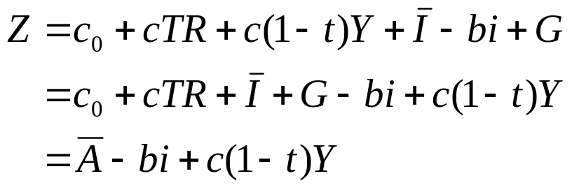
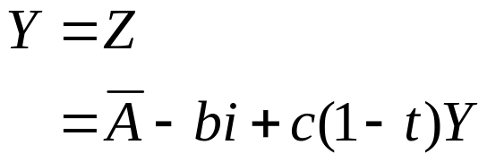
Deriving the IS-curve
Aggregate Demand function becomes:
In goods market equilibrium
Goods market eqm occurs for
a given i, at equilibrium income level
Z,Y
Goods market eqm
Y=Z
Z
Ā-bi
Y

Slide 10
Y=Z
Y,Z
Z₁
If interest rate i drops:
*Investment demand
increases;
**Z shifts up;
***A new goods market eqm
occurs with new i;
Holding everthing constant,
the IS-curve shows the
alternative combinations of
goods market equilibria
(i and Y that clear the
Goods market)
Important:
i is determined outside the
Goods market; Y is determined
in the goods market
Z₀
Ā-bi₁
Ā-bi₀
Y₀
Y₁
Y
i
i₀
i₁
IS
Y₀
Y₁
Y

Slide 11
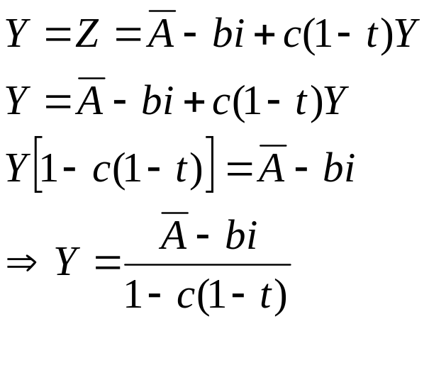
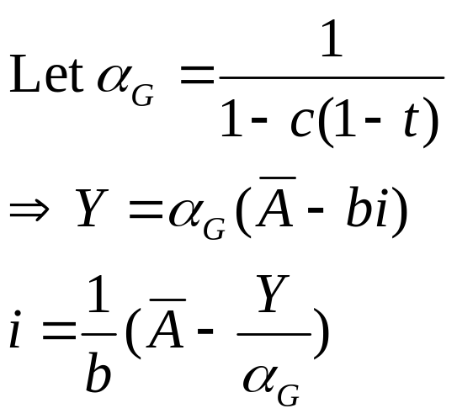
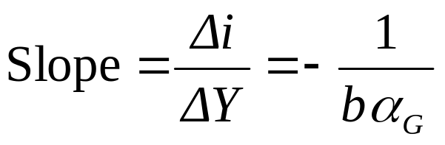
Deriving the IS-curve
We can express the IS-curve algebraically, as well:
The parameter b and the
multiplier determine
together how steep
or how flat the IS-curve is

Slide 12
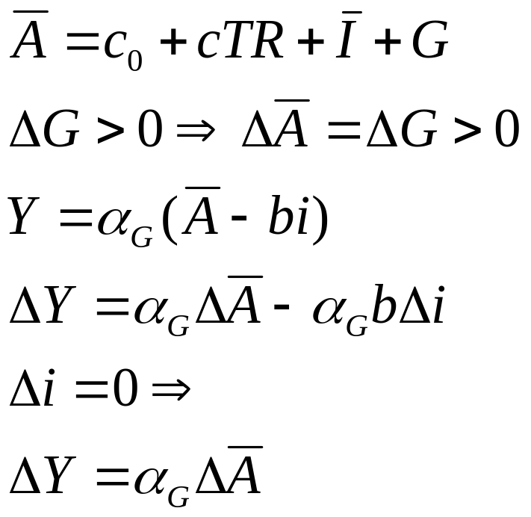
Shifts in the IS-curve
Shifts in the IS curve are caused by changes in the autonomous expenditures, Ā, given a constant interest rate, i.

Slide 13
Shifts in the IS-curve
Important:
Changes in the interest rate lead to movements along a given IS-curve, only!..
Changes in the interest rate do not cause the IS-curve to shift!..

Slide 14


Y=Z
Y,Z
Z₁
Z₀
Ā ₁-bi₀
Ā ₀-bi₀
Y₀
Y₁
Y
i
i₀
IS’
IS
Y₀
Y₁
Y
Full multiplier effect on Y

Slide 15
The Money Market and the LM-curve
LM-curve: shows the alternative combinations of interest rate and income levels which clear the money markets (where the quantity of money demanded is equal to the quantity of money supplied in real terms)
Deriving the LM-curve:
  Elaborate on the money demand schedule
  Establish the money market equilibrium

Slide 16
The Demand for Money
Demand for Real Balances:
  Consider the demand for real amount of money, rather than the nominal amount of money
  Why?
  Because people are interested in the real purchasing power of the money that they hold for transactions purposes
  Example:
  Suppose you hold 100 TL, and 100 TL buys 50 kg of apples, at 2 TL per kg.
  Let’s say that the price of apples increase to 4 TL per kg from 2 TL per kg
  Then, to buy the same 50 kg of apples, you need to hold 200 TL rather than 100 TL
  In nominal terms, you hold twice the amount of money, but in real terms, nothing has changed.
Demand for real balances: Represented in goods and services, not in monetary or nominal terms.

Slide 17
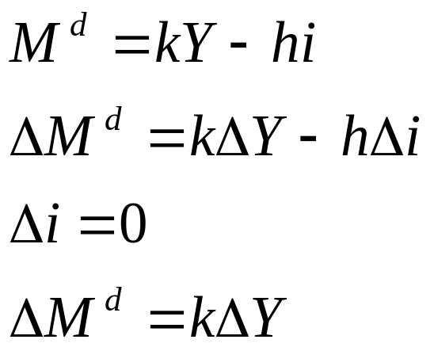
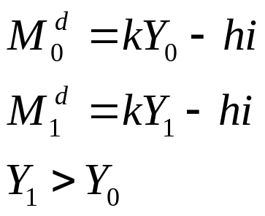

The Demand for Money
i
M
(Y is real income)
(horizontal distance)
M₁^{d}
M₀^{d}

Slide 18
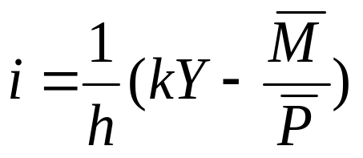
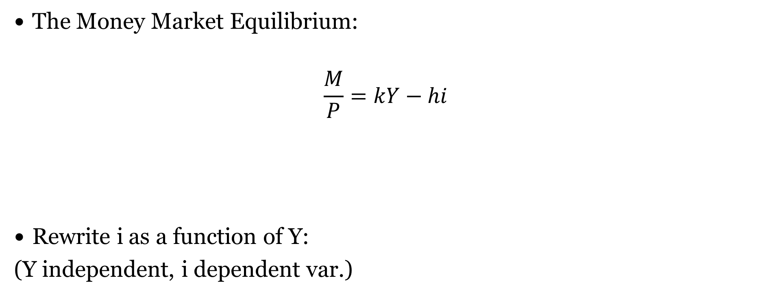
The Money Market Equilibrium
The Money Market Equilibrium:
$$\frac{M}{P}=kY−hi$$
Rewrite i as a function of Y:
(Y independent, i dependent var.)
(Real money supply=Real demand for money)
LM-relationship

Slide 19

Derivation of the LM-curve
i
i
LM
i₁
i₀
M₁^{d}
M₀^{d}
M
Y₀
Y₁
Y
Excess demand
for money

Slide 20
Shifts in the LM-curve
Shifts in the LM-curve are caused by only changes in the real money supply:
  Expansionary monetary policy effects
  Contractionary monetary policy effects
Changes in the interest rate lead to movements along a given LM-curve, only!..

Slide 21


Shifts in the LM-curve
i
i
LM
Excess supply
of money
LM’
i₀
i₁
M₀^{d}
M
Y₀
Y
Nominal money supply M increases

Slide 22
Shifts in the LM-curve
i
i
LM’
LM
i₁
Excess demand
for money
i₀
M₀^{d}
M
Y₀
Y
Nominal money supply M decreases

Slide 23
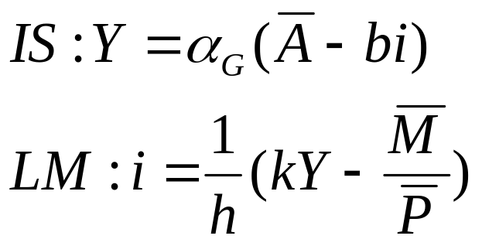
Simultaneous Equilibria in the Goods and Money Markets
For simultaneous equilibria in both markets, interest rates and income levels must be such that both markets are in equilibrium:
i
LM
i’’
B
A
E
i^{EQ}
i’
C
D
IS
Y’
Y^{EQ}
Y’’
Y
At point E interest rate is such that
people hold the available money stock
(i.e. Money market is in equilibrium) and
the supply of goods is equal to the demand
for goods (goods market is in equilibrium);
people purchase the marketed goods with the money held

Slide 24
Simultaneous Equilibria in the Goods and Money Markets
Points A, C: Money market is in equilibrium, goods market is not
Points B, D: Goods market is in equilibrium, money market is not
Point A: With the given interest rate, the goods market reaches equilibrium at a lower Y, hence there is excess supply of goods at A
Point B: With the given Y level, the money market reaches equilibrium at a lower interest rate, hence there is excess supply of money at B
Point C: At the given interest rate, the goods market reaches equilibrium at a higher Y level, there is excess demand for goods at C;
Point D: With the given Y level, the interest rate is too low for equilibrium, the interest rate must increase to establish money market equilibrium at this Y level, hence there is excess demand for money at D

Slide 25
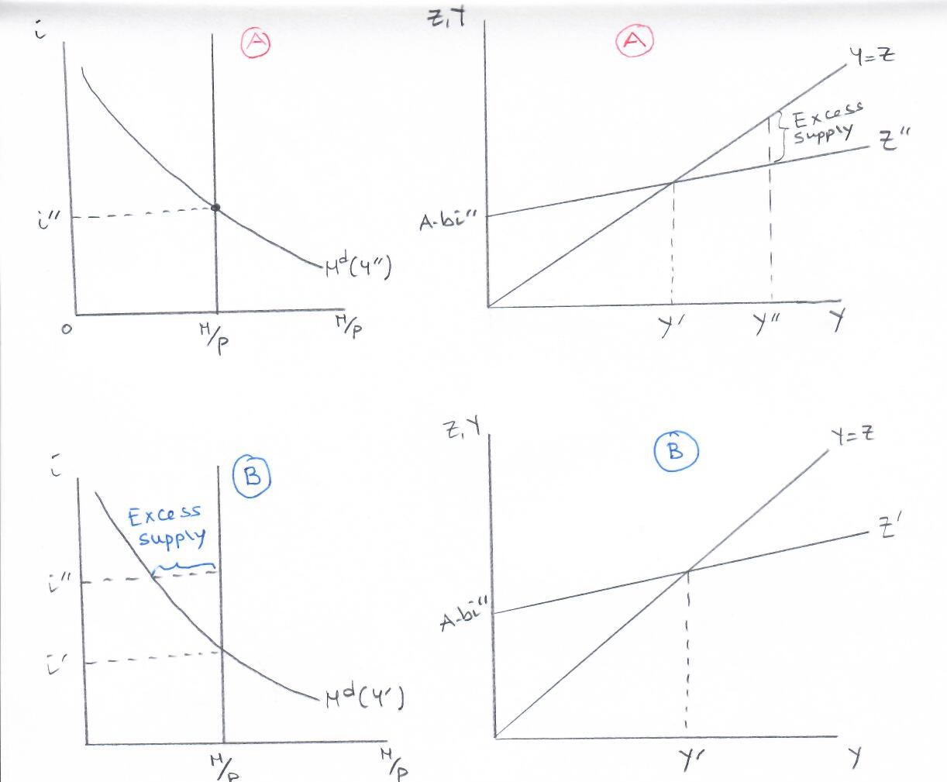

Slide 26
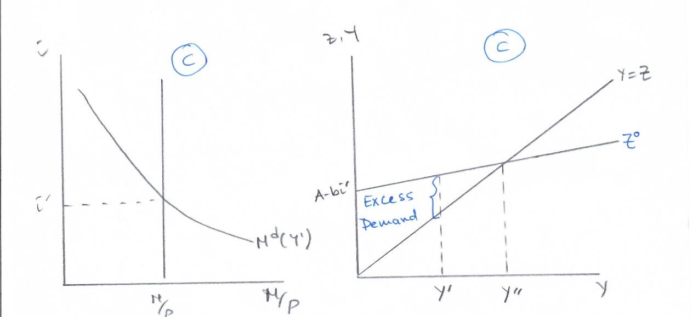

Slide 27
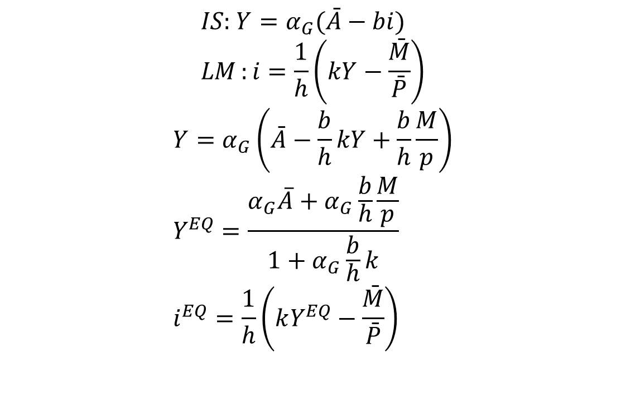
Simultaneous Equilibria in the Goods and Money Markets
Solution to IS-LM equilibrium:
  Plug i from the LM into IS as follows:
$$IS\text{: }Y=α_{G}(\bar{A}−bi) \\ LM:{i}=\frac{1}{h}\left(kY−\frac{\bar{M}}{\bar{P}}\right)$$
$$Y=α_{G}\left(\bar{A}−\frac{b}{h}kY+\frac{b}{h}\frac{M}{p}\right) \\ Y^{EQ}=\frac{α_{G}\overline{A}+α_{G}\frac{b}{h}\frac{M}{p}}{1+α_{G}\frac{b}{h}k} \\ i^{EQ}=\frac{1}{h}\left(kY^{EQ}−\frac{\bar{M}}{\bar{P}}\right)$$
(A system of 2 equations with 2 unknowns, i and Y)

Slide 28

Changes in Equilibrium (Shifts in IS)
1. Increase in autonomous expenditures, Ā:
An increase in autonomous spending (Ā>0);
Let the government spending G has increased (expansionary fiscal policy);
With fixed i, increase in G increases the aggregate demand, increases the equilibrium income in goods market;
Increase in income increases money demand;
In the money markets, this increase in money demand increases the interest rate (move upwards on LM-curve);
Increase in interest rate induces a decrease in investment spending (move backwards on IS-curve)
Establish new equilibrium:
i
LM
i₁
i₀
IS’
IS
Y₀
Y₁
Y’₀
Y

Slide 29
Changes in Equilibrium (Shifts in IS)
Crowding out effect of an increase in government spending G:
  An increase in G leads to an increase in income and output;
  Increase in income leads to an increase in money demand;
  Increase in money demand leads to an increase in interest rate;
  Increase in interest rate decreases the investment demand;
  Hence, an increase in government spending crowds out investment demand through an increase in the interest rate
Because of the crowding out effect, the increase in income and output is not by the full multiplier effect.

Slide 30
Changes in Equilibrium (Shifts in IS)
Contractionary fiscal policy (a decrease in G):
A decrease in G;
Aggregate demand, and income/output at goods market equilibrium falls;
In money market, money demand falls;
Interest rate falls;
In goods market, new investment is induced because of the decrease in interest rate (crowding in effect of a decrease in G)
LM
i₀
i₁
IS
IS’
Y’₀
Y₁
Y₀

Slide 31
Changes in Equilibrium (Shifts in LM)
Expansionary monetary policy (an increase in M):
An increase in M (e.g. an open market purchase)
In the money market, decrease in interest rate
In the goods market, an increase in investment demand;
In goods market equilibrium, an increase in income/output (at the new lower interest rate, Y rises in goods market)
Y increases, money demand increases, i starts rising
The increase in i: Move upwards along new LM’, move upwards along original IS (investments fall)
i
LM
LM’
Initial impact
Impact in goods market
IS
Y

Slide 32



Expansionary Monetary Policy
2
Z’₀
Z₁
i₀
i₁
3
Z₀
i’₀
A-bi’₀
1
A-bi₁
A-bi₀
M
LM
LM’
Full transmission mechanism
of a change in monetary policy
i₀
i₁
i’₀
Y₀
Y₁
Y’₀

Slide 33
Expansionary Fiscal Policy
i’₀
Z’₀
i₁
Z₁
i₀
Z₀
Ā-bi₀
Ā-bi₁
A-bi₀
M
LM
i’₀
An increase in G and/or
A decrease in net taxes
i₁
i₀
IS’
IS
Y₀
Y₁
Y’₀

Slide 34
Special Cases: The Liquidity Trap
Liquidity trap: People are willing to hold more money (more liquidity) at the same nominal interest rate
  Liquidity trap occurs when the opportunity cost of holding money for transactions purposes is zero or very close to zero, i.e. the interest rate is zero.
  Now, both the bonds and the transactions money pay the same interest: zero; then, people are indifferent between holding money versus bonds, and the demand for money becomes perfectly elastic.

Slide 35
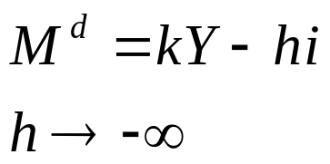
Special Cases: The Liquidity Trap
i
i
IS’
LM
LM’
M^{d}
IS
M
Y₀
Y
Monetary policy: Fully Ineffective
Fiscal policy: Fully effective

Slide 36
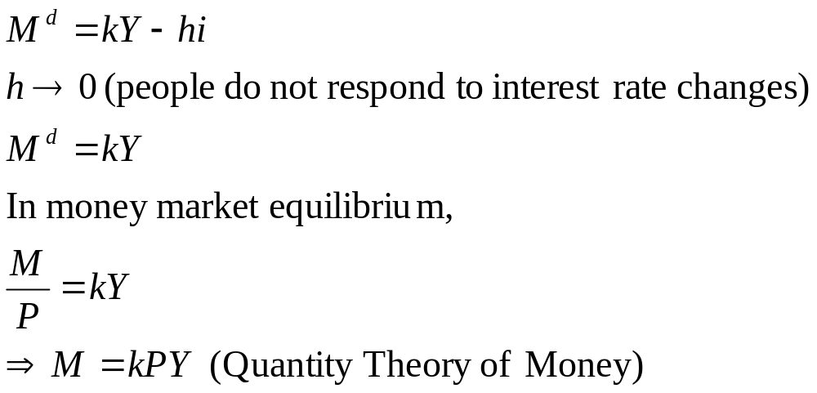
Special Cases: The Quantity Theory of Money
This is the Classical Case, in which people are fully unresponsive to the changes in the interest rate
  No matter what the interest rate is, people prefer to hold exactly the same amount of money (and that is determined by the volume of transactions, only)
(regardless of the interest rate, people hold money based on their transactions needs)

Slide 37
Special Cases: The Quantity Theory of Money
i
M^{d}
i
LM
IS
Y₀
Y
M
The sensitivity parameter is 0, the slope
of the money demand function is infinite
The slope of the LM is infinite

Slide 38
Special Cases: The Quantity Theory of Money
Fiscal policy: fully ineffective (any increase in output and income is fully crowded out by the increase in interest rate)
Monetary policy: fully effective (an increase in M→an increase in Y with a constant P)
i
LM
i₁
i₀
IS’
IS
Y₀
Y

Slide 39
POLICY MIXES
In order to reach specific goals, the governments may use monetary and fiscal policy together
Goal 1: Increase the income/output level, but at the same time keep interest rate from rising
  To achieve this goal, use expansionary fiscal and expansionary monetary policy: “Accomodative Monetary Policy”
Monetary Accomodation
LM
i
2
LM’
i₀
1
IS’
IS
Y₀
Y₁
Y

Slide 40
POLICY MIXES
Goal 2: Keep income/output the same, decrease the interest rate
*Contractionary fiscal
*Expansionary monetary
Goal 3: Keep interest rate the same, decrease the income
*Contractionary fiscal
*Contractionary monetary
LM
LM’
LM
LM’
IS
IS
IS’
IS’

Slide 41
The LM-Relation as an Interest Rate Rule
So far, we derived the LM function (relationship between Y and i in the money market) for a GIVEN money supply;
However, in actuality, central banks think in terms of targeting the interest rate, and adjusting the money supply to the changes in economic activity (endogenous money supply) to achieve the targeted interest rate;
Hence, we may derive the LM function under an alternative assumption that the central bank sets the interest rate and adjusts the money supply to achieve the targeted interest rate

Slide 42
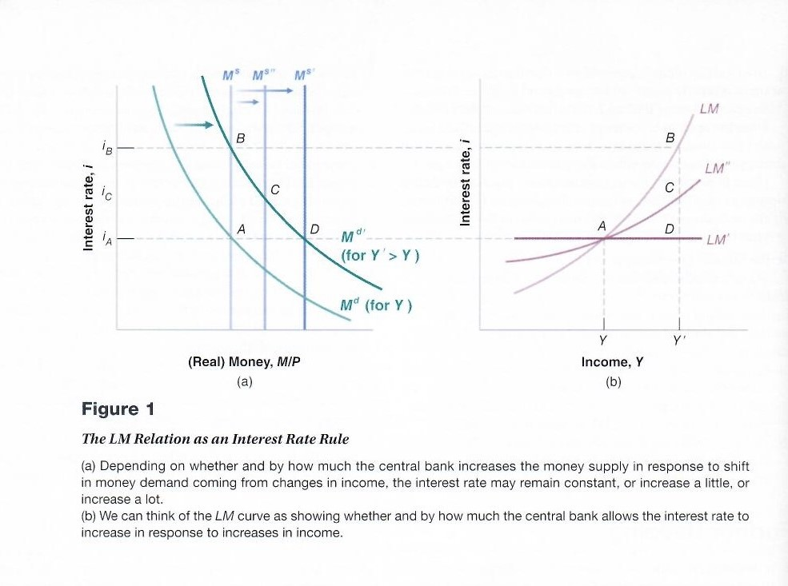
The LM-Relation as an Interest Rate Rule

Slide 43
The LM-Relation as an Interest Rate Rule
The LM that we derive here gives us the relationship between the income level and the interest rate when the central bank follows an interest rate rule, and lets the money supply adjust as needed;
The slope of the LM then depends on how much the central bank lets the interest rate to change in response to an increase in income and thus money demand;
Suppose that there is an increase in government spending which leads to an increase in government budget deficit;
With constant money supply, this would increase the interest rate;
But if the central bank has a constant interest rate rule, money supply will adjust and leave the interest rate intact.

Slide 44
The LM-Relation as an Interest Rate Rule
Under which of the two different assumptions (letting the interest rate adjust or letting the money supply adjust) do you think expansionary fiscal policy has the stronger effect on income and output?

