Slide 1
Fall 2025-26
Econ 202.02
Chapter 6-The Labor Market
Lecture Notes

Slide 2
Chapter 6 Contents
Labor market measurement
Wage determination
Wages, prices and unemployment
  Price determination
  Wage-setting relation
  Price setting relation
  Equilibrium
  Changes in equilibrium

Slide 3
Labor market measurement
Population
Non-institutional civilian population
Population not eligible for work
Working age (15 and above)
Below Working age (below 15)
Labor force
Not in labor force
Employed
Unemployed

Slide 4
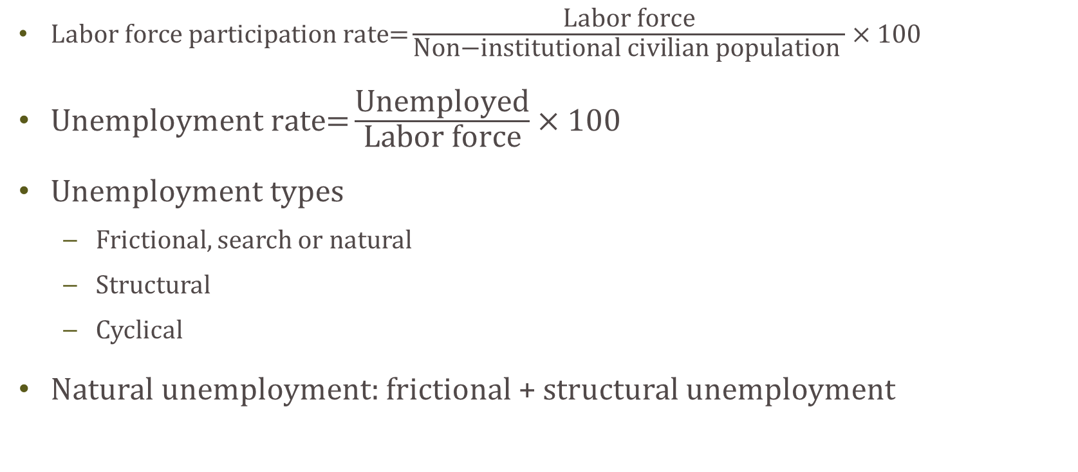
Labor market measurement
$\text{Labor} \text{force} \text{participation} \text{rate}\text{=}\frac{\text{Labor} \text{force}}{\text{Non}\text{−}\text{institutional} \text{civilian} \text{population} }×100$
$\text{Unemployment} \text{rate}\text{=}\frac{\text{Unemployed}}{\text{Labor} \text{force}}×100$
Unemployment types
  Frictional, search or natural
  Structural
  Cyclical
Natural unemployment: frictional + structural unemployment

Slide 5
Wage Determination
How are wages determined, and what is the relation between wages and employment?
Wages are determined by
  Collective bargaining
  Directly set by the employer (no negotiation)
  Bilateral bargaining between employer and employee
Factors that affect the wage determination process:
  Reservation wage
  Condition of the labor market
  Efficiency wages

Slide 6
The process of wage bargaining
What are the factors that affect the bargaining process?
  Who has a higher bargaining power in negotiations
The bargaining power that a worker has depends on
  how indispensable he/she is to the employer
  The labor market conditions (whether unemployment is high or low)

Slide 7
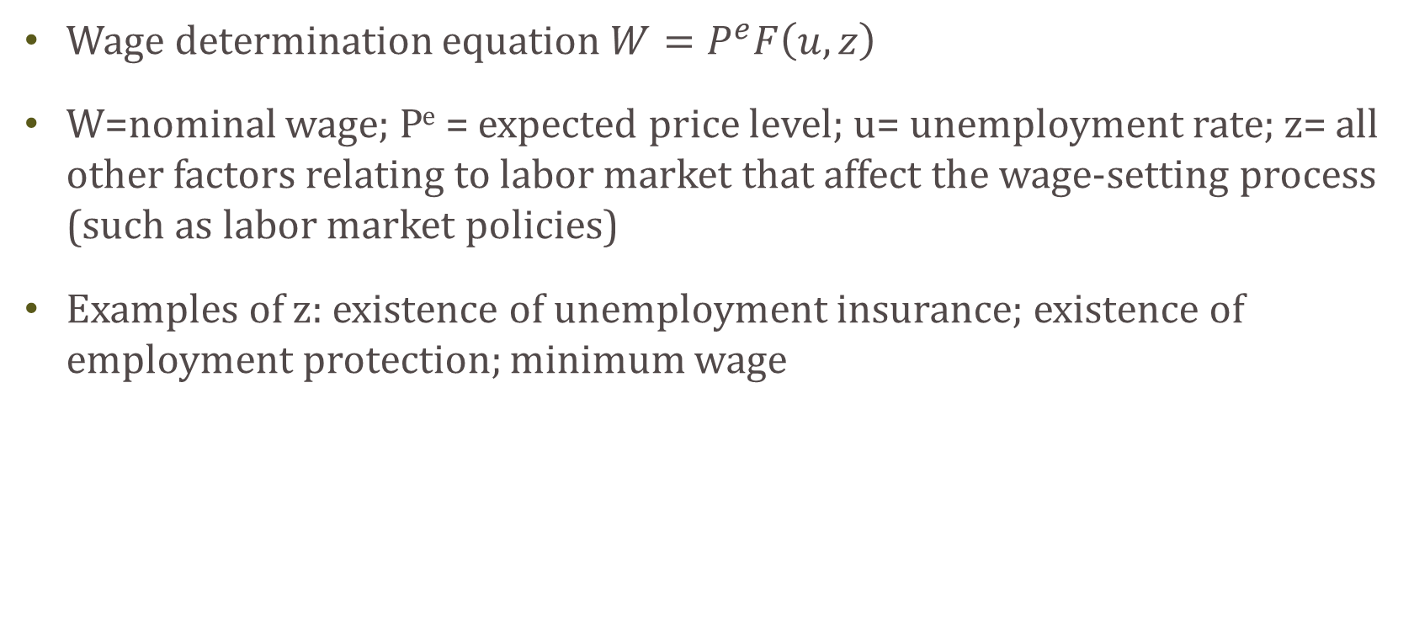
Wages, Prices and Unemployment
Wage determination equation $W=P^{e}F\left(u,z\right)$
W=nominal wage; P^{e} = expected price level; u= unemployment rate; z= all other factors relating to labor market that affect the wage-setting process (such as labor market policies)
Examples of z: existence of unemployment insurance; existence of employment protection; minimum wage

Slide 8
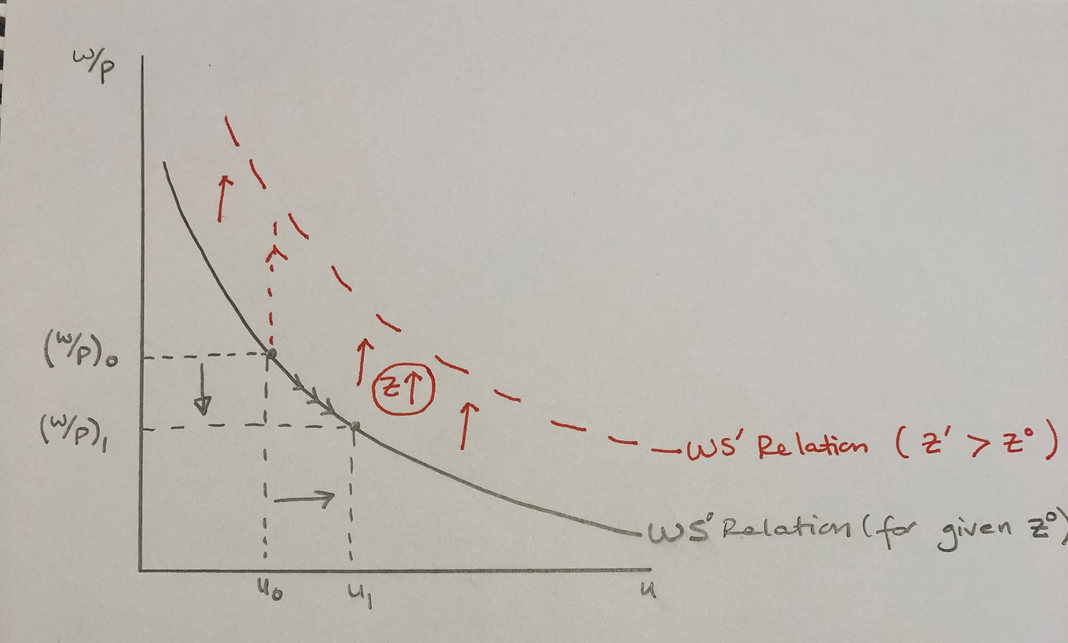
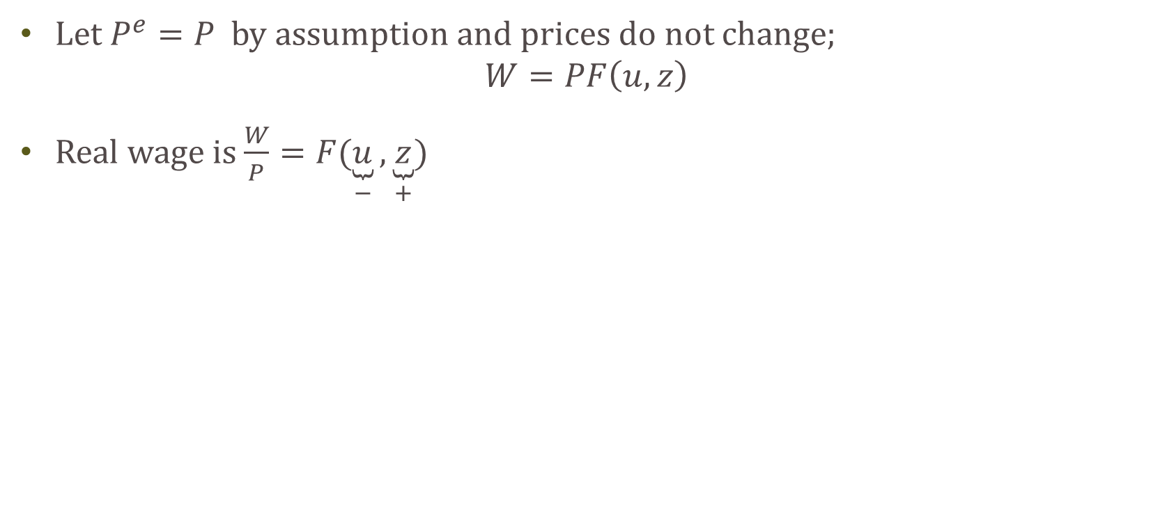
Wage-setting Relation
Let $P^{e}=P$ by assumption and prices do not change;
$$W=PF\left(u,z\right)$$
Real wage is $\frac{W}{P}=F(\underset{−}{\underbrace{u}},\underset{+}{\underbrace{z}})$

Slide 9
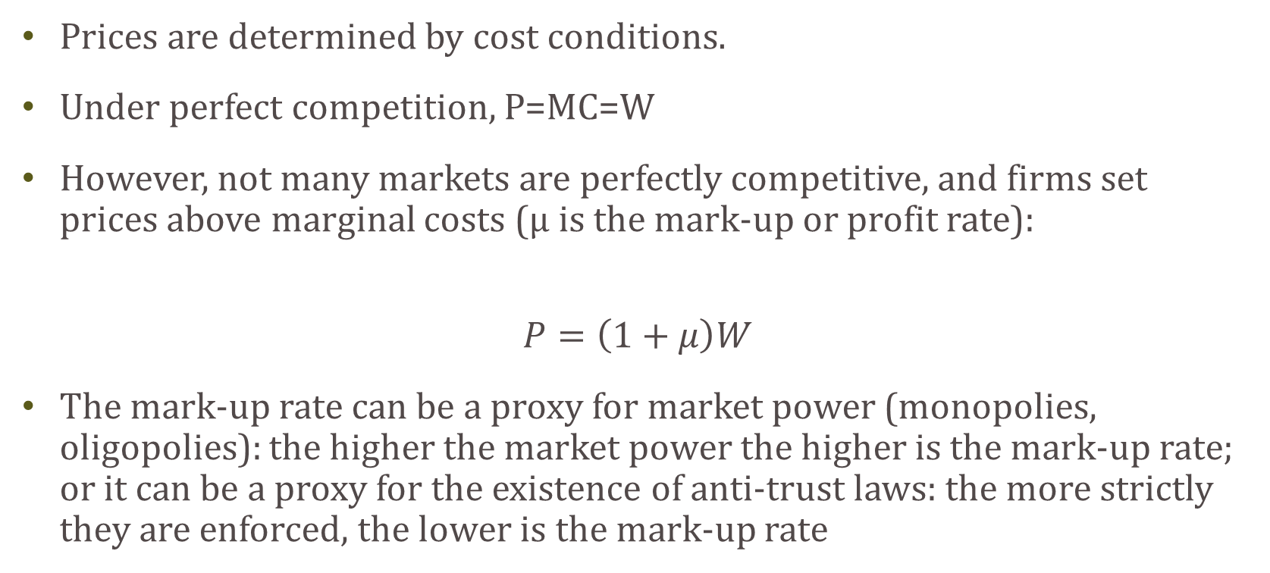
Price Determination
Prices are determined by cost conditions.
Under perfect competition, P=MC=W
However, not many markets are perfectly competitive, and firms set prices above marginal costs (μ is the mark-up or profit rate):
$$P=\left(1+μ\right)W$$
The mark-up rate can be a proxy for market power (monopolies, oligopolies): the higher the market power the higher is the mark-up rate; or it can be a proxy for the existence of anti-trust laws: the more strictly they are enforced, the lower is the mark-up rate

Slide 10
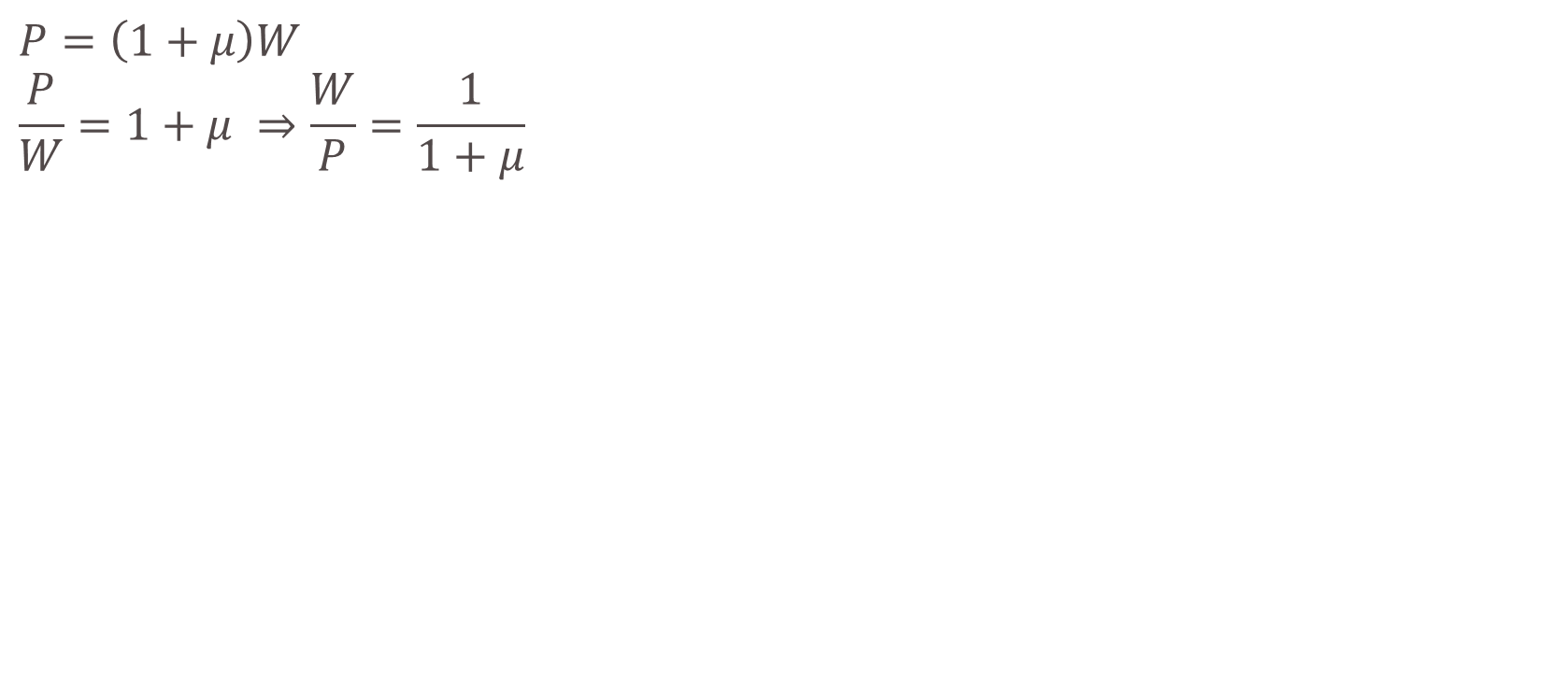

Price-setting Relation
$$P=\left(1+μ\right)W$$
$$\frac{P}{W}=1+μ ⇒\frac{W}{P}=\frac{1}{1+μ}$$
W/P
$$\frac{1}{1+μ}$$
PS-relation
u

Slide 11
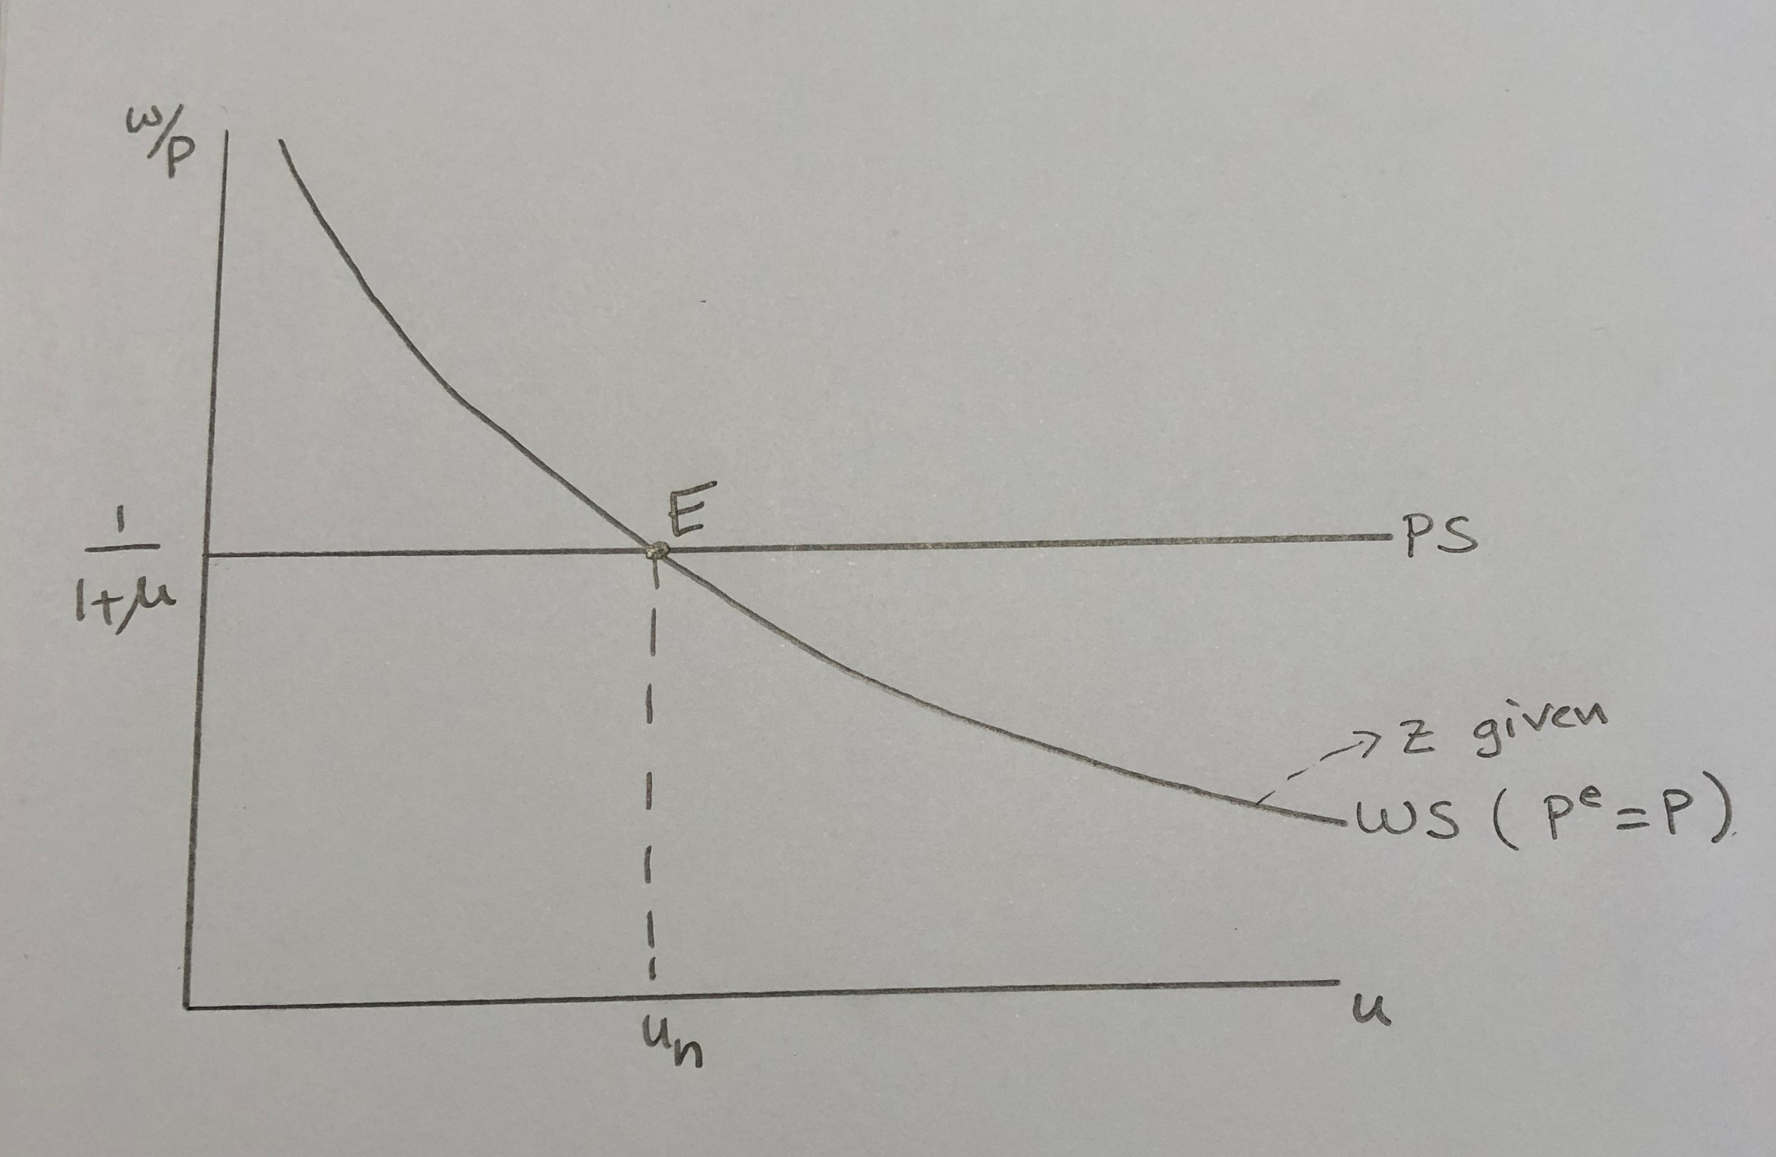
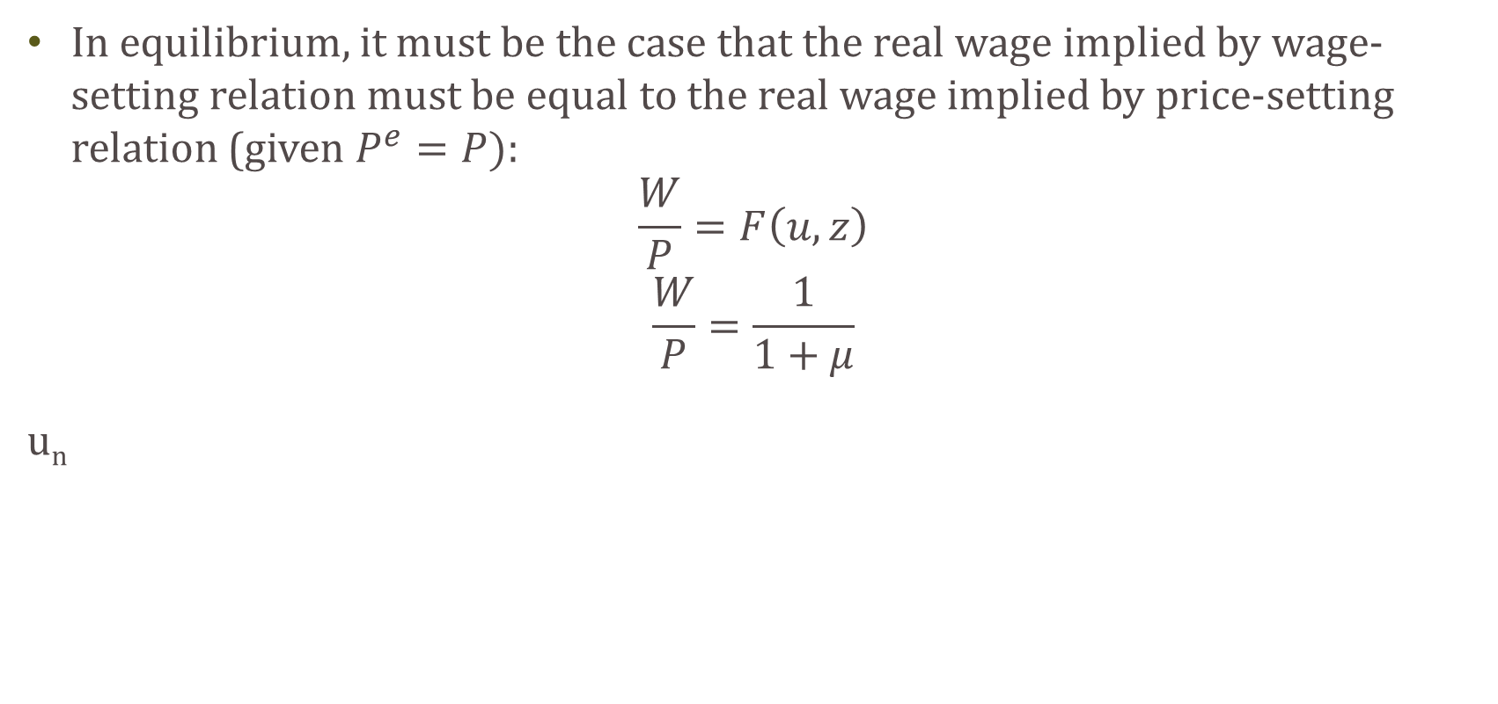
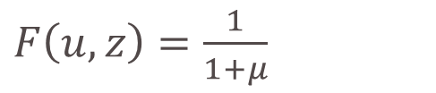
Equilibrium in the Labor Market
In equilibrium, it must be the case that the real wage implied by wage-setting relation must be equal to the real wage implied by price-setting relation (given $P^{e}=P)$:
$$\frac{W}{P}=F\left(u,z\right)$$
$$\frac{W}{P}=\frac{1}{1+μ}$$
u_{n}
$F\left(u,z\right)=\frac{1}{1+μ}$
at some u=u_{n}
u_{n} is the natural rate of unemployment-frictional plus structural (occurs when the economy is at full employment, or is producing potential output)

Slide 12
Changes in Equilibrium
Changes in equilibrium can be due to changes in WS and/or changes in PS
Changes in WS relationship are due to changes in z (taken as given and constant along a given WS-curve)
Changes in z:
  Changes in minimum wage
  Changes in unemployment benefits or unemployment insurance
  Changes in employment protection laws

Slide 13
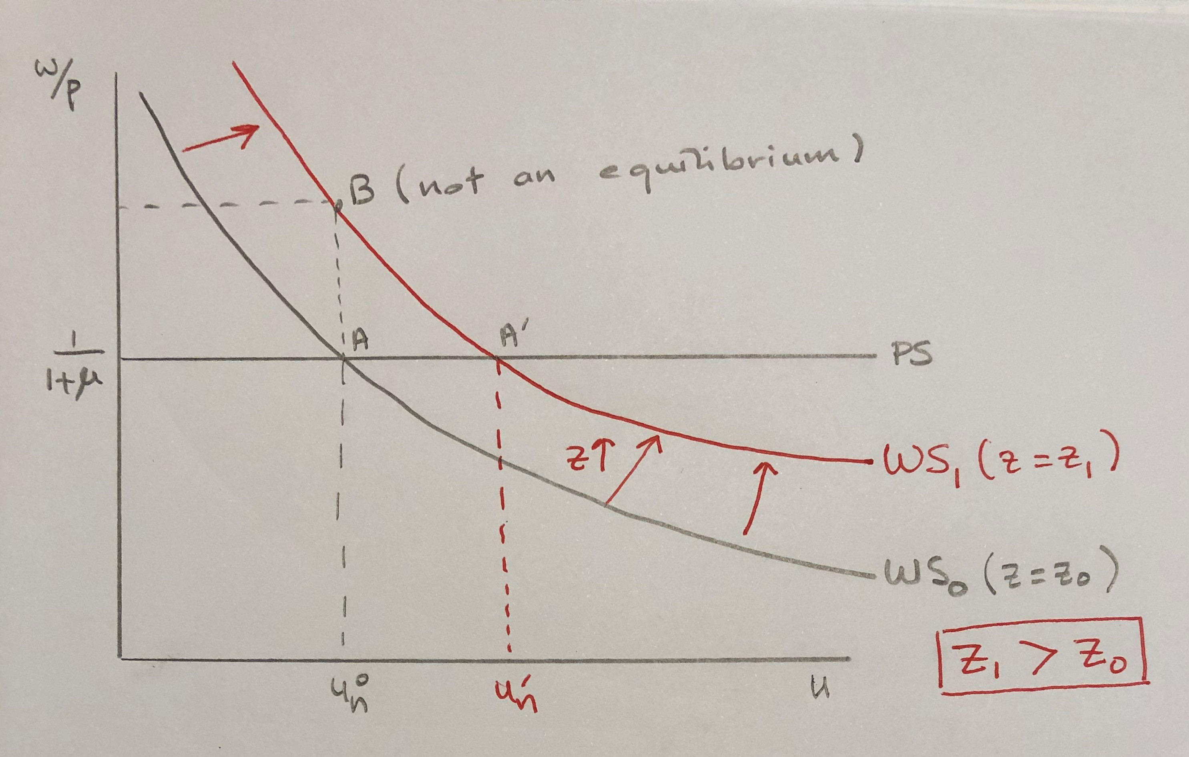
Changes in Equilibrium
An increase in z may represent:
An increase in minimum wage;
An increase in employment protection;
An increase in unemployment insurance
These changes all lead to an increase in reservation wage and an increase in natural rate of unemployment (no change in equilibrium real wage)

Slide 14
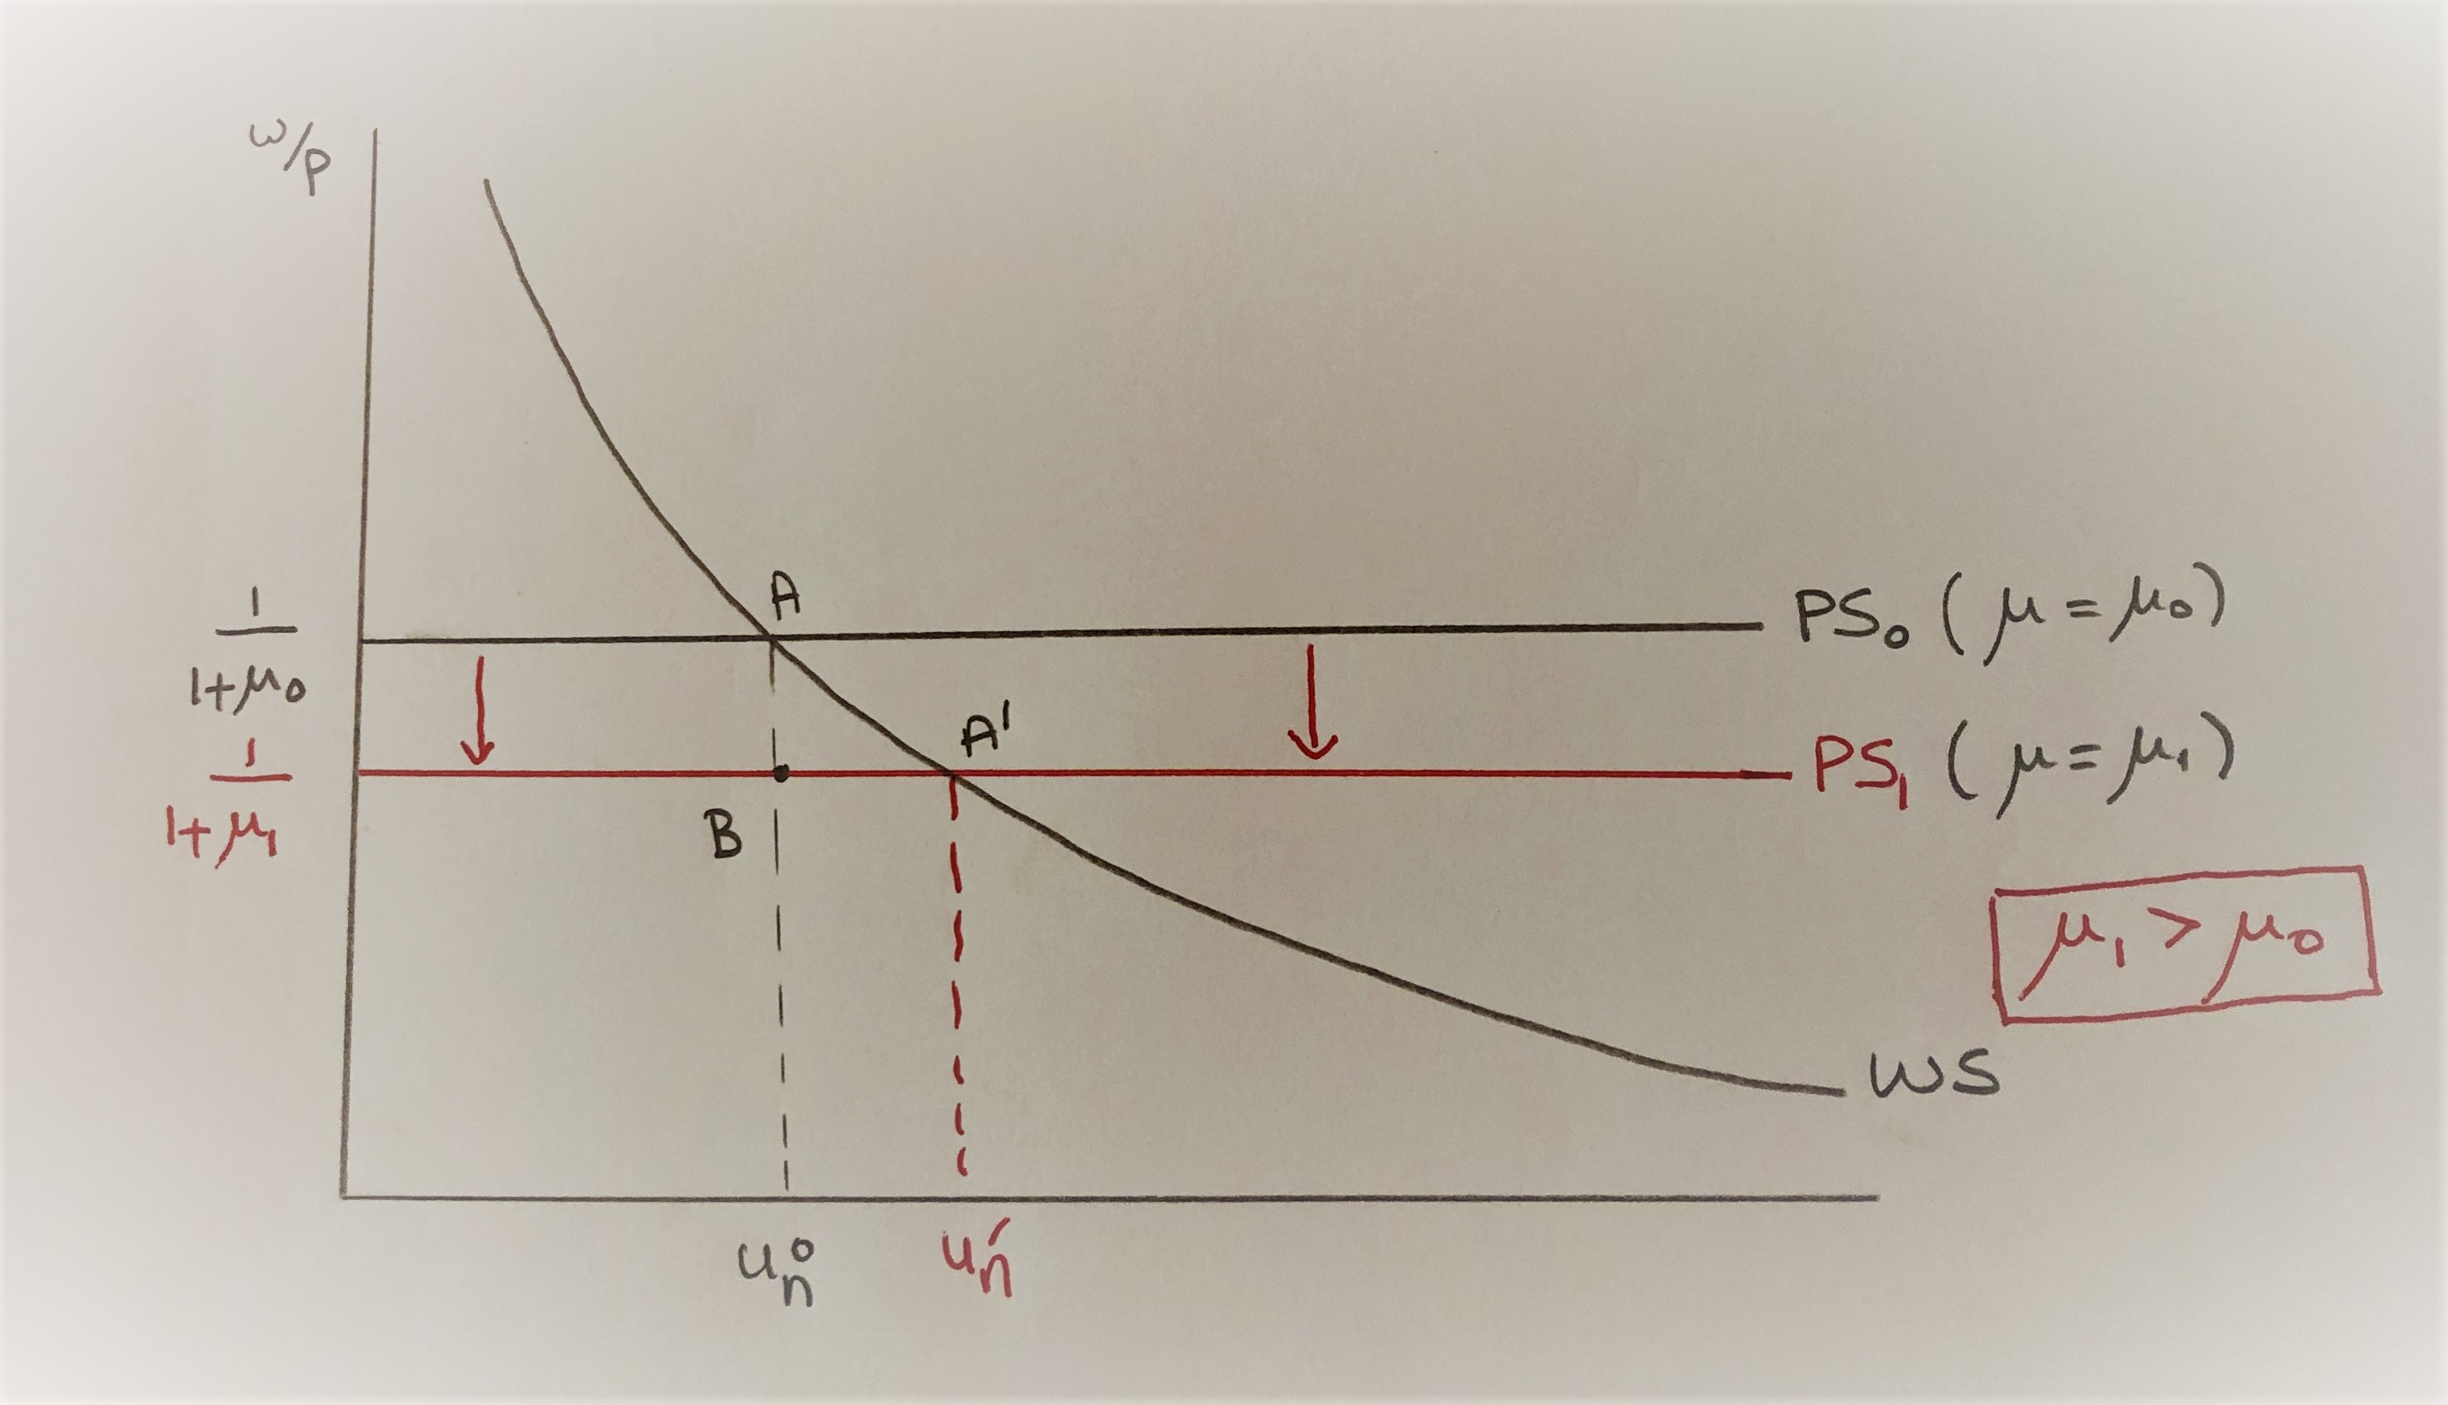
Changes in Equilibrium
Changes in PS are due to changes in the mark-up rate, μ
  Changes in the degree of enforcement of anti-trust laws
  Changes in market power
An increase in the mark-up rate may represent:
A decrease in the degree of enforcement of anti-trust laws (more relaxed enforcement);
An increase in market power;
An increase in the price of inputs in production, other than wages (labor price)

