Slide 1
Benefits of Trade, Comparative Advantage, and Empirical Trade Work
A Presentation on Comparative Advantage and Global Trade Patterns

Slide 2
Law of Comparative Advantage (Recap)
Does the law of comparative advantage hold in the data?
A primer on the size of the gains from trade.

Slide 3
Comparative Advantage and Gains from Trade
In Lecture 1:
Established Comparative Advantage (CA) and Gains from Trade (GTA)
Next Step:
Demonstrate how CA can predict trade patterns.
Principle of Comparative Advantage:
CA arises from differences in relative autarky prices.
Explanation:
If countries have the same autarky prices, trade will not occur.
Law of Comparative Advantage:
Countries export goods where they have CA (lower autarky prices).

Slide 4
Autarky Prices and Export Position Correlation
Establishing Autarky Prices (pa):
Recall from Lecture 1: Autarky prices refer to prices when a country is closed to trade.
Key Proposition:
In a neoclassical trade model, with a representative household in country n:
After opening to trade, the correlation between prices (p), autarky prices (pa), and export position (tn) is non-negative (corr(p-pa,tn) ≥ 0).

Slide 5
Challenges in Testing the Comparative Advantage Theory
Objective:
Determine truth/falsity of Comparative Advantage using export, import, and price data.
The Challenge:
Problem 1: Principle version too weak for real-world tests (more than 2 countries or goods).
Problem 2: Latent variable problem: 'Law' version is about trading behavior but is based on autarky prices.
Problem 3: Periods of autarky rarely observed.

Slide 6
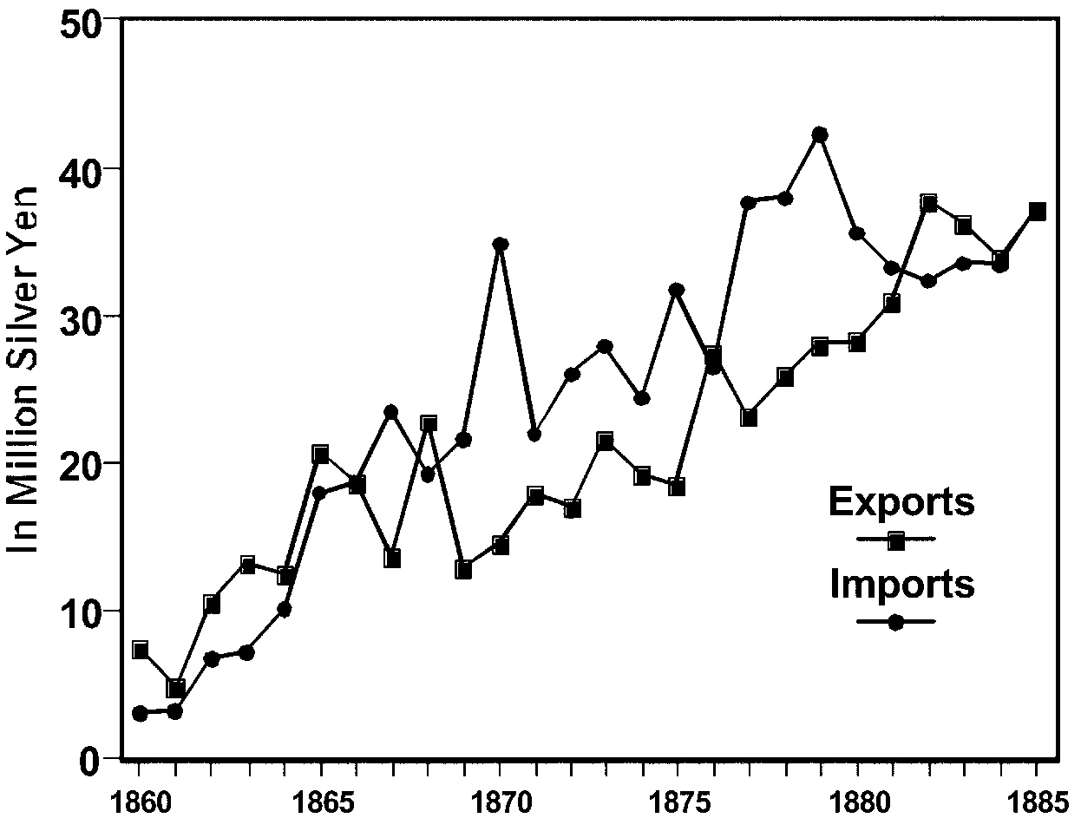
Testing Comparative Advantage: Bernhofen and Brown’s Natural Experiment
Bernhofen and Brown (JPE, 2004):
Japan (1858 closed economy, opened in 1859) as a natural experiment to test CA.
Solving Problem 3:
Japan's near-closed economy means autarky prices (pa) are almost observed.
Additional Attractive Features:
Simple production technologies and exogenous opening to trade (forced by USA).

Slide 7
Establishing the Effects of Trade in Japan
Argument Recap:
The situation before 1858 resembled the idealized case of autarky.
Trade was exogenous to societal changes like liberalization.
Next Steps: Identify positive and negative price effects in sectors.
Final Goal: Assess the extent to which Comparative Advantage holds.

Slide 8
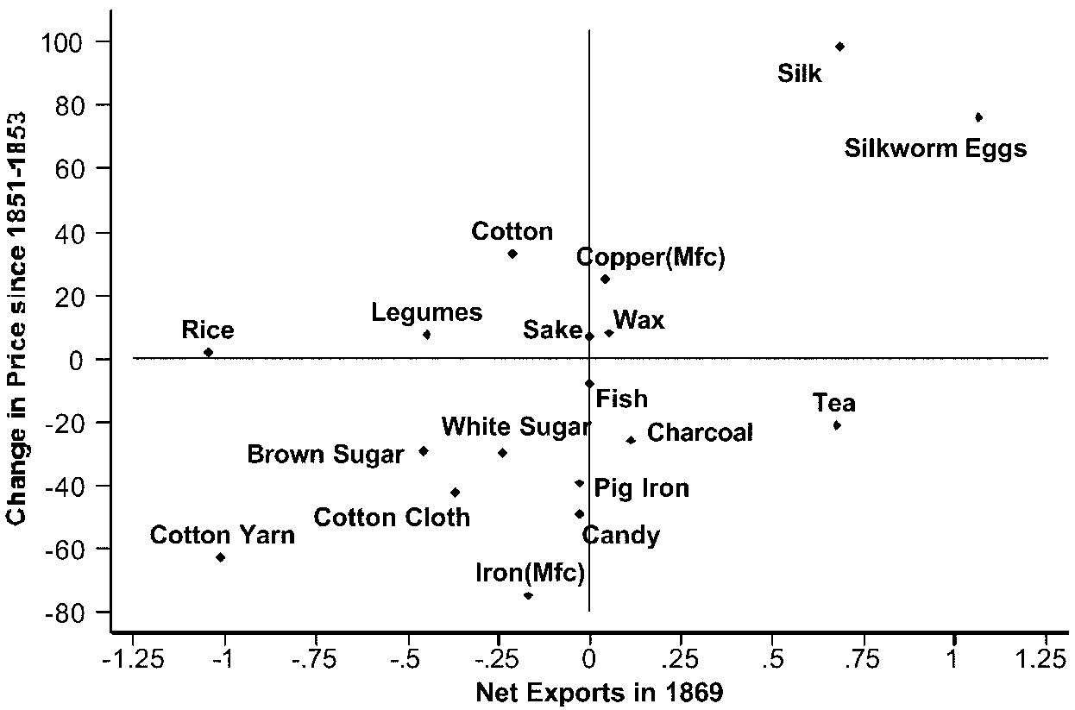
Empirical Findings and Japan’s Advantages/Disadvantages

Slide 9
Estimating the Gains from Trade Effects
Objective: To quantify the gains from trade by analyzing Japan's opening.
Methodology: Compare pre-trade autarky prices and post-trade market prices.
Challenges: Limited historical data and isolating trade effects.
Outcomes: Positive price effects in CA sectors, negative effects in competitive sectors.

Slide 10
Table 2 - Approximate Inner Product in Various Test Years (Millions of Ryō)
Year of Net Export Vector Components | 1868 | 1869 | 1870 | 1871 | 1872 | 1873 | 1874 | 1875
Imports with observed autarky prices | -2.24 | -4.12 | -8.44 | -7.00 | -5.75 | -5.88 | -7.15 | -7.98
Imports of woolen goods | -0.98 | -0.82 | -1.29 | -1.56 | -2.16 | -2.50 | -1.56 | -2.33
Imports with approximated autarky prices | -1.10 | -0.95 | -0.70 | -0.85 | -1.51 | -2.08 | -1.60 | -2.65
Exports with observed autarky prices | 4.07 | 3.40 | 4.04 | 5.16 | 4.99 | 4.08 | 5.08 | 4.80
Exports with approximated autarky prices | 0.09 | 0.03 | 0.07 | 0.07 | 0.15 | 0.07 | 0.11 | 0.10
Total inner product | -0.18 | -2.47 | -6.31 | -4.17 | -4.28 | -6.31 | -5.11 | -8.06

Slide 11
Trade Dynamics and Welfare Implications
Import and Export Price Trends: Lower import prices, higher export prices.
Welfare Implications: How does trade impact societal welfare?
Counterfactual: Compare welfare gains with the scenario if Japan had remained closed.
Key Historical Shocks: The Suez Crisis and OPEC Oil Price Hike.

Slide 12
Measuring Gains to a Representative Japanese Consumer from the 1858 Opening Up
Slutsky Compensation: Calculate the welfare change in an autarkic Japan.
ΔW = e(p_a^t1858) − e(p_a1858)
ΔW measures the amount of income needed to afford the counterfactual consumption under trade.

Slide 13
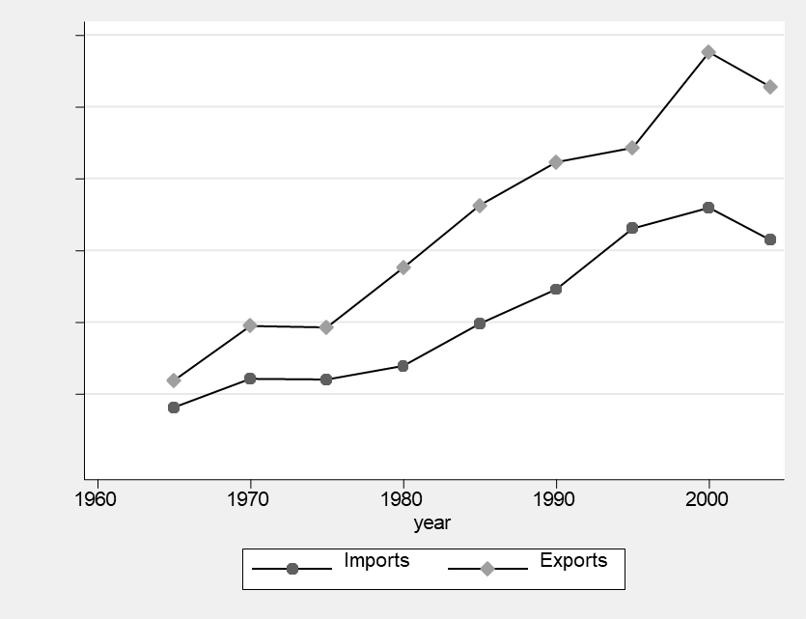
Can We Use the Increased Use and Ease of Air Travel as a Measure of Trade Shock?

Slide 14
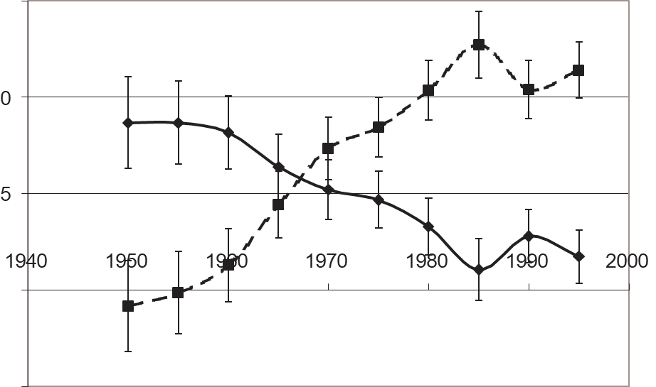
Air Distance Dominating Over Ship Distance

Slide 15
The Role of Exogenous Factors in Shaping Trade Patterns
Technological Innovation and Trade: Steam-powered oceanic shipping revolutionized trade.
Key Events: The Suez Crisis and Gaza Blockade altered global trade patterns.
Consequences: Loss of specialization opportunities reduces productivity gains.
The shock most acutely felt in specific countries- where the greatest GAT effect resides.

Slide 16
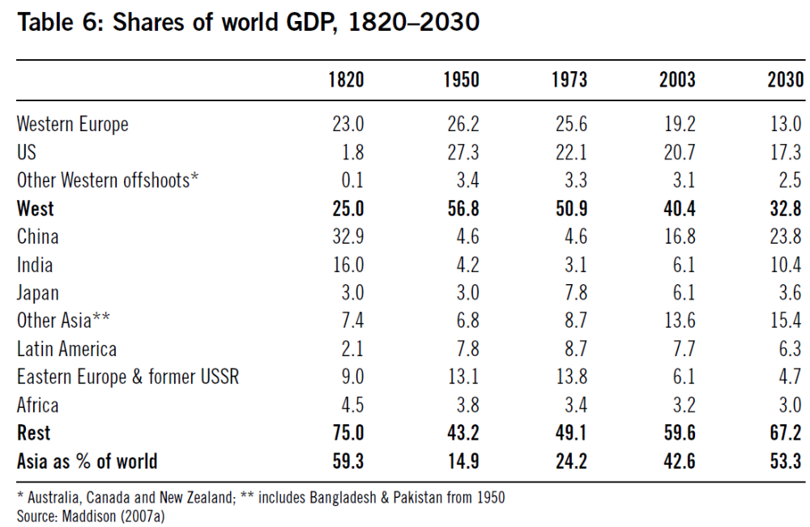



It is about the differences in growth
The rest had still the largest production center by 1820 due to its population

Slide 17
A Simple Story That Needs to Be Complicated
Some countries were unprepared for technological innovations in the first trade cycle (1870-1913).
Countries with strong institutions and central states adapted better.
The gap between rich and poor countries widened, rather than shrinking, due to this age of `free-trade`.

