Slide 1
Chapter 25:
Economic Policy in the Open Economy Under Fixed Exchange Rates
Econ 202-Lecture Notes-PART I
The BOP Curve
McGraw-Hill/Irwin
Copyright © 2014 by the McGraw-Hill Companies, Inc. All rights reserved.

Slide 2
Learning Objectives
Explain general equilibrium in the macroeconomy using the IS/LM/BP model.
Describe the impact of changes in fiscal policy on income, trade, and interest rates under fixed exchange rates.
Describe the impact of changes in monetary policy on income, trade, and interest rates under fixed exchange rates.
Demonstrate how varying degrees of capital mobility alter the effectiveness of fiscal and monetary policy under a system of fixed exchange rates.

Slide 3
General Equilibrium in the Open Economy: the IS/LM/BP Model
  To understand the effects of policies on the open economy, we need to use a general equilibrium model.
  The IS/LM/BP model is built around three sorts of equilibria:
    money market equilibrium (the LM curve),
    real sector equilibrium (the IS curve), and
    BOP equilibrium (the BP curve).

Slide 4
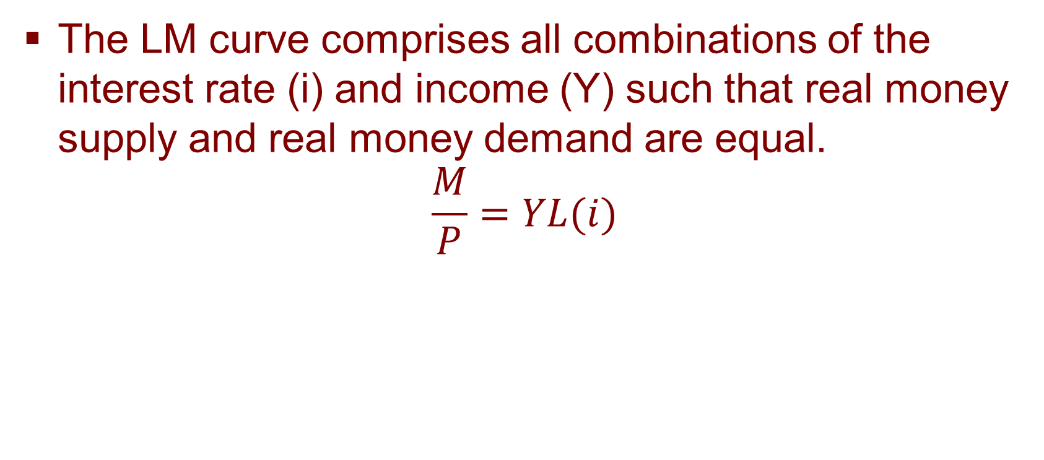
Money Market Equilibrium: the LM Curve
The LM curve comprises all combinations of the interest rate (i) and income (Y) such that real money supply and real money demand are equal.
$$\frac{M}{P}=YL(i)$$

Slide 5
Money Market Equilibrium: the LM Curve
  Money supply is assumed to equal money demand in money market equilibrium.
  Money supply is fixed.
  Money demand depends inversely on the interest rate (i) and positively on income (Y).
    As interest rates rise, the opportunity cost of holding money rises, and so the quantity demanded of money decreases.
    As income rises demand for money increases.

Slide 6
Money Market Equilibrium: the LM Curve
M_{s}
i
At i₁, M_{s}>M_{d}: people will buy
bonds, reducing i.
At i₂, M_{s}<M_{d}: people will sell
bonds, increasing i.
i₁
i_{e}
i₂
L = f(i,Y)
money

Slide 7
Money Market Equilibrium: the LM Curve
  If income rises, money demand will exceed money supply, and interest rates will rise.
  Therefore, the LM curve is the positive relationship between the interest rate and income (Y) in money market equilibrium.
  Points to the left of the LM curve mean there is an excess supply of money; points to the right imply an excess demand.

Slide 8
Money Market Equilibrium: the LM Curve
i
LM
income

Slide 9
Money Market Equilibrium: the LM Curve
  Increases in M_{s} or exogenous decreases in M_{d} (exogenous behavioral changes) will shift LM to the right.
  Decreases in M_{s} or exogenous increases in M_{d} (exogenous behavioral changes) will shift LM to the left.

Slide 10
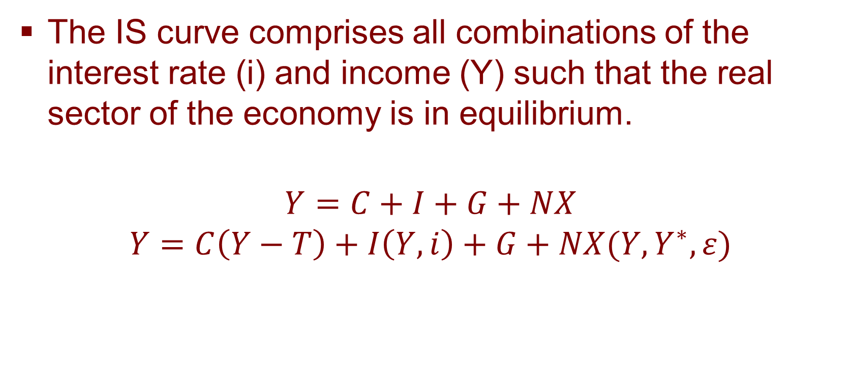
Real Sector (Goods Market) Equilibrium: the IS Curve
The IS curve comprises all combinations of the interest rate (i) and income (Y) such that the real sector of the economy is in equilibrium.
$$Y=C+I+G+NX$$
$$Y=C\left(Y−T\right)+I\left(Y,i\right)+G+NX(Y,Y^{∗},ε)$$

Slide 11
Real Sector (Goods Market) Equilibrium: the IS Curve
  Investment should depend inversely on the interest rate (i).
    As interest rates rise, the cost of borrowing rises, so I falls.
  As before, consumption (C) depends positively on income (Y).
  Also, exports (X), real exchange rate and government spending (G) are fixed.

Slide 12
Real Sector (Goods Market) Equilibrium: the IS Curve
  The IS curve is the relationship between the interest rate and Y in the goods market equilibrium.
    As the interest rate falls, investment increases, thereby increasing Y.
    As the interest rate rises, investment decreases, thereby decreasing Y.
  Therefore, the IS curve is downward- sloping.

Slide 13
Real Sector (Goods Market) Equilibrium: the IS Curve
i
IS
income

Slide 14
Real Sector (Goods Market) Equilibrium: the IS Curve
  Increases in autonomous C, I, X, G or decreases in T will shift IS to the right.
  Assuming Marshall-Lerner condition holds, an exogenous increase in real exchange rate (real depreciation) will shift IS to the right (as NX increases).
  Decreases in autonomous C, I, X, G or increases in T will shift IS to the left.
  Assuming NX worsens with real exchange rate appreciation (a fall in ε), IS will shift to the left (as NX falls).

Slide 15
External Balance or Equilibrium in the Balance of Payments: The BP Curve
Current Account (Deficit)
Capital and Financial Account (Surplus)
Current Account (Surplus)
Capital and Financial Account (Deficit)

Slide 16
External Balance or Equilibrium in the Balance of Payments: The BP Curve
If there is a Current Account (CA) deficit, it is balanced with a surplus in capital/financial account surplus (by net borrowing from rest of the world by capital/financial inflows larger than outflows)
If there is a Current Account (CA) surplus, it is balanced with a deficit in capital/financial account surplus (by net lending to rest of the world by capital/financial outflows larger than inflows)

Slide 17
External Balance or Equilibrium in the Balance of Payments: The BP Curve
For our purposes, we leave out the account relating to the changes in Central Bank official reserves, we only concentrate on long-term and short-term capital/financial inflows and outflows to counter the current account balance (i.e. in our case, changes in Central Bank official reserves do not affect the BP relation)

Slide 18
BOP Equilibrium: the BP Curve
What is the BP curve?
The BP curve comprises all alternative combinations of the interest rate (i) and income (Y) such that the balance of payments is in equilibrium.
We will at first concentrate on the BP-relationship under a given or fixed exchange rate.
Similarly, foreign interest rate, foreign income, foreign prices, etc. are assumed to be fixed.

Slide 19
BOP Equilibrium: the BP Curve
In the BP model (holding all else constant);
  As income Y increases, volume of imports M increases, Current Account balance worsens (negative effect)
  As income Y falls, volume of imports M falls, Current Account balance improves (positive effect)
  As domestic interest rate i rises, more capital/financial inflow into the country, capital/financial account improves (more borrowing)
  As domestic interest rate i falls, less capital/financial inflow into the country, capital/financial account worsens (less borrowing)

Slide 20
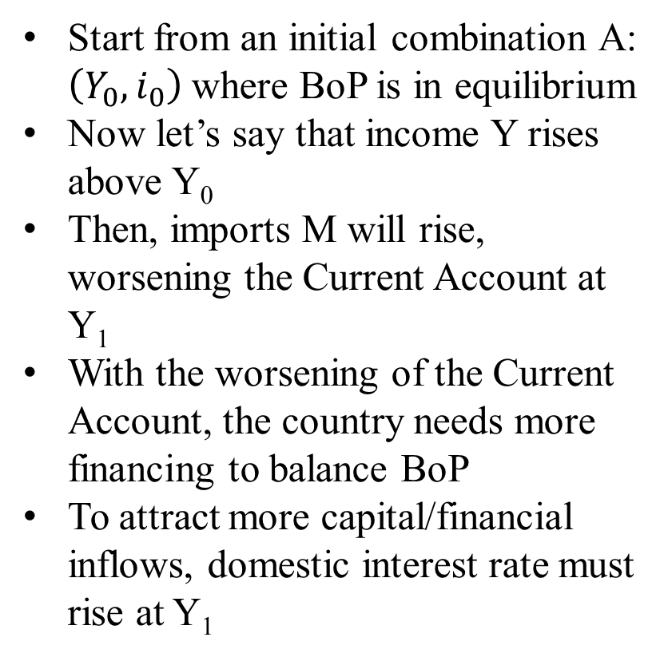
BOP Equilibrium: the BP Curve
Start from an initial combination A: $\left(Y_{0},i_{0}\right)$where BoP is in equilibrium
Now let’s say that income Y rises above Y₀
Then, imports M will rise, worsening the Current Account at Y₁
With the worsening of the Current Account, the country needs more financing to balance BoP
To attract more capital/financial inflows, domestic interest rate must rise at Y₁
i
i₁
B
i₀
●A
Y₀
Y₁
Y

Slide 21
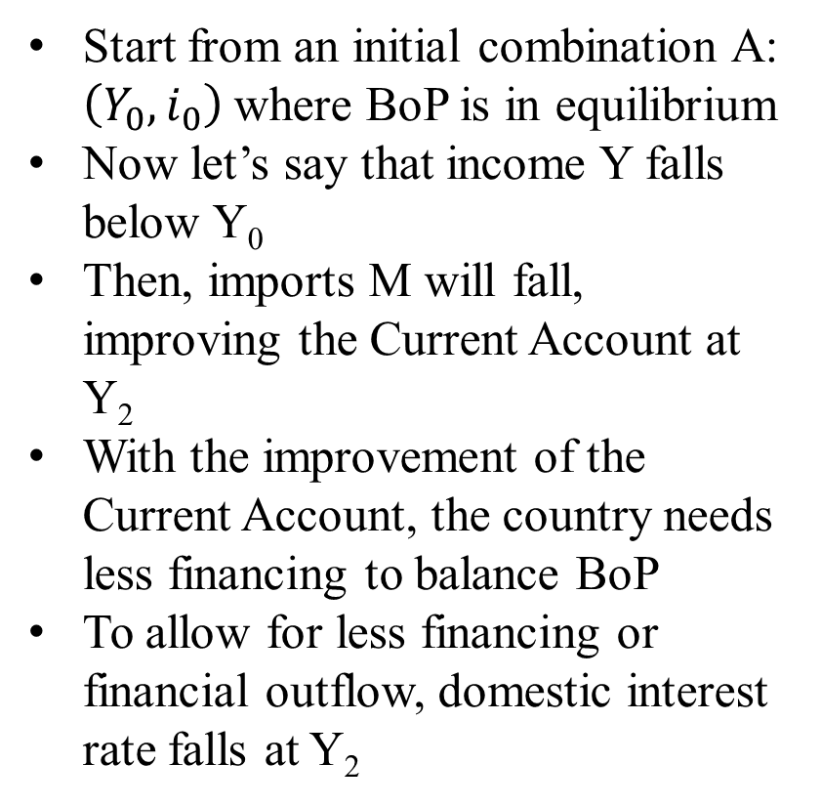
BOP Equilibrium: the BP Curve
Start from an initial combination A: $\left(Y_{0},i_{0}\right)$where BoP is in equilibrium
Now let’s say that income Y falls below Y₀
Then, imports M will fall, improving the Current Account at Y₂
With the improvement of the Current Account, the country needs less financing to balance BoP
To allow for less financing or financial outflow, domestic interest rate falls at Y₂
i
i₀
●A
i₂
C
Y₂
Y₀
Y

Slide 22
BOP Equilibrium: the BP Curve
  The BP curve shows the positive relationship between the interest rate and Y.
    If Y increases and i is unchanged, M will increase and a BOP deficit will open.
    To return to BOP balance, i must rise. This would trigger net short-term capital inflows.
  Therefore, the BP curve is upward- sloping.

Slide 23
BOP Equilibrium: the BP Curve
i
BP
Income, Y

Slide 24
BOP Equilibrium: the BP Curve
i
Points to the left of BP (BoP surplus)
BP (BoP equilibrium)
Y is too low and/or
i is too high
Points to the right of BP (BoP deficit)
Y is too high and/or
i is too low
Y

Slide 25
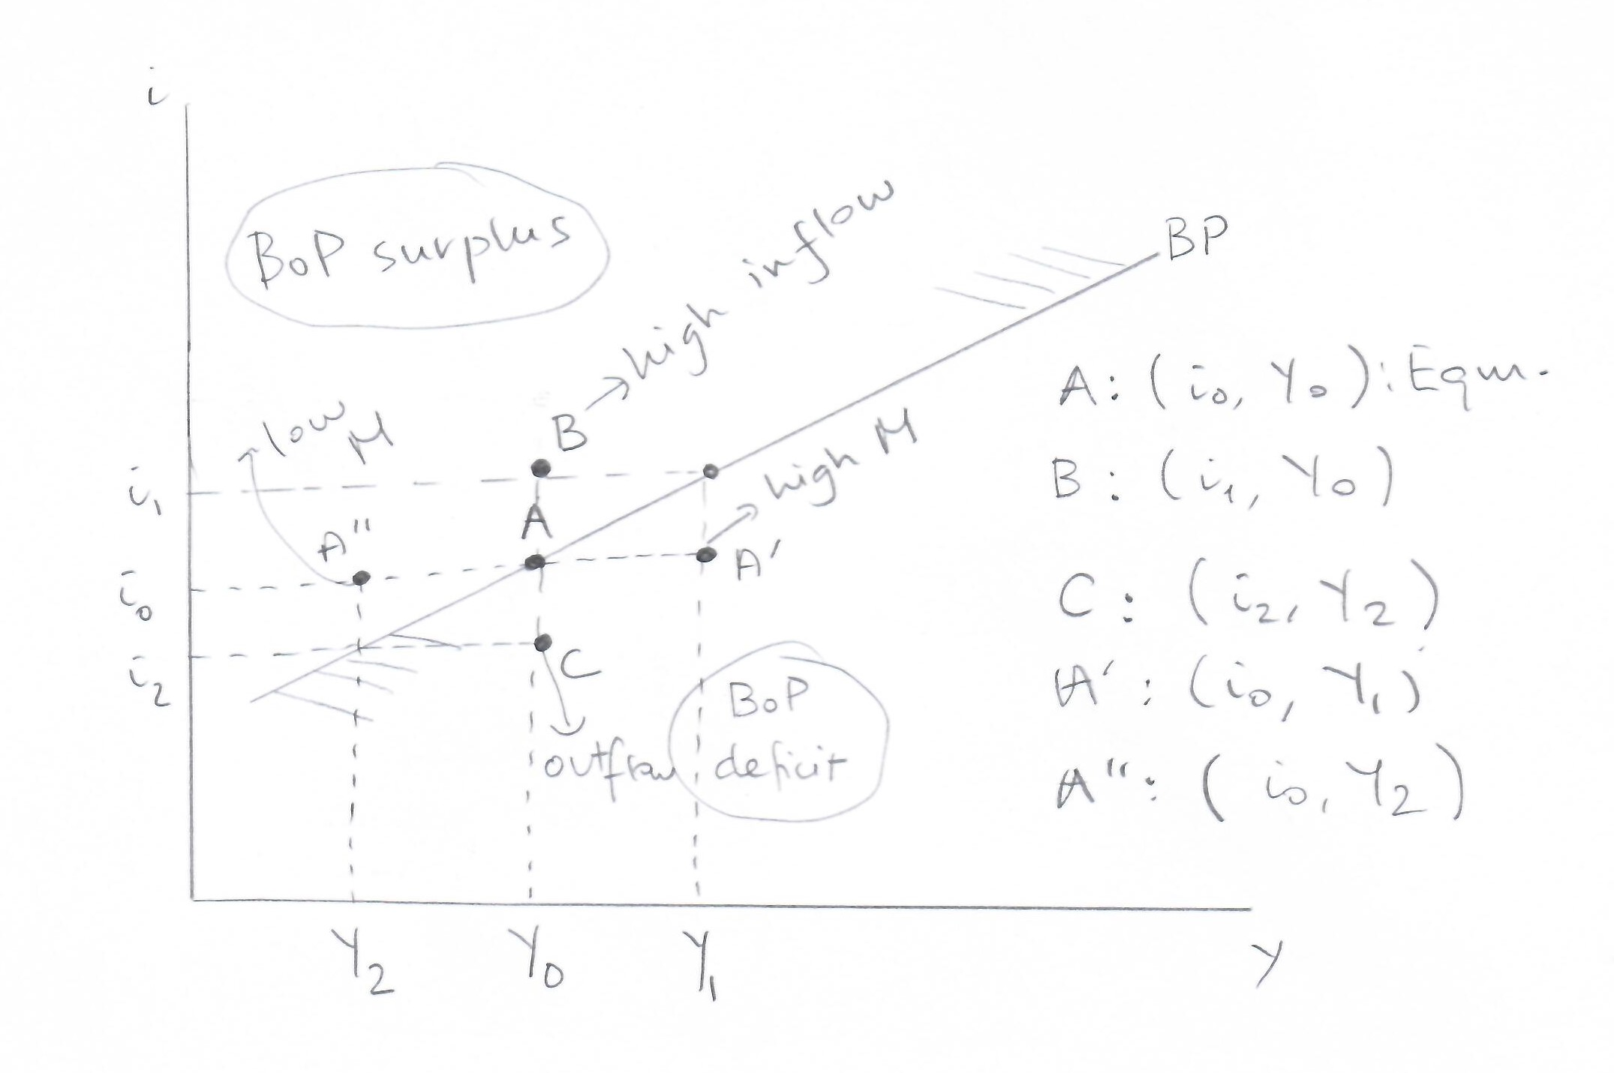
BOP Equilibrium: the BP Curve

Slide 26
BOP Equilibrium: the BP Curve
  Points to the left of the BP curve imply a BOP surplus.
  Points to the right of the BP curve imply a BOP deficit.

Slide 27
BOP Equilibrium: the Slope of the BP Curve
Although we show a positively sloped BP-curve, the shape or the exact slope of the BP-curve depends on the degree of capital mobility in the country
We will show that:
  Perfectly elastic (horizontal) BP-curve: perfect capital mobility (no controls on capital inflows and outflows)
  Perfectly inelastic (vertical) BP-curve: perfect capital immobility (no capital inflows or outflows allowed)
  Any positive slope in between: some degree of capital mobility exists

Slide 28
BOP Equilibrium: the Slope of the BP Curve
Perfectly inelastic BP-curve: Perfect capital immobility
i
Stricter capital flow
controls
i₀
Perfectly elastic BP-curve:
Perfect capital mobility
(no capital controls)
Varying degrees of capital mobility
Y₀
Y

