Slide 1
Chapter 26:
Economic Policy in the Open Economy Under Flexible Exchange Rates
Econ 202.02-Lecture Slides for Chapter 26
McGraw-Hill/Irwin
Copyright © 2014 by the McGraw-Hill Companies, Inc. All rights reserved.

Slide 2
Learning Objectives
Analyze the impact of fiscal policy on income, trade, and exchange rates under flexible exchange rates.
Analyze the impact of monetary policy on income, trade, and exchange rates under flexible exchange rates.
Show how external economic shocks affect the domestic economy under flexible exchange rates.

Slide 3
The Effects of Fiscal and Monetary Policy Under Flexible Exchange Rates
The effectiveness of monetary and fiscal policies at influencing national income differ dramatically under fixed and flexible (or, floating) exchange rate systems.
Under a flexible exchange rate system, combinations of income and interest rates that are not on the BP curve will cause disequilibrium in foreign exchange markets, and force an adjustment in the exchange rate (no intervention by the central bank; exchange rate is allowed to change or, float).
This will cause the BP curve to shift.

Slide 4
The Effects of a Currency Depreciation on the BP Curve
i
BP₀
BP₁
A depreciation expands exports and contracts imports (improves Net Exports and Current Account Balance). For any given level of Y, a lower i is required to bring the BOP to an equilibrium.
Y

Slide 5
The Effects of a Currency Appreciation on the BP Curve
i
BP₁
BP₀
An appreciation contracts exports and expands imports (worsens Net Exports and Current Account Balance). For any given level of Y, a higher i is required to bring the BOP to an equilibrium.
Y

Slide 6
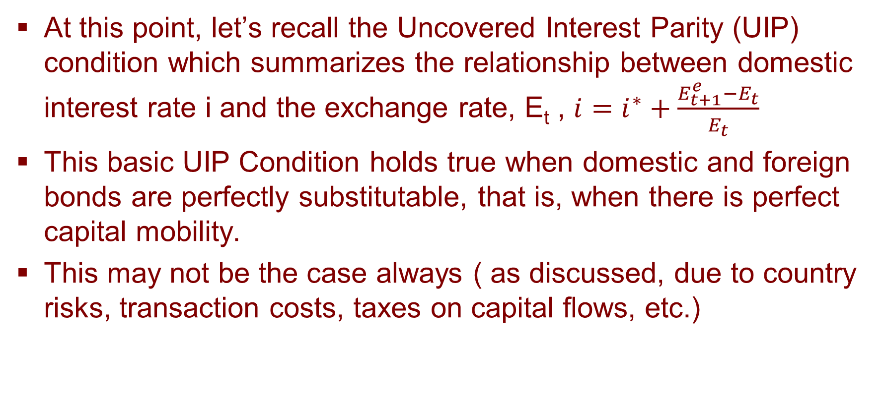
Uncovered Interest Parity Relation
At this point, let’s recall the Uncovered Interest Parity (UIP) condition which summarizes the relationship between domestic interest rate i and the exchange rate, E_{t} , $i=i^{∗}+\frac{E_{t+1}^{e}−E_{t}}{E_{t}}$
This basic UIP Condition holds true when domestic and foreign bonds are perfectly substitutable, that is, when there is perfect capital mobility.
This may not be the case always ( as discussed, due to country risks, transaction costs, taxes on capital flows, etc.)

Slide 7
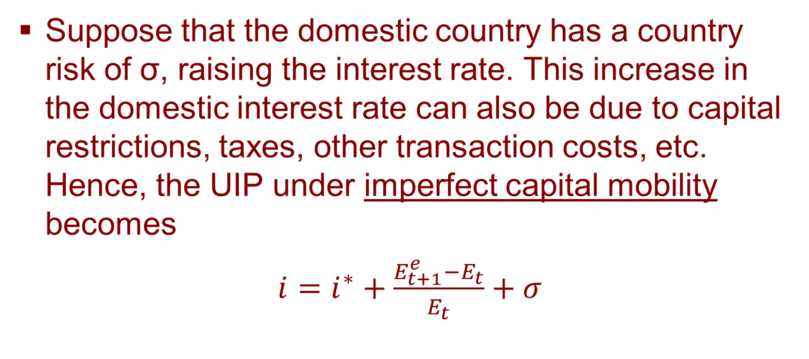
Uncovered Interest Parity Relation
Suppose that the domestic country has a country risk of σ, raising the interest rate. This increase in the domestic interest rate can also be due to capital restrictions, taxes, other transaction costs, etc. Hence, the UIP under imperfect capital mobility becomes
$i=i^{∗}+\frac{E_{t+1}^{e}−E_{t}}{E_{t}}+σ$

Slide 8
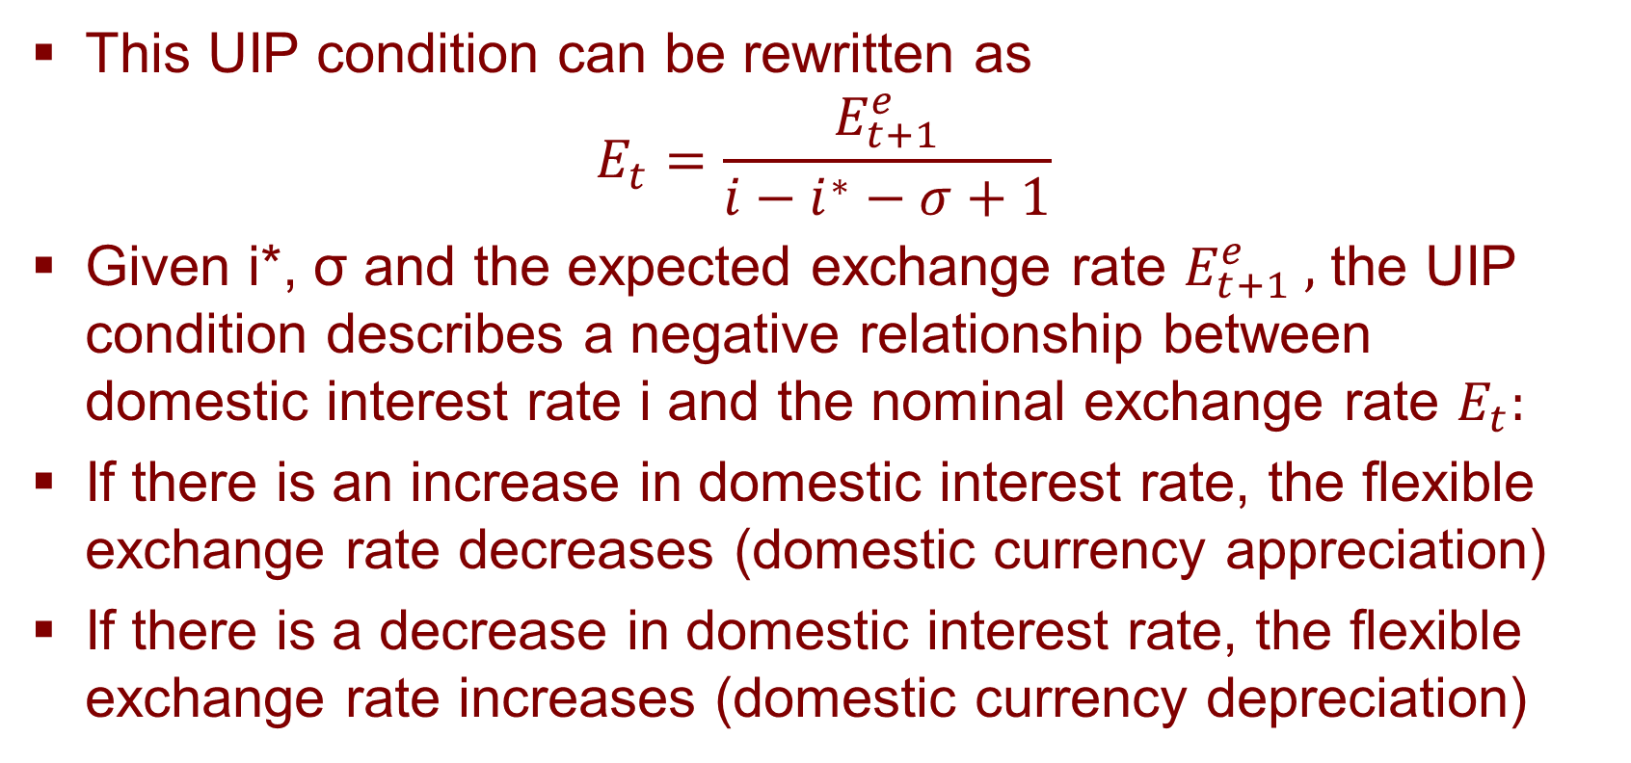
Uncovered Interest Parity Relation
This UIP condition can be rewritten as
$$E_{t}=\frac{E_{t+1}^{e}}{i−i^{∗}−σ+1}$$
Given i*, σ and the expected exchange rate $E_{t+1}^{e} ,$ the UIP condition describes a negative relationship between domestic interest rate i and the nominal exchange rate $E_{t}:$
If there is an increase in domestic interest rate, the flexible exchange rate decreases (domestic currency appreciation)
If there is a decrease in domestic interest rate, the flexible exchange rate increases (domestic currency depreciation)

Slide 9
Fiscal Policy under Flexible Exchange Rates
Case 1: BP is relatively flat compared to LM
Let ∆G>0:
Initial shift in the IS curve with increase in G; domestic interest rate rises; international capital responds fast and there is capital inflow; incipient BoP surplus; domestic currency appreciates, causing NX to worsen (exports fall imports rise);
IS shifts left and BP shifts left with lower NX
i
Incipient BoP Surplus
LM₀
i’
BP₁
(2)
BP₀
B
i₁
i₀
(2)
A
(1)
IS₁
IS₂
IS₀
Y₀
Y₁
Income, Y

Slide 10
Fiscal Policy under Flexible Exchange Rates
BP₀
Case 2: BP is relatively steep compared to LM. Let ∆G>0:
Initial shift in the IS curve with increase in G; income level rises, imports rise, NX and Current Account worsens; international capital does not respond much to the rise in i, demand for foreign currency rises, foreign currency appreciates, domestic currency depreciates;
Subsequent shifts in BP and IS curves with incipient BoP deficit and domestic currency depreciation: NX increases with domestic currency depreciation; IS and BP both shift rightwards
Notice: The increase in Y is higher than that in Case 1
i
Incipient BoP Deficit
BP₁
LM₀
(2)
i₁
i’
i₀
(2)
(1)
IS₂
IS₁
IS₀
Y₀
Y₁
Y

Slide 11
Fiscal Policy Under Flexible Exchange Rates
  With perfect capital immobility, any fiscal stimulus increases Y and i.
  This creates an incipient BOP deficit, causing a depreciation and a rightward shift of the BP curve.
  The depreciation increases exports, increases exports, decreases imports, and shifts IS even farther rightwards.
  This continues until IS, LM, and BP intersect at a common equilibrium point.

Slide 12
Fiscal Policy Under Flexible Exchange Rates
Case 3: BP is vertical
Let ΔG>0:
IS shifts right with increase in G; there is incipient BoP deficit and thus domestic currency depreciation;
With currency depreciation, NX increases; IS shifts further to the right, BP curve shifts right with higher Y
Final outcome: Higher Y
BP₀
BP₁
Perfect capital immobility
i
LM
(2)
i₂
Incipient BoP Deficit
i₀
(2)
(1)
IS ''
IS
IS'
Y₀
Y₂
income

Slide 13
Fiscal Policy Under Flexible Exchange Rates
  With perfect capital mobility, any fiscal stimulus increases Y and i.
  This creates an incipient BOP surplus (with an inflow of foreign capital), causing an appreciation of the domestic currency.
  The appreciation decreases exports, increases imports, and shifts IS even back to the left.

Slide 14
Fiscal Policy Under Flexible Exchange Rates
Case 4: BP is horizontal
Let ΔG>0:
IS shifts right with increase in G; there is incipient BoP surplus and thus domestic currency appreciation;
With currency appreciation, NX falls; IS shifts back to original position
Final outcome: No effect in Y and i
LM
i
Perfect capital mobility
i’
Incipient BoP Surplus; capital inflow
i_{E}
BP
(1)
(2)
IS'
IS
Y₀
income

Slide 15
Fiscal Policy Under Flexible Exchange Rates
  The bottom line:
    When capital is relatively immobile, fiscal policy is more effective at increasing national income.
    When capital is relatively mobile, fiscal policy is less effective at increasing national income.
    Between these two extremes, the effect on the exchange rate depends on the relative slopes of LM and BP:
      BP steeper than LM: domestic currency depreciation
      LM steeper than BP: domestic currency appreciation

Slide 16
Monetary Policy under Flexible Exchange Rates
Case 1: BP is relatively flat compared to LM
Let ΔMs>0:
LM shifts to the right, i falls, Y increases, incipient BoP deficit; domestic currency depreciates
With currency depreciation, NX improves; IS shifts right, BP shifts right
Final outcome: With subsequent currency depreciation, the effectiveness of initial expansionary monetary policy is increased
LM₀
LM₁
(1)
BP₀
(2)
BP₁
A
i₀
B
Incipient BoP deficit;
capital outflow
i’
(2)
IS₁
IS₀
Y₀
Y₁
Income, Y

Slide 17
Monetary Policy under Flexible Exchange Rates
BP₀
Case 2: BP is relatively steep compared to LM
Let ΔMs>0:
LM shifts to the right, i falls, Y increases, imports increase, incipient BoP deficit; domestic currency depreciates, E rises
With currency depreciation, NX improves; IS shifts right, BP shifts right
Final outcome: With subsequent currency depreciation, the effectiveness of initial expansionary monetary policy on income is increased
BP₁
LM₀
(2)
(1)
LM₁
BoP Deficit
(2)
IS₁
IS₀

Slide 18
Monetary Policy Under Flexible Exchange Rates
  With perfect capital immobility, a monetary stimulus increases Y, and the increase in imports causes an incipient BOP deficit to emerge.
  As currency depreciates, BP shifts rightward.
  Depreciation also shifts IS rightwards.

Slide 19
Monetary Policy Under Flexible Exchange Rates
Case 3: BP is vertical
Let ΔMs>0:
LM shifts to the right, Y increases, incipient BoP deficit; domestic currency depreciates
With currency depreciation, NX improves; IS shifts right, BP shifts right
Final outcome: With subsequent currency depreciation, the effectiveness of initial expansionary monetary policy is increased
Perfect capital immobility
BP
BP'
LM
i
LM'
(1)
(2)
i₂
i₀
BoP deficit
(2)
IS
IS'
Y₀
Y₂
income

Slide 20
Monetary Policy Under Flexible Exchange Rates
  With perfect capital mobility, any monetary stimulus increases Y, decreases i.
  This generates a large capital outflow and a depreciation of the home currency.
  The depreciation causes NX to increase and IS to shift outwards.

Slide 21
Monetary Policy Under Flexible Exchange Rates
Case 4: BP is horizontal
Let ΔMs>0:
LM shifts to the right, Y increases, I falls; incipient BoP deficit; domestic currency depreciates
With currency depreciation, NX improves; IS shifts right, BP shifts right
Final outcome: With subsequent currency depreciation, monetary expansion is effective
LM
Perfect capital mobility
i
LM'
(1)
(2)
i_{E}
BP
BoP deficit;
capital outflow
IS'
IS
Y₀
Y₂
income

Slide 22
Monetary Policy Under Flexible Exchange Rates
  The bottom line:
    When capital is relatively immobile, monetary policy is effective at increasing national income.
    When capital is relatively mobile, monetary policy is particularly effective at increasing national income.
  Hence, regardless of the degree of capital mobility, monetary policy is effective in increasing the GDP in flexible exchange rate regime.

Slide 23
Effects of Shocks in the IS/LM/BP Model (Imperfect K-Mobility)
  So far, we’ve examined the effects of fiscal and monetary policy holding a number of factors constant, including
    domestic and foreign prices,
    foreign interest rate,
    trade policies,
    economic institutions at home and abroad,
    foreign income level, and
    expected exchange rate changes.
  How are changes in such variables (“shocks”) transmitted through the economy?

Slide 24
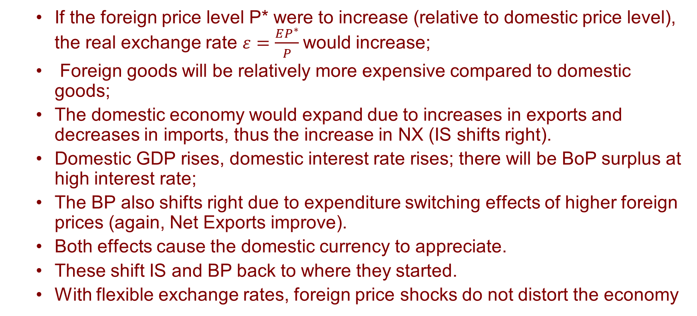
Effects of Shocks: A Foreign Price Shock
  If the foreign price level P* were to increase (relative to domestic price level), the real exchange rate $ε=\frac{EP^{∗}}{P}$would increase;
  Foreign goods will be relatively more expensive compared to domestic goods;
  The domestic economy would expand due to increases in exports and decreases in imports, thus the increase in NX (IS shifts right).
  Domestic GDP rises, domestic interest rate rises; there will be BoP surplus at high interest rate;
  The BP also shifts right due to expenditure switching effects of higher foreign prices (again, Net Exports improve).
  Both effects cause the domestic currency to appreciate.
  These shift IS and BP back to where they started.
  With flexible exchange rates, foreign price shocks do not distort the economy

Slide 25
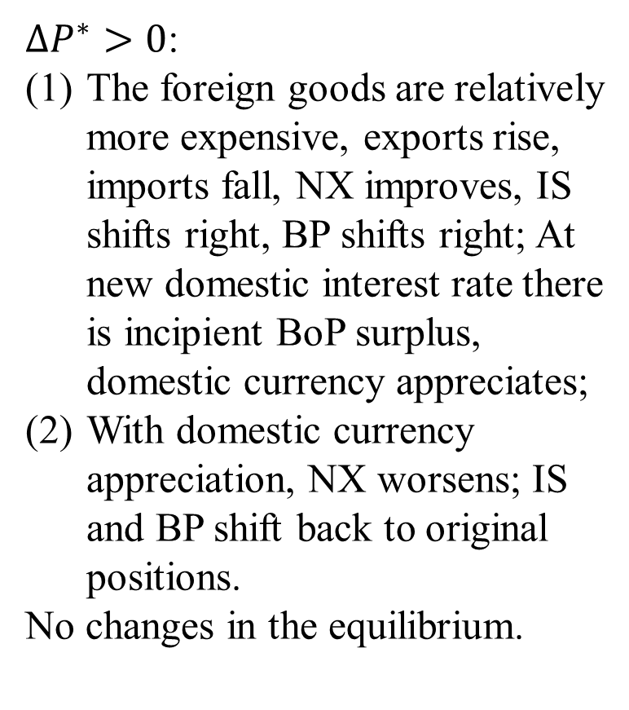
Foreign Price Shock
$∆P^{∗}>0$:
The foreign goods are relatively more expensive, exports rise, imports fall, NX improves, IS shifts right, BP shifts right; At new domestic interest rate there is incipient BoP surplus, domestic currency appreciates;
With domestic currency appreciation, NX worsens; IS and BP shift back to original positions.
No changes in the equilibrium.
i
LM
BoP surplus
(2)
BP
(1)
BP'
(2)
i₀
(1)
IS'
IS
Y₀
Y

Slide 26
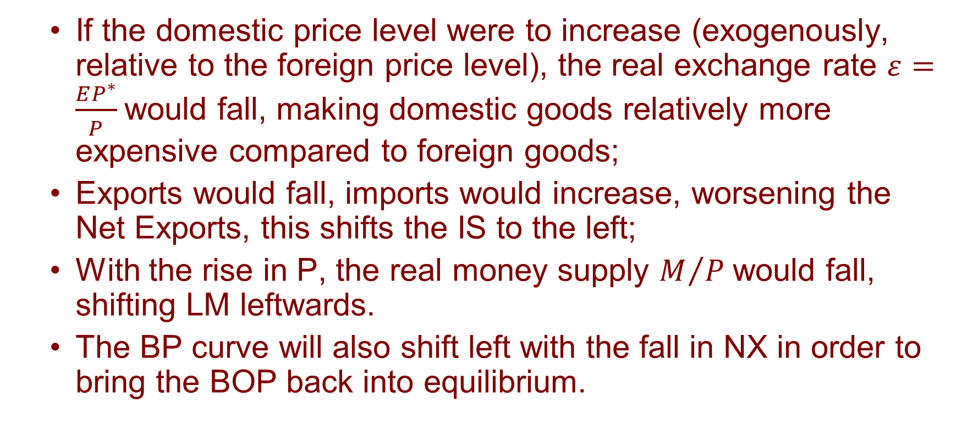
Effects of Shocks: A Domestic Price Shock
  If the domestic price level were to increase (exogenously, relative to the foreign price level), the real exchange rate $ε=\frac{EP^{∗}}{P}$would fall, making domestic goods relatively more expensive compared to foreign goods;
  Exports would fall, imports would increase, worsening the Net Exports, this shifts the IS to the left;
  With the rise in P, the real money supply $M/{P }$would fall, shifting LM leftwards.
  The BP curve will also shift left with the fall in NX in order to bring the BOP back into equilibrium.

Slide 27
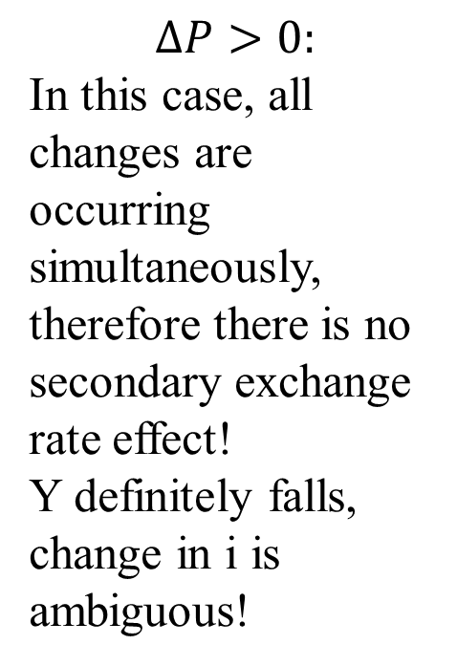
Domestic Price Shock
LM'
i
LM
$$∆P>0:$$
In this case, all changes are occurring simultaneously, therefore there is no secondary exchange rate effect!
Y definitely falls, change in i is ambiguous!
BP'
BP
i₁
i₀
IS
IS'
Y₁
Y₀
Y

Slide 28
Effects of Shocks: A Foreign Interest Rate Shock
  If the foreign interest rate were to increase, the home country should experience an exogenous outflow of short-term capital; BP shifts leftwards.
  At the original domestic interest rate, there will be incipient BoP deficit;
  With BoP deficit, the domestic currency depreciates.
  This shifts
    the IS curve rightward and
    the BP curve back towards the right.

Slide 29
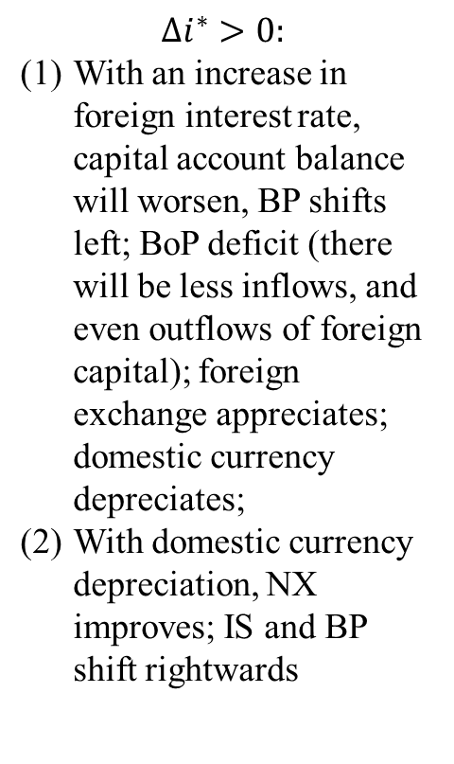
Foreign Interest Rate Shock
$$∆i^{∗}>0:$$
With an increase in foreign interest rate, capital account balance will worsen, BP shifts left; BoP deficit (there will be less inflows, and even outflows of foreign capital); foreign exchange appreciates; domestic currency depreciates;
With domestic currency depreciation, NX improves; IS and BP shift rightwards
i
LM
BP'
BP''
BP
i₁
i₀
BoP deficit
IS
IS'
Y₀
Y₁
Y

